Slide 1
E-rate Training Workshop Form 471 Filing Guide
February 2015

Slide 2
New Form 471 – Lots of Changes
New Online 471 Format
Longer time-out periods (warning after 25 min of NO activity)
Modern interface
Form navigation arrows at the top of the screen to show progress and pages completed
Cannot be paper-filed
Block 4 and Block 5 Templates available that can be created offline and uploaded into Form 471
Block 4 template is easy and recommended for all
Block 5 template is recommended just for C2 applications with multiple rows

Slide 3
Form 471, Block 4 for Category 2
Must list all buildings in the District in order to calculate district-wide discount
Do not list ONLY the buildings that will be receiving the equipment/service
You can copy from previously-submitted FY 2015 Form 471 (not drafted)
Cannot copy from 2014 Block 4

Slide 4
Form 471, Block 5
Standardized format for data collection
Identify exactly what services and equipment go to which building
Item 21 data will be embedded in actual Form 471
No longer a separate process
Cannot be submitted post-window
All data will be publicly available and downloadable
New online 471 available for practice
It will take much longer to complete this year so please, please do not wait until the last minute to file

Slide 5
Form 471, Block 5 - Preparing
Make a list of each component with make/model number and building served by that equipment
Create your own internal worksheet per building to track building’s C2 budget
Do not apply for more than building’s C2 budget
Will require USAC to contact you to determine what equipment should be removed from your application

Slide 6
Let’s Look at the Form 471 Discount Calculation Templates!

Slide 7
Import Templates
Templates can be found at
http://www.usac.org/sl/tools/forms/471-templates.aspx
There is a template (and instructions) available for
Discount Calculation details
Item 21 funding request line items
Category One (Item 21a)
Internet Access, Telecommunications Services, Voice Services
Category Two
Internal Connections (Item 21b)
Managed Internal Broadband Services (‘MIBS’) (Item 21c)
Basic Maintenance of Internal Connections (Item 21d)

Slide 8
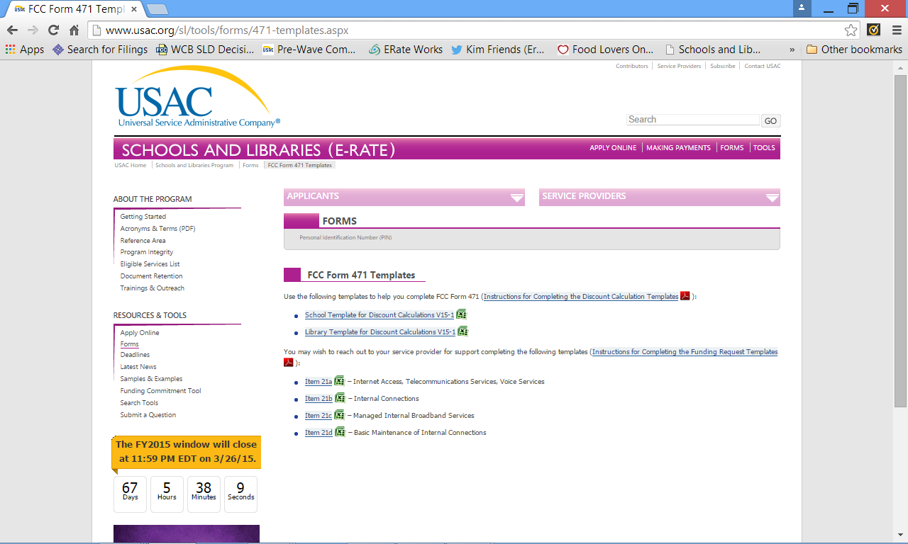
Import Templates

Slide 9
Discount Calculation Template
All of the templates include macros and you must be careful not to disable or otherwise interfere with the macros or your import will not work
You must use the provided templates, without modification, to import information
The provided templates have built-in tools to ensure consistency with the online FCC Form 471 and are designed to properly upload your entities’ information and calculate the appropriate discount rate

Slide 10
Discount Calculation Template
To successfully complete this template, you must:
Use Excel 2007 or higher
Use the paste special/text command when pasting data from an external source, i.e., the Internet
Use the paste/values command when pasting from within the template or from another spreadsheet
Templates are really only valuable if you have multiple line items/components of service being provided by the same provider in the same category of service.
You can use “Step-By-Step” or “All on one page” option when creating funding request(s)

Slide 11
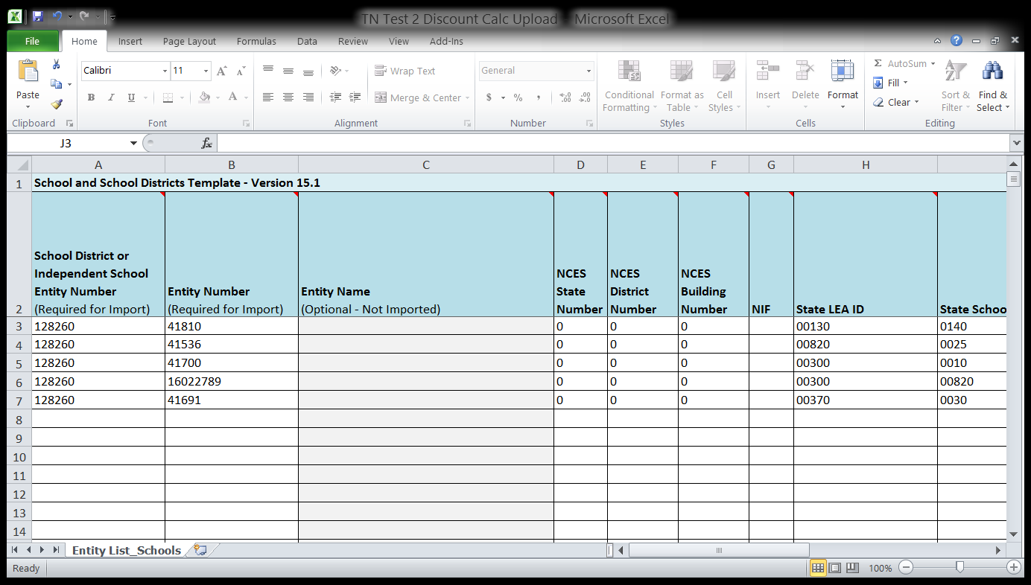
Discount Calculation Template
If site is a NIF, select YES. If not, leave blank

Slide 12
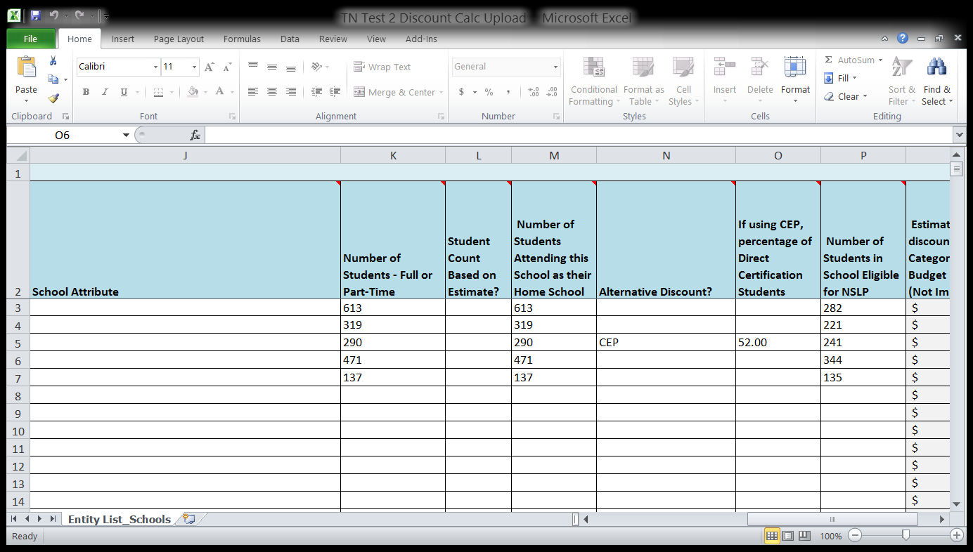
Discount Calculation Template
Choose the appropriate school attribute(s) from the dropdown list. The attributes are: Pre-K, Head Start, Adult Education, Juvenile Justice, ESA, Dormitory, Charter, and Tribal. If no attribute applies, leave this field blank.
If using CEP, select “CEP” from dropdown list in column N
If using CEP, enter % of direct certified students here and column P calculates automatically using the 1.6 multiplier

Slide 13
Let’s Demonstrate the New Form 471!

Slide 14
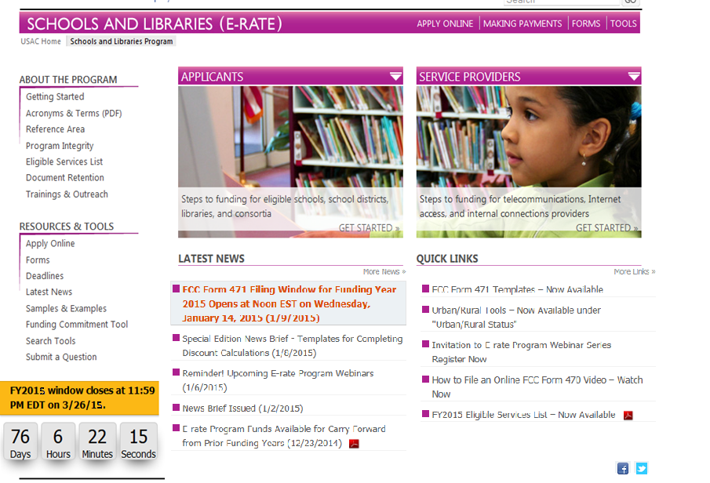
Getting Started (Live Site)
Start by Clicking “Apply Online”
Click on
FCC Form 471

Slide 15
Getting Started
Click on “Start”

Slide 16
Getting Started
Enter YOUR Billed Entity Number, and click on “Enter” to pull up information
Enter Billed Entity Number, and click on “Enter” to pull up information
Enter YOUR Billed Entity Number, and click on “Enter” to pull up information
The FCC Registration Number likely will pre-populate for you.

Slide 17
Getting Started
Select Application type and one or more types of Recipients
Select Application type and one or more types of Recipients

Slide 18
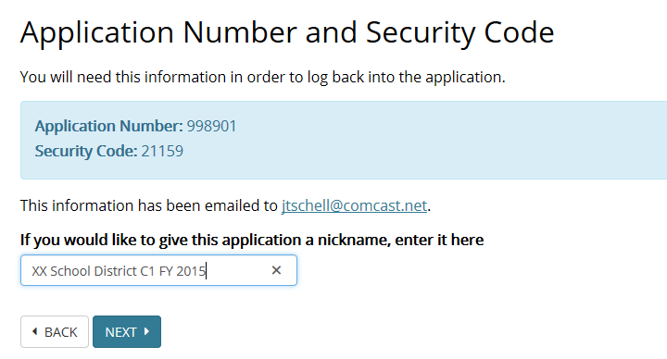
Assign a NICKNAME
VERY IMPORTANT INFORMATION!
Note! This information has already been e-mailed to you!
Note: This information has already been e-mailed to you!
NOTE
Give your 471 a nickname!

Slide 19
Contact Information
YES or NO?
Yes or No
YES or NO?

Slide 20
Contact Information

Slide 21
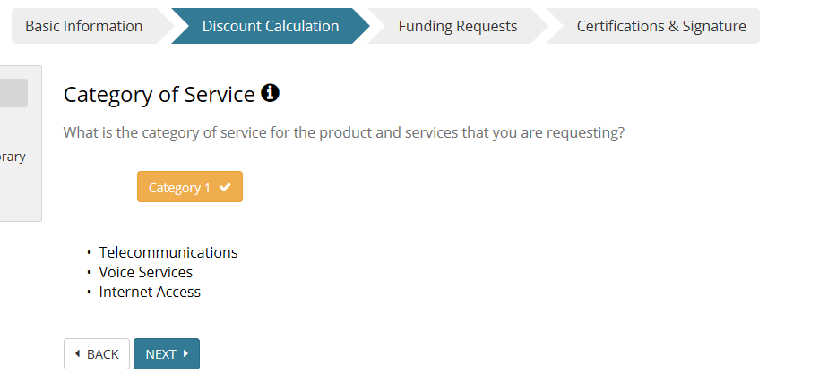
Category of Service – Category 1
Category 2
Once you make a selection and click NEXT, you cannot change this selection
Once you make a selection and click NEXT, you cannot change this selection

Slide 22
Discount Calculation Details
Use this option to upload a Block 4 Discount Calculation Template

Slide 23
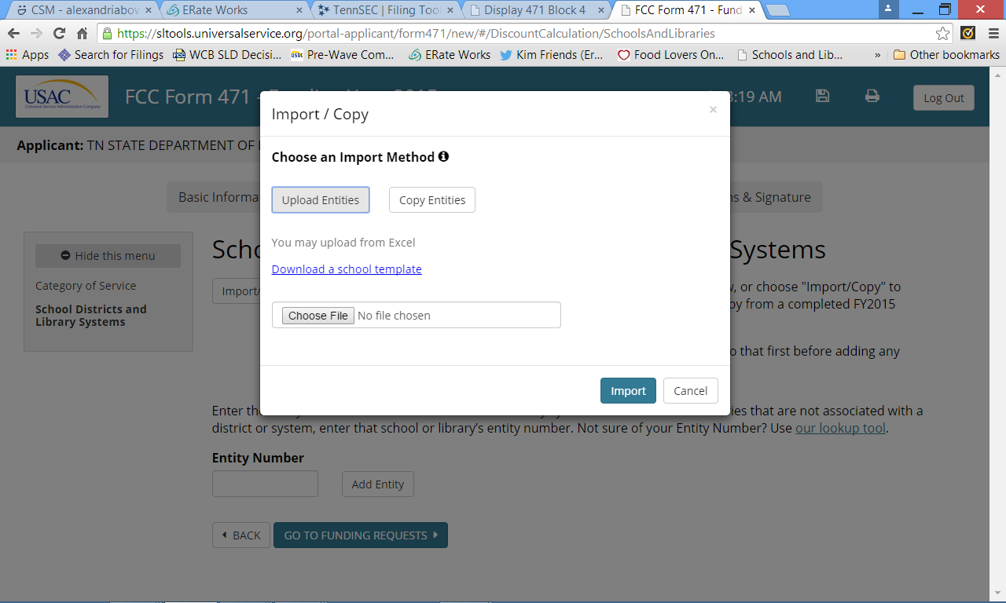
Import Data (from template)

Slide 24
Import Data
Be patient…

Slide 25
Moving On…
You can click on the BEN to verify the information you’ve imported
When your import is complete, this is the screen you will see

Slide 26
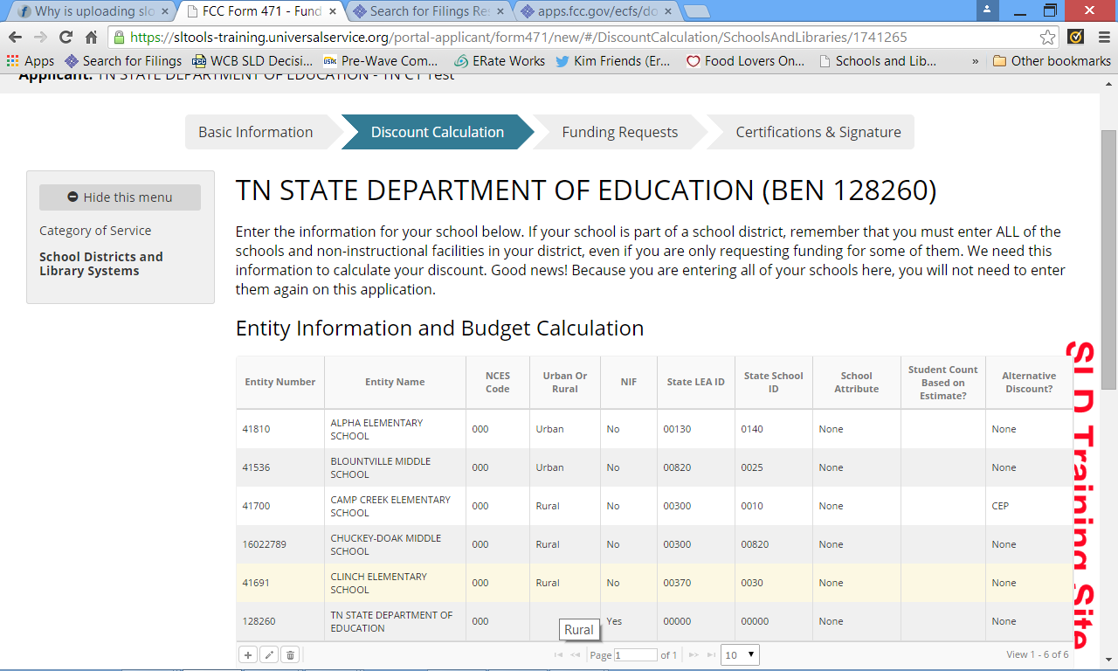
Verify Discount Data
Note that this applicant has 3 RURAL sites and 2 URBAN sites so the applicant is RURAL. No U/R for NIF because NIFs do not count in U/R determination.

Slide 27
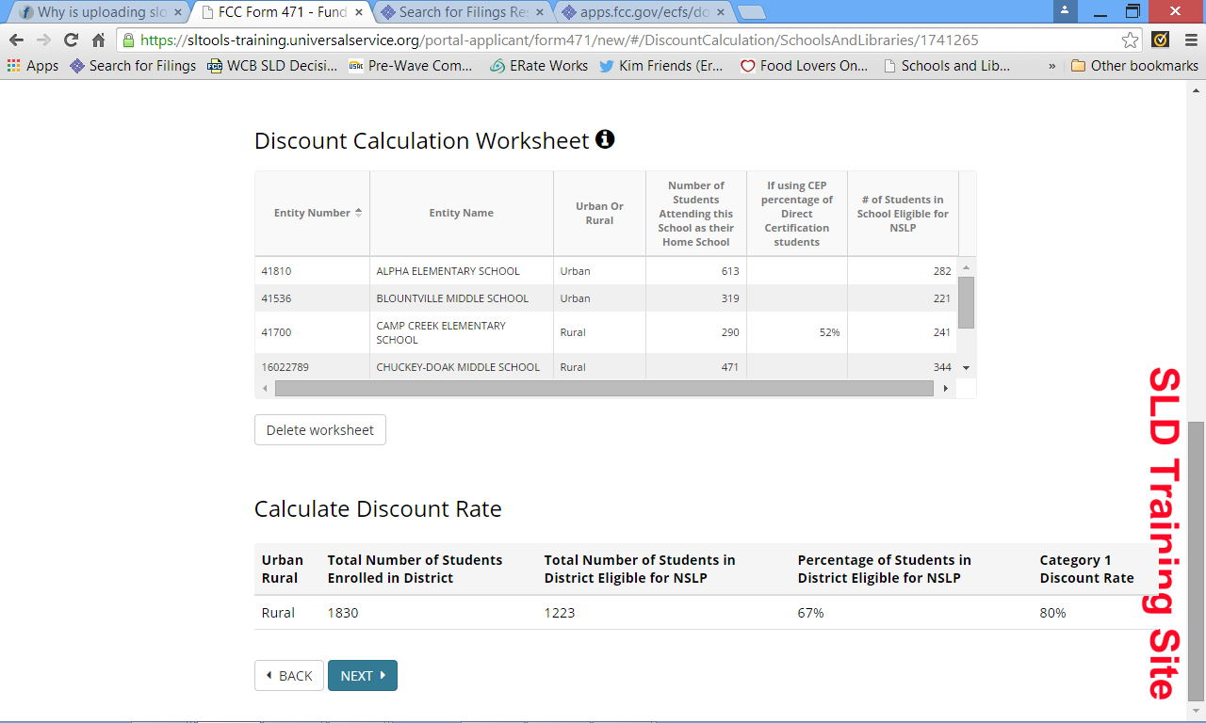
Verify Matrix (E-Rate) Discount
You can verify your Urban/Rural designation as well as your C1 discount rate
Click NEXT

Slide 28
Connectivity Questions (required)
Click “Connectivity Questions” to move on

Slide 29
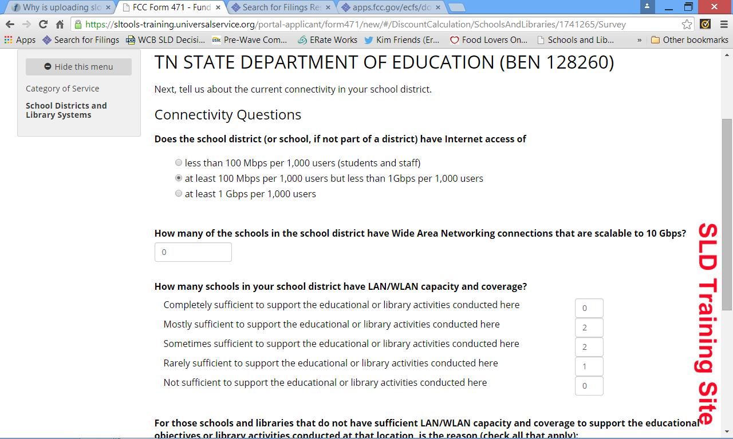
Connectivity Questions
You must answer these questions for every different Form 471 application you file
Must be a number in every box

Slide 30
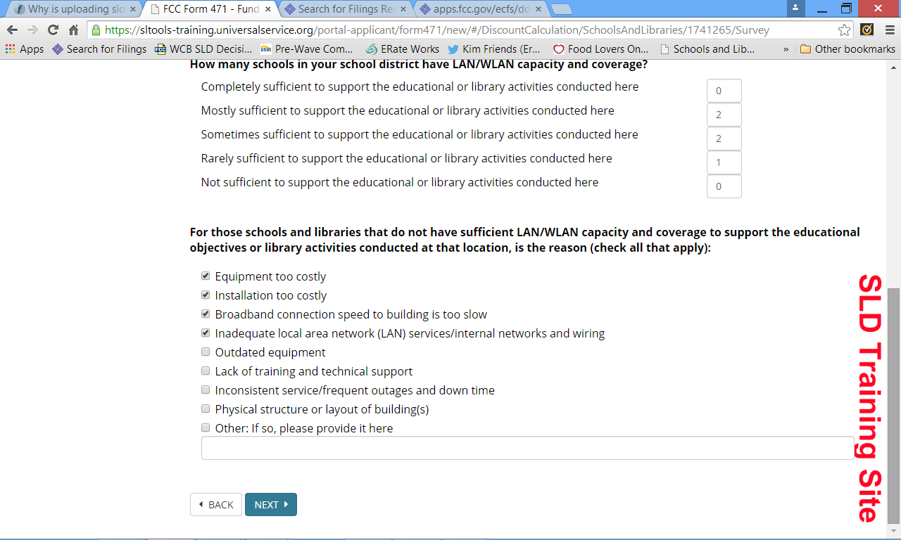
Connectivity Questions
Unless ALL of your sites are COMPLETELY sufficient (above), you will get this set of questions. You can select as many as are applicable

Slide 31
Let’s Look at the Form 471, Block 5 for Category 1 Funding Requests!

Slide 32
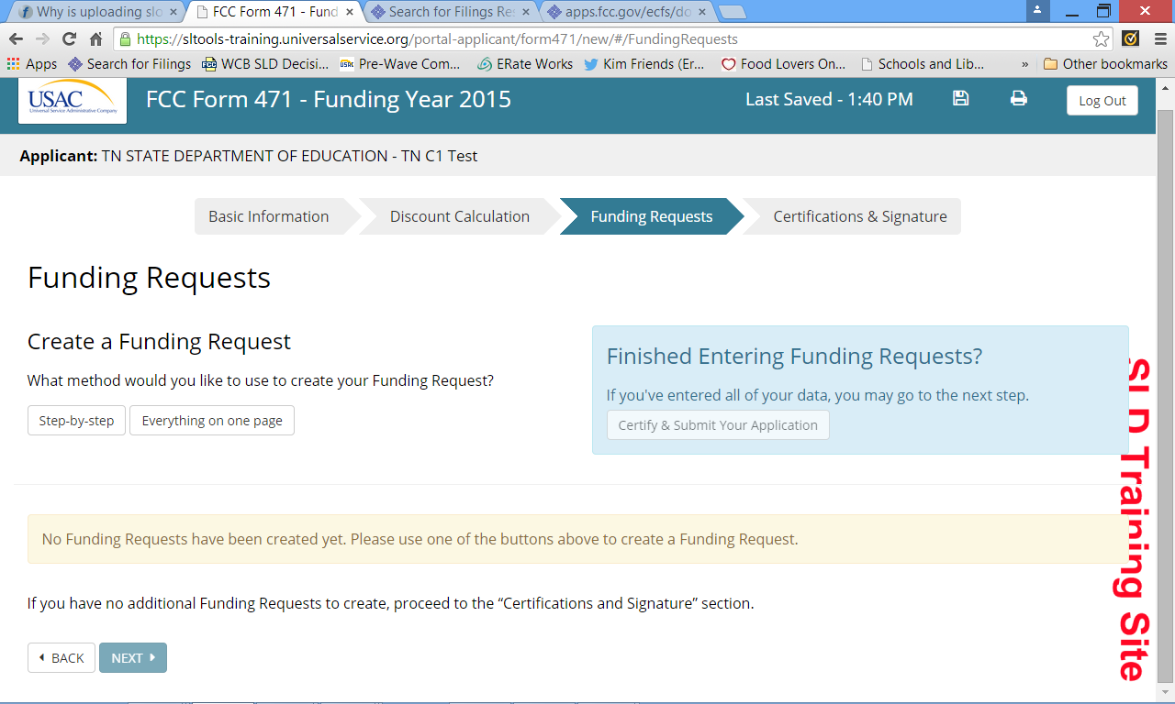
Begin Funding Request(s)
We recommend using this method because it most closely resembles the ‘old’ Form 471, Block 5

Slide 33
Key Information
You will need very specific information to complete this section
NICKNAME
Service Type
Telecommunications
Voice
Internet Access
Form 470 #
Service Provider Identification Number (“SPIN”)

Slide 34
Key Information
Billing Acct #
Purchase Type
Tariff
MTM
Contract
Service Dates
Contract Award Date
Contract Expiration Date
Service Start Date
Voluntary Extensions?
Yes or No
# of extensions
# of MONTHS available by extension

Slide 35
Key Information
Is this a Master Contract?
Yes or No
Is this a continuing FRN?
Yes or No
If yes, you need previous funding request number
Descriptive narrative of the service
Pricing Confidentiality
Yes or No
If yes, must cite statute

Slide 36
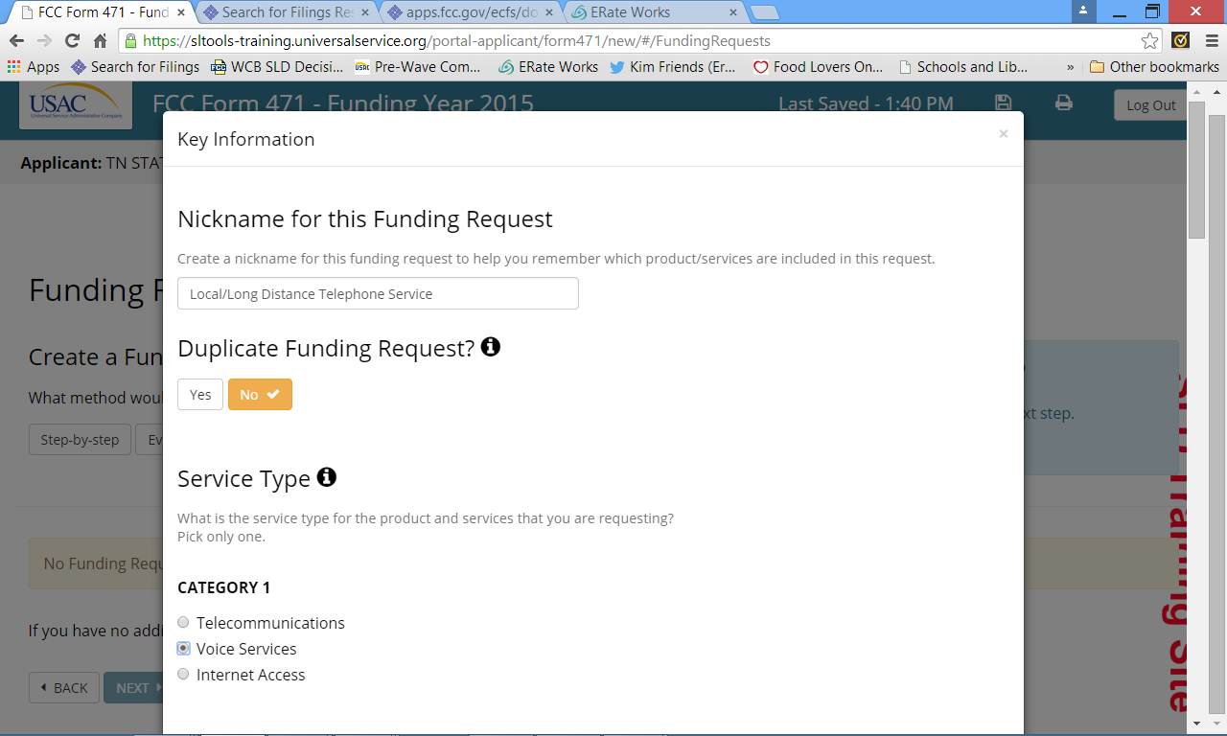
Key Information

Slide 37
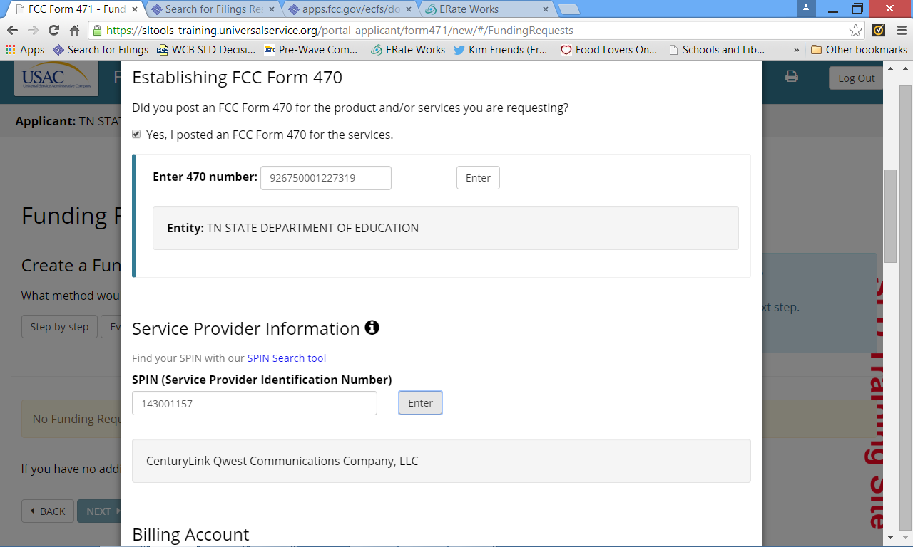
Key Information
You must click “Enter” if you populate any of these fields or you will get an error at the end of the page

Slide 38
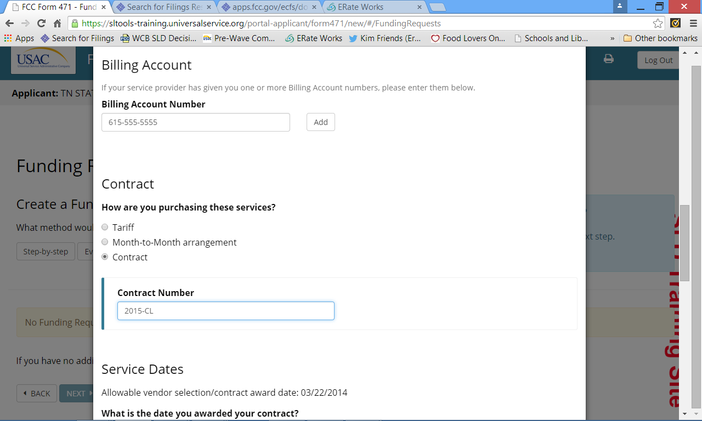
Key Information
Only click ‘Add” if you have more than one Billing Account Number to enter
You can enter N/A if no contract #

Slide 39
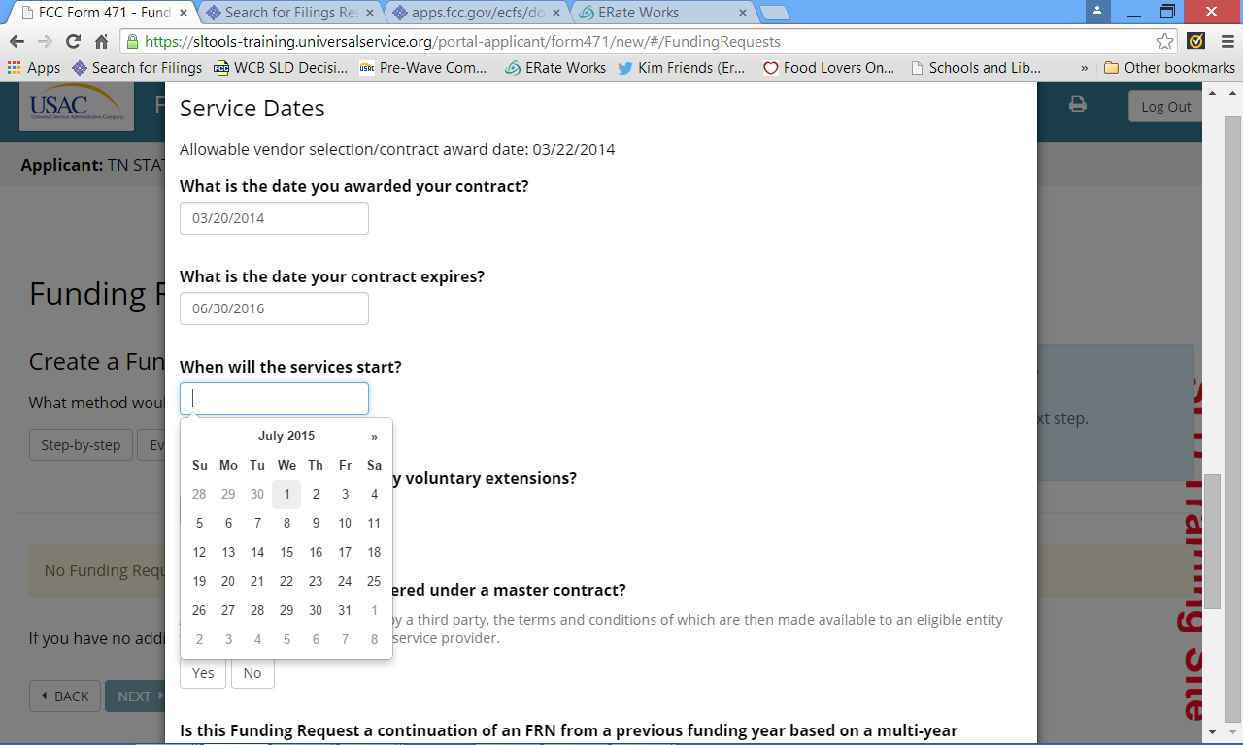
Key Information
ACD is established by the Form 470 # you entered above
Use calendar function or manual input – use 4 digit year with manual
Service Start Date Should Always Be 7/1/2015

Slide 40
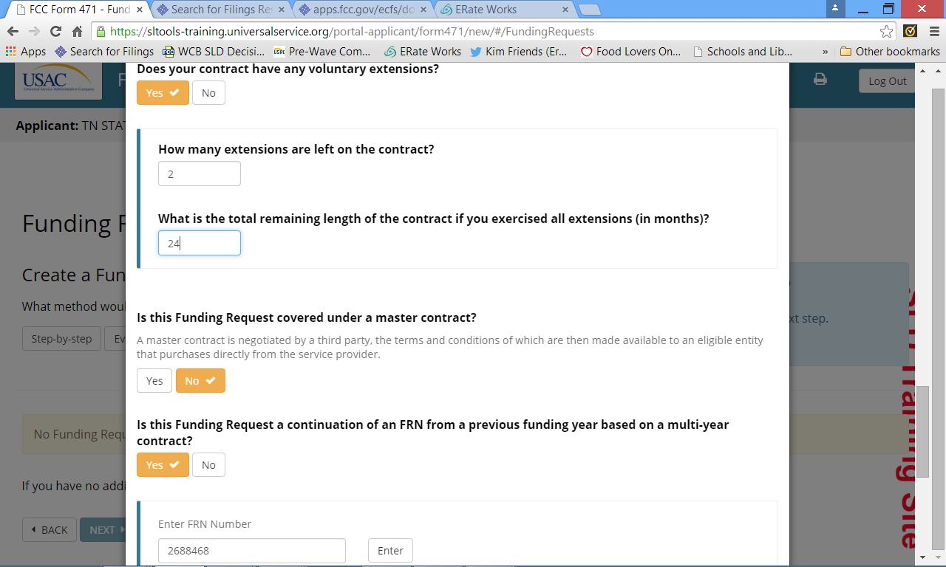
Key Information
Remember to click “Enter” if you use this field

Slide 41
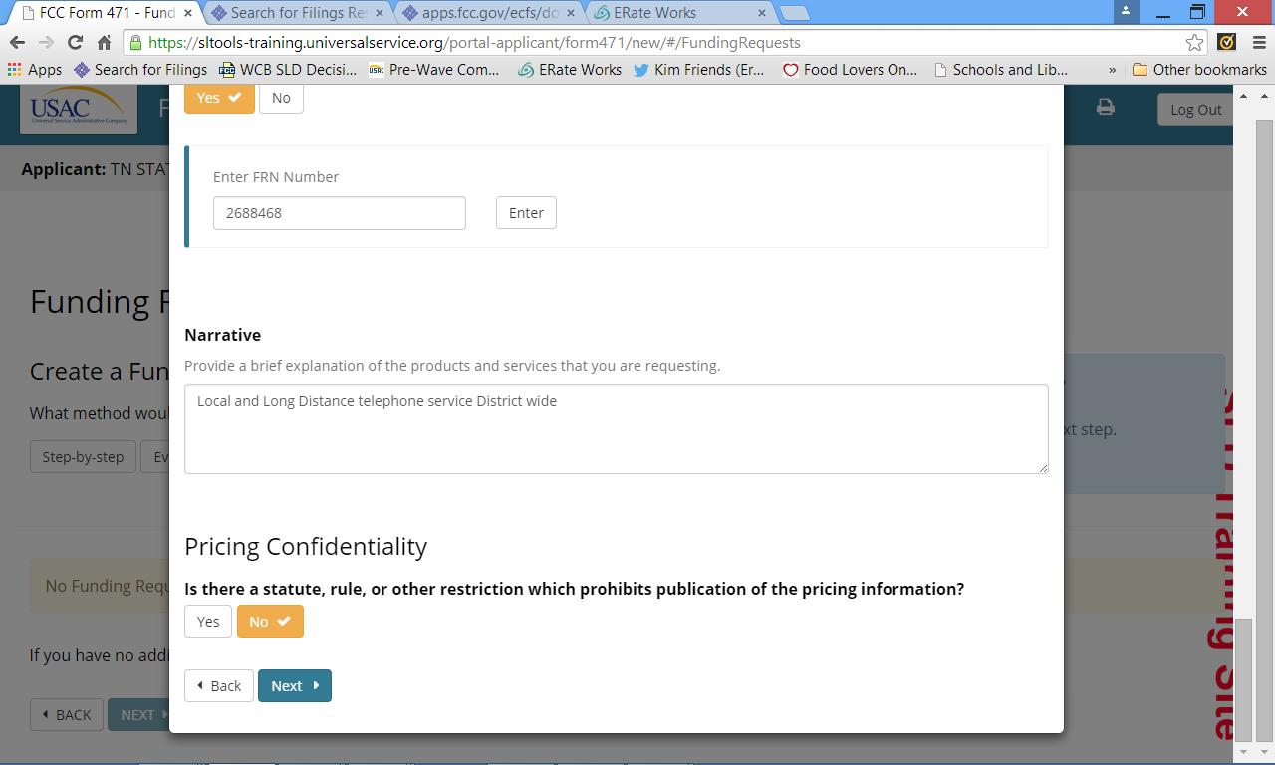
Key Information

Slide 42
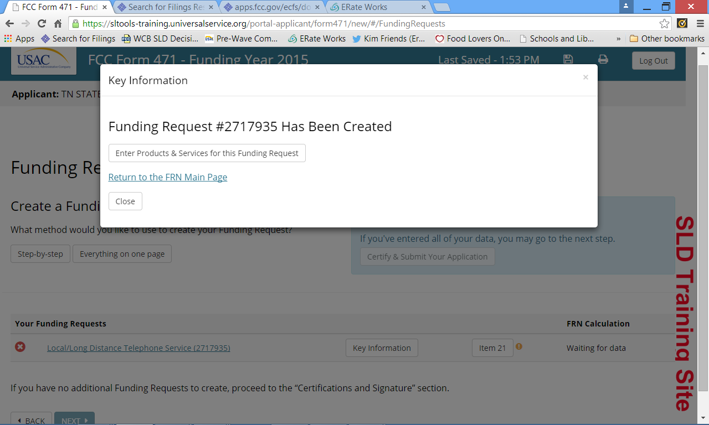
Funding Request Number Assigned
Congratulations! You’ve created a Funding Request! Be sure to record this number in your records for tracking purposes.

Slide 43
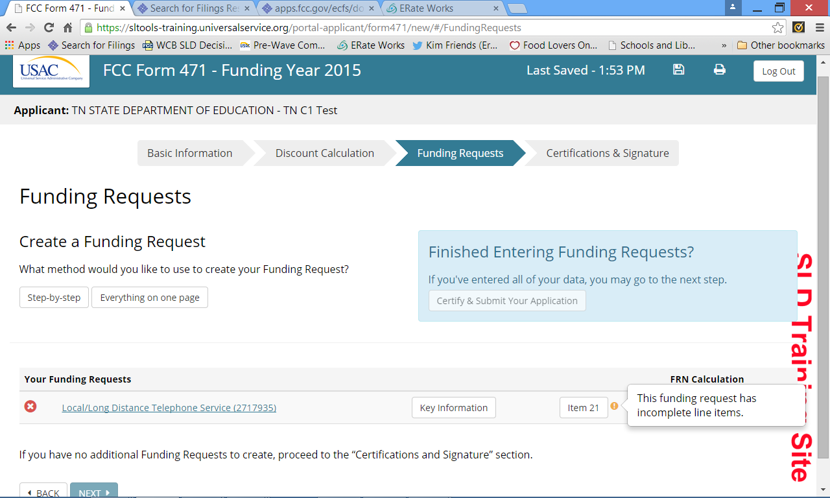
Item 21 Details
Now it’s time to enter all of the pertinent details for your Funding Request
This information comes from your Nickname!
Click the “Item 21” button

Slide 44
Item 21 – C1
Leave upload and download speeds blank for voice services.
NEW: Enter ELIGIBLE monthly cost and INELIGIBLE monthly cost. Not TOTAL cost.

Slide 45
Item 21 – C1 Manage Recipients

Slide 46
Item 21 – C1 Manage Recipients
If you select yes, you’re done with this field.

Slide 47
Item 21 – C1 Manage Recipients
If you select NO, then you must select the specific entities receiving the service for this line item..

Slide 48
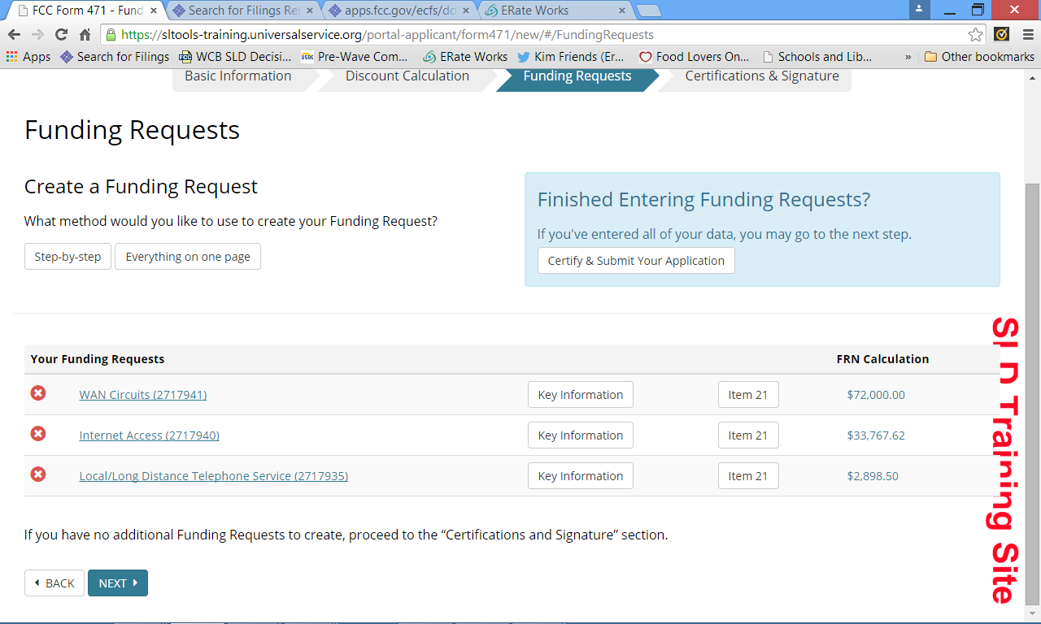
Time to Review and Submit
If no more funding requests or line items, click “Certify and Submit Your Application”

Slide 49
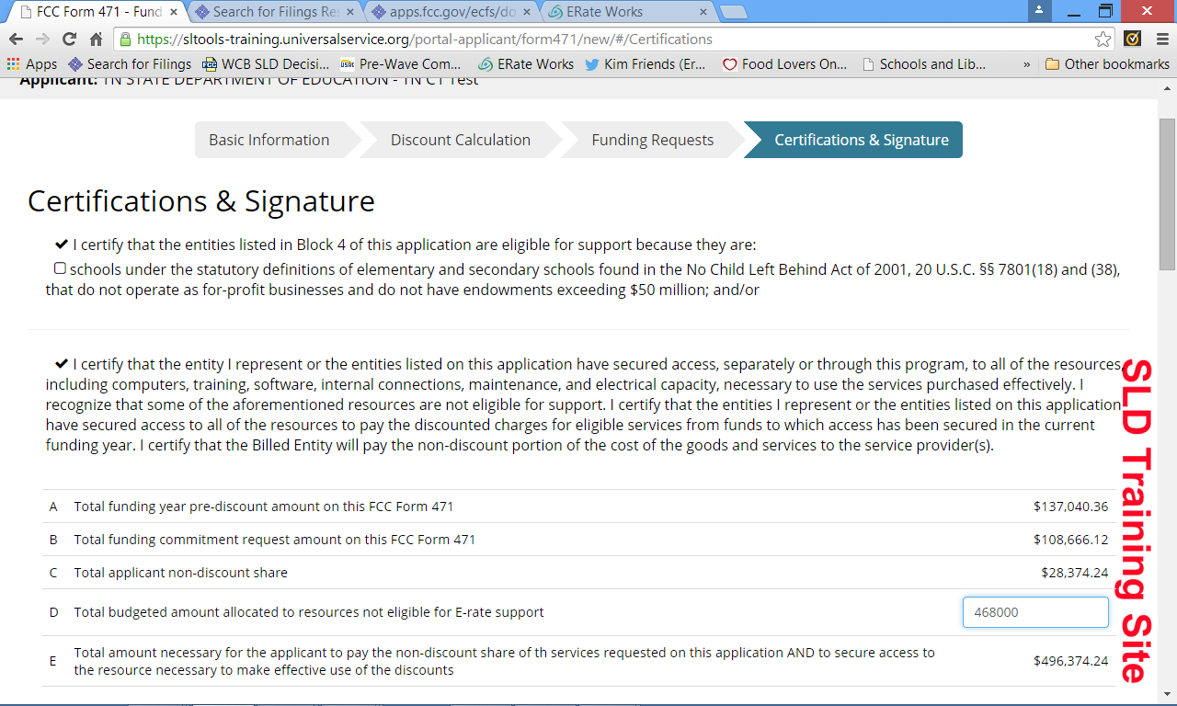
Certifications and Authorized Signer
Check all of the appropriate certifications and fill in your budget amount allocated to resources NOT eligible for E-Rate support.

Slide 50
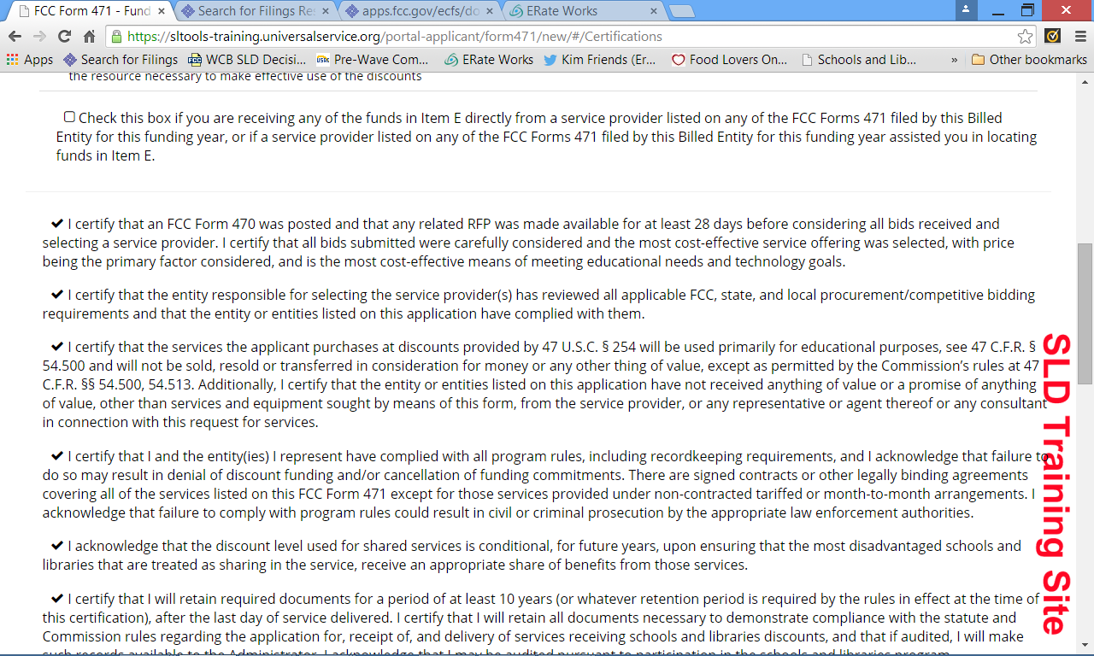
Certifications and Authorized Signer
Be careful of this certification…don’t ‘just check it’
Remember, it’s 10 years now….

Slide 51
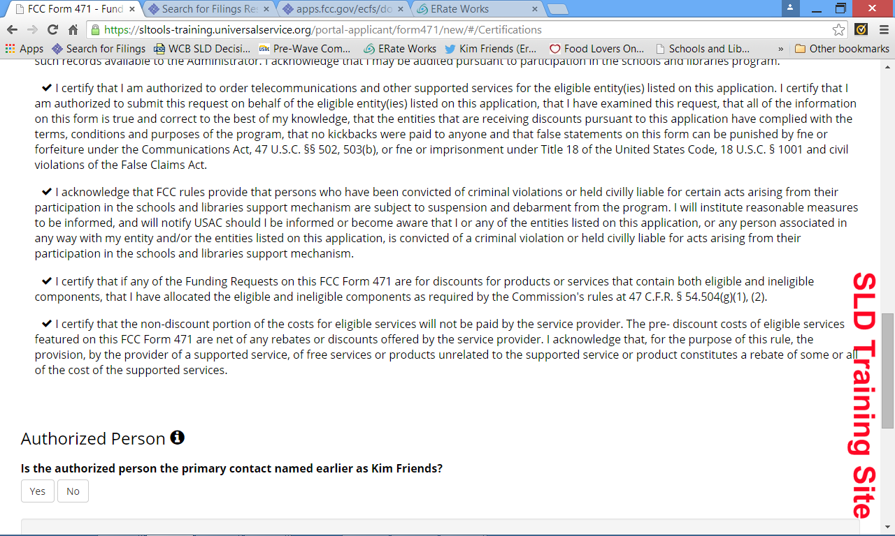
Certifications and Authorized Signer
Select YES or NO

Slide 52
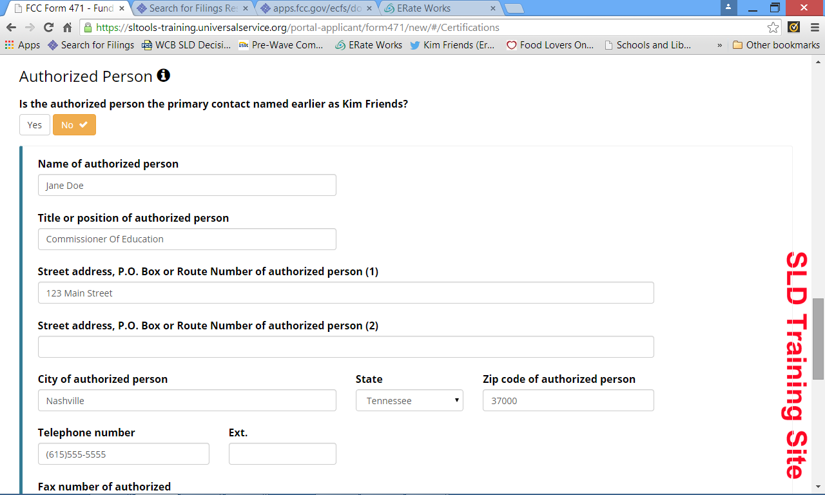
Certifications and Authorized Signer
If you click NO, complete the information below

Slide 53
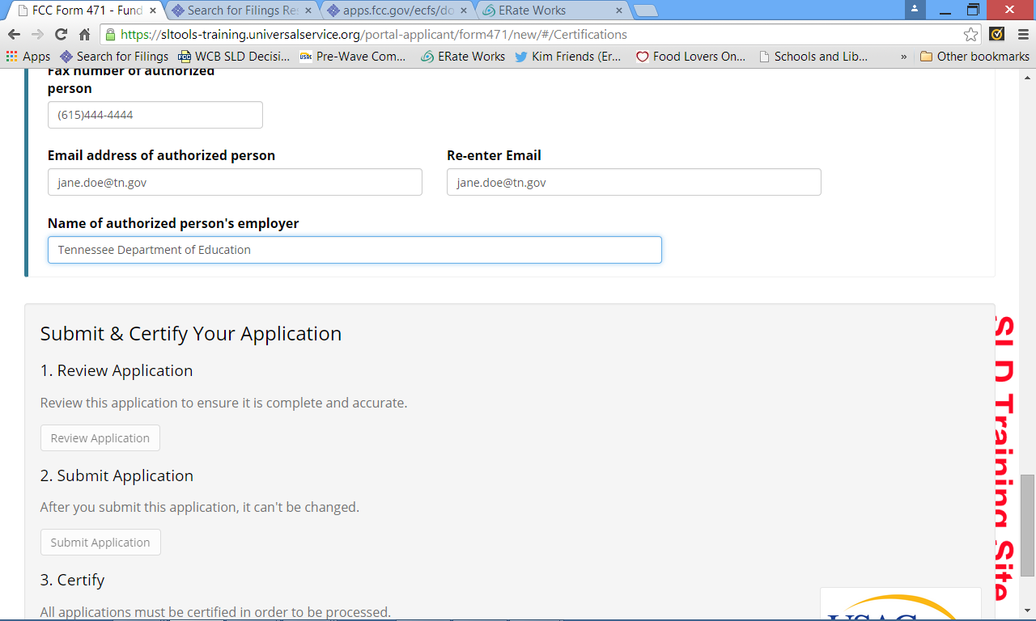
Certifications and Authorized Signer
Once all of the information is complete, the “Review Application” button is available. If errors, it will not be available. The other button are NOT available until you have Reviewed.

Slide 54
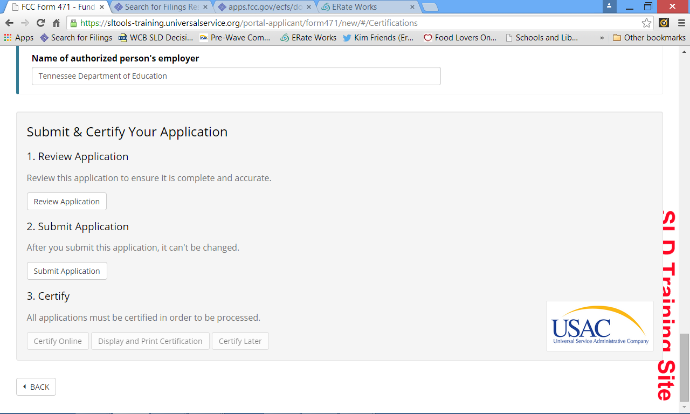
Submit Application

Slide 55
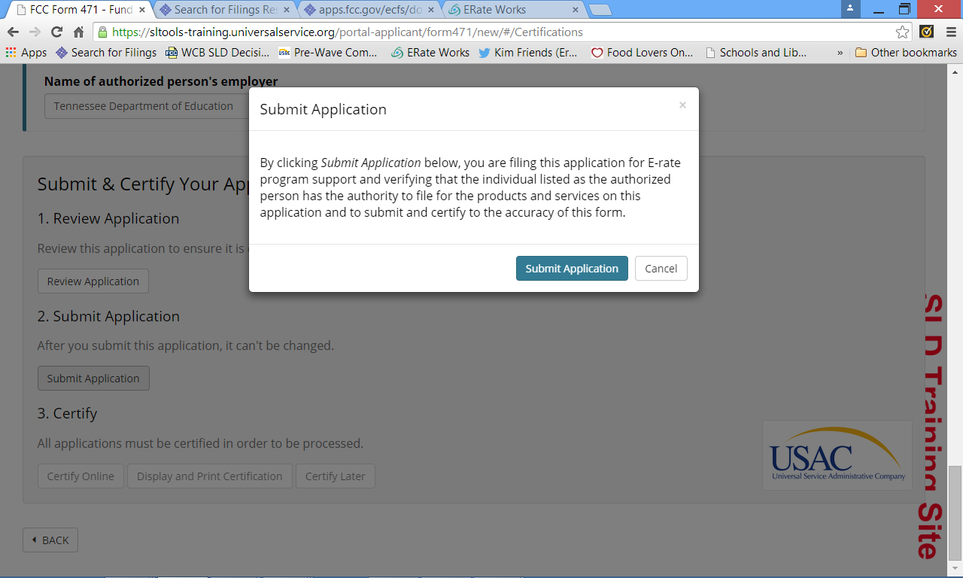
Submit Application

Slide 56
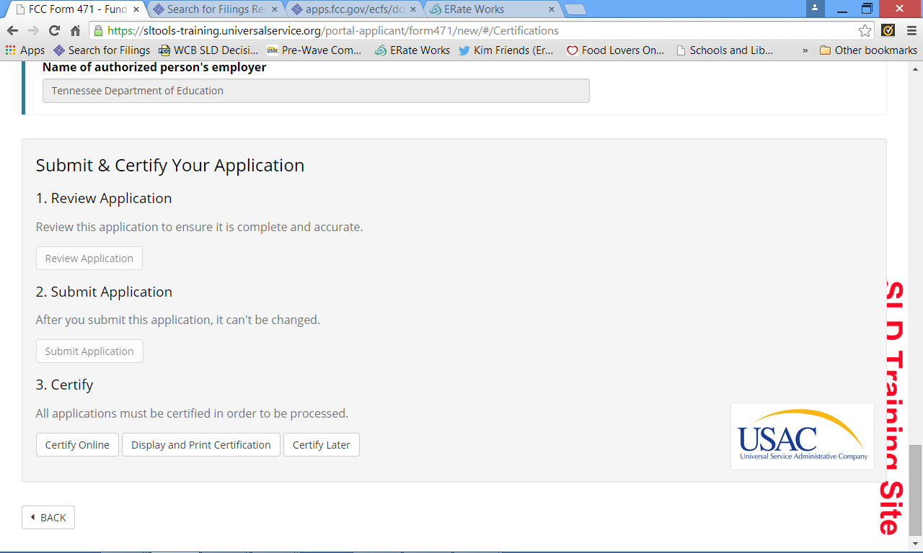
Certify Application
IF you DO NOT have a PIN
IF you have a PIN
To CERTIFY LATER

Slide 57
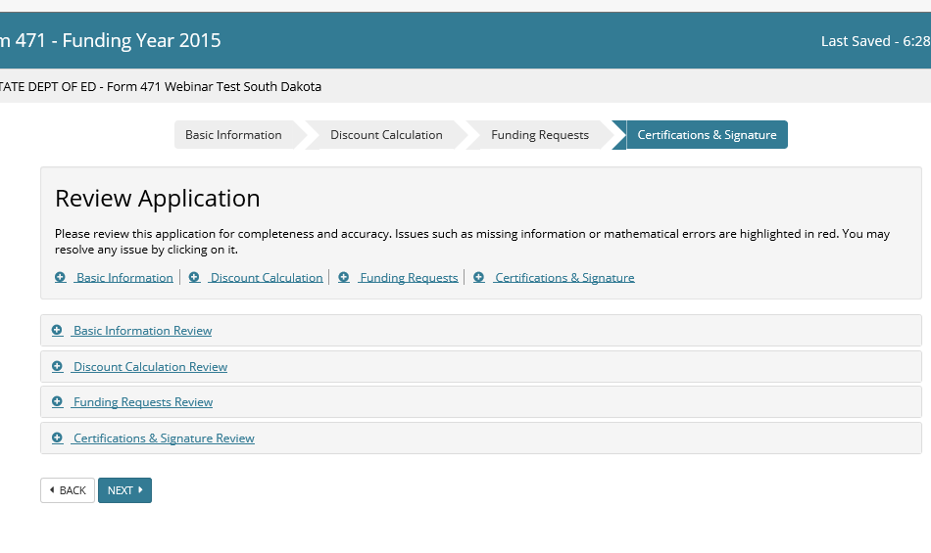
IMPORTANT: In order to be able to print out your application, you must click on each of the buttons of each section to expand your form and then print it.

Slide 58
Let’s Look at the Form 471 Item 21 Templates for Category 1 Services!

Slide 59
Item 21 Import/Data Entry
You can either upload a template or manually add a line item

Slide 60
Block 5, Item 21 Templates – Category 1
Templates are really only valuable if you have multiple line items/components of service being provided by the same provider in the same category of service.
You can use “Step-By-Step” or “All on one page” option when creating funding request(s)
The templates can be useful as planning/prep documents

Slide 61
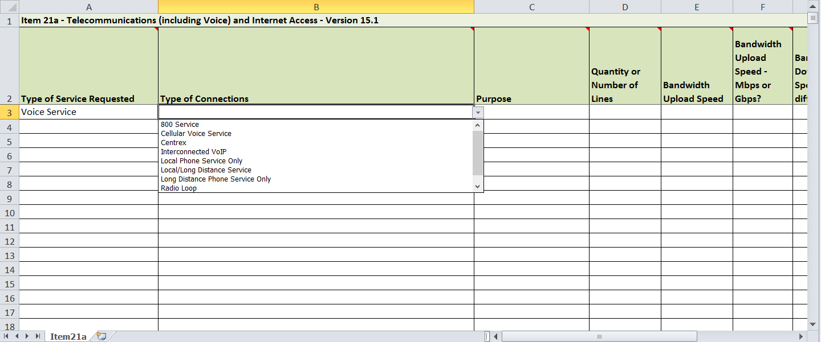
C1 FRN Item 21a Template - Voice
NOTE: There is no option for PRI or other voice related circuit line item so our recommendation is that you select ‘local/long distance service’ and include total MRC in the appropriate column

Slide 62
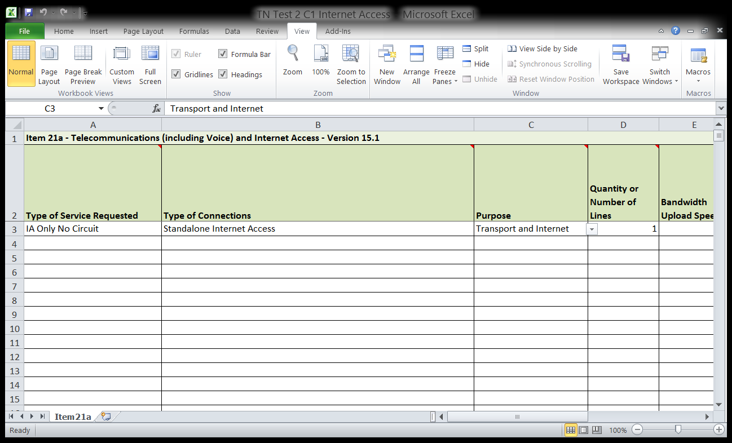
C1 FRN Item 21a Template – Internet Access
For Internet Access, you should start with “IA Only No Circuit” then indicate more specifics in column C as to whether the service is
Transport Only
Internet (only)
Transport and Internet

Slide 63
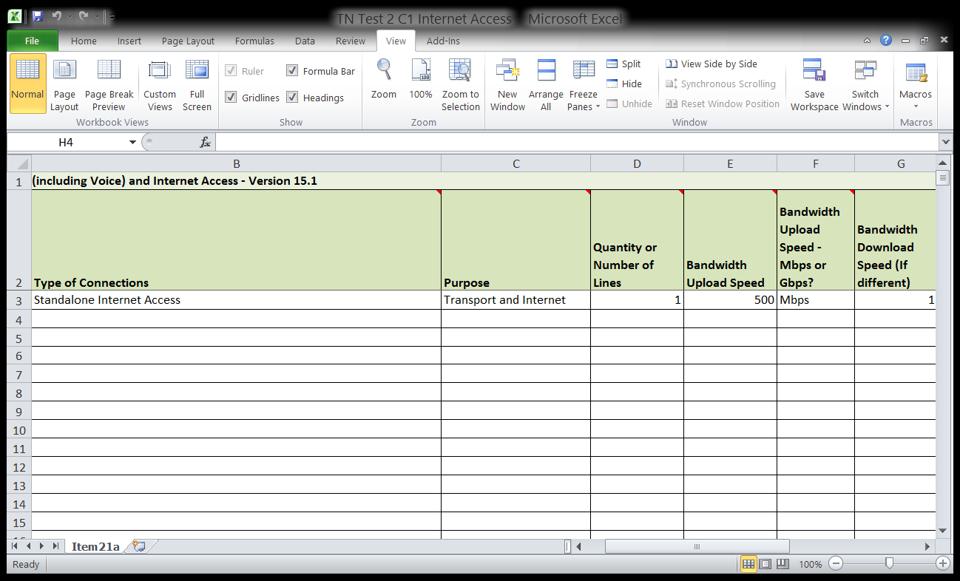
C1 FRN Item 21a Template – Internet Access
Enter total number of lines/circuits of this type
Use the dropdown list to indicate what increment of speed is used
Enter UPLOAD speed in whole number(s)

Slide 64
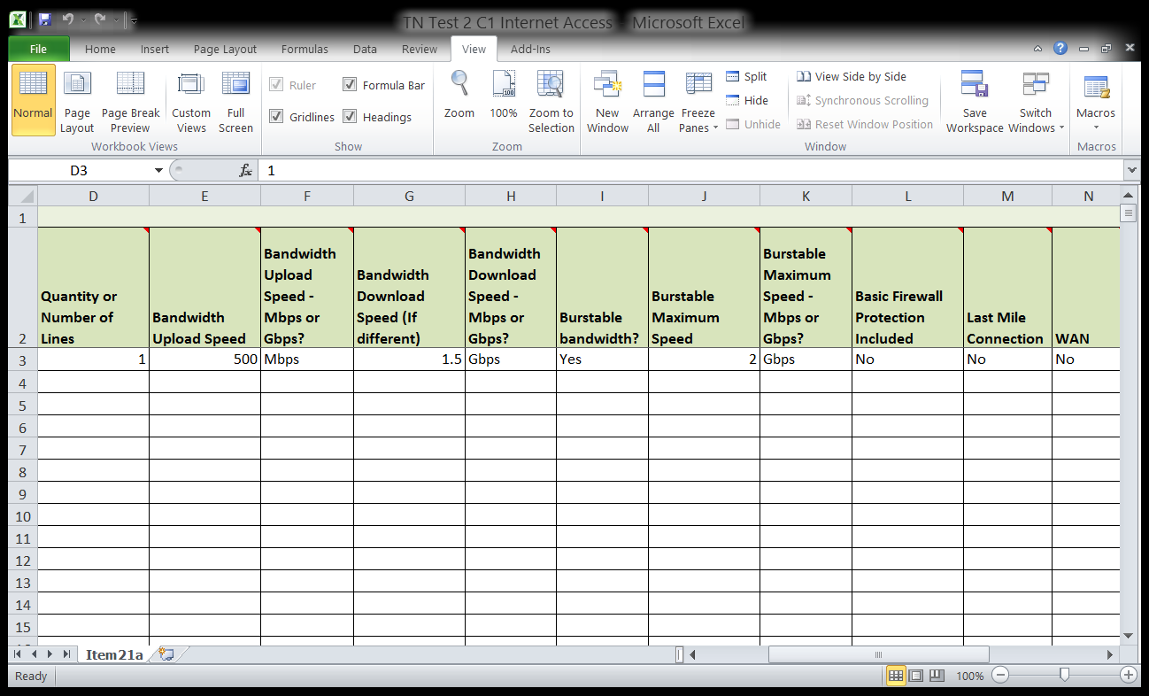
C1 FRN Item 21a Template – Internet Access
You should collect ALL of this data prior to either completing the template or using the data input available in the funding request section of Form 471.

Slide 65
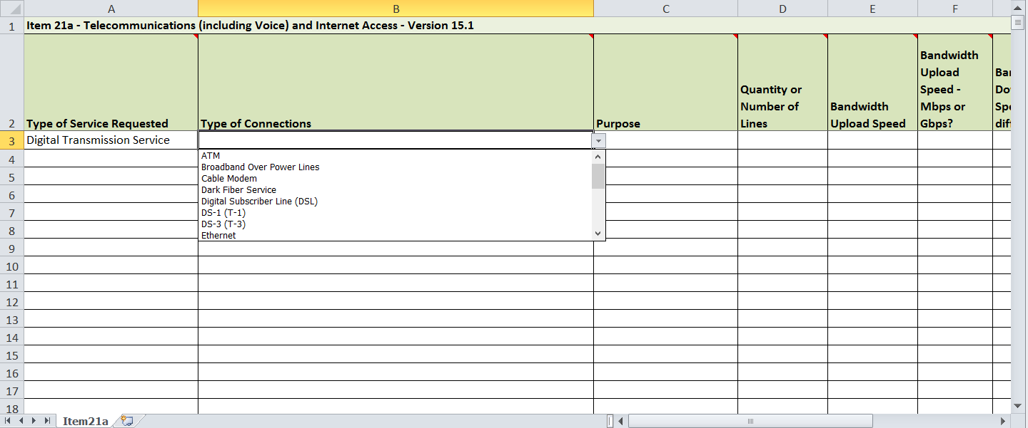
C1 FRN Item 21a Template – WAN Connections

Slide 66
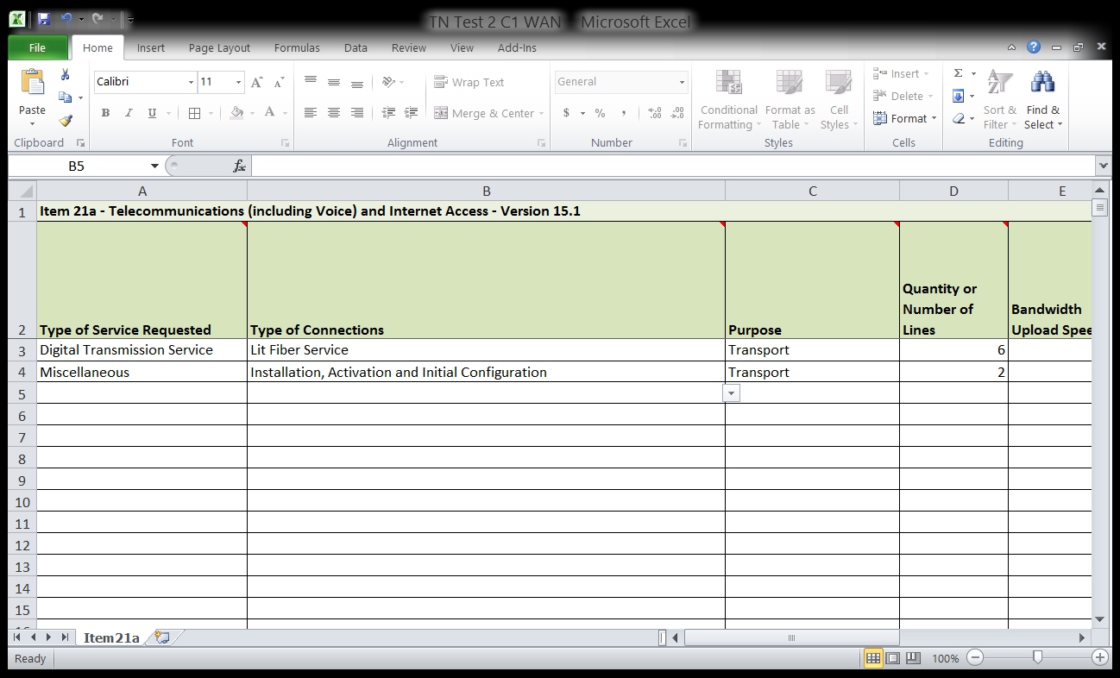
C1 FRN Item 21a Template – WAN Connections
NOTE: Two line items for a single FRN, one considered ‘Miscellaneous”

Slide 67
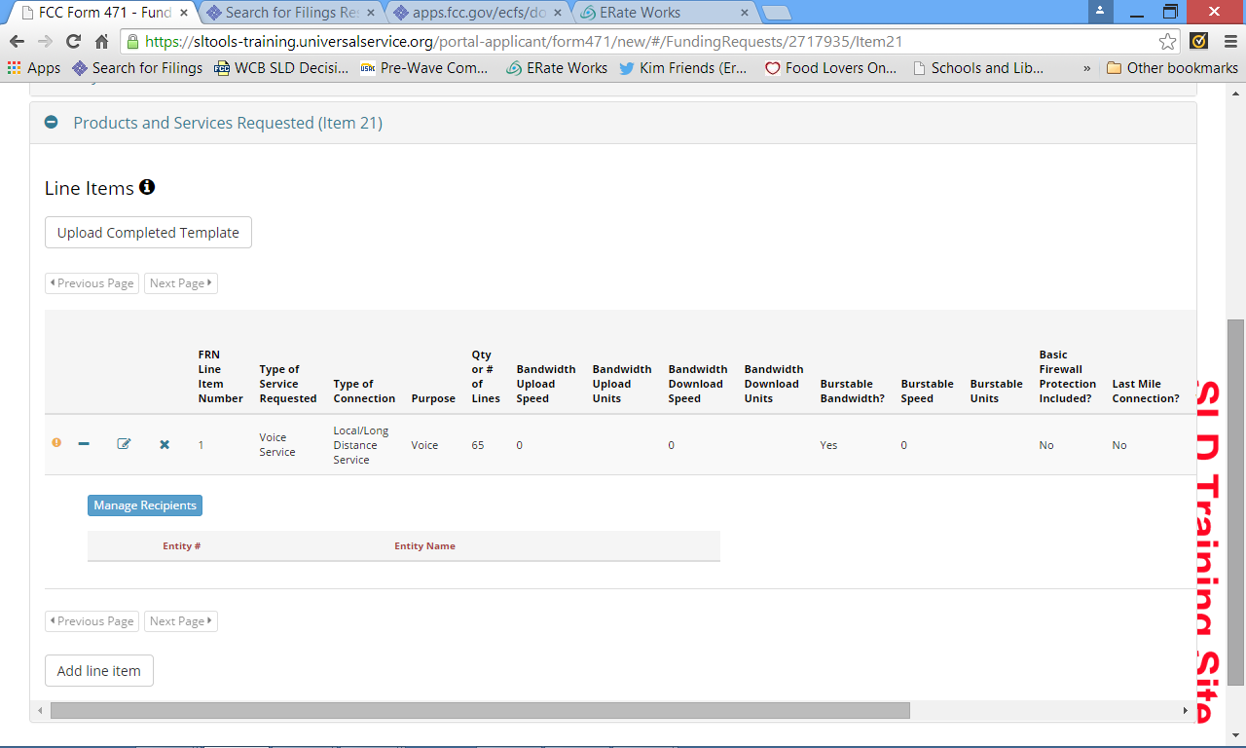
Item 21 Import Details
This is what happens with an imported template

Slide 68
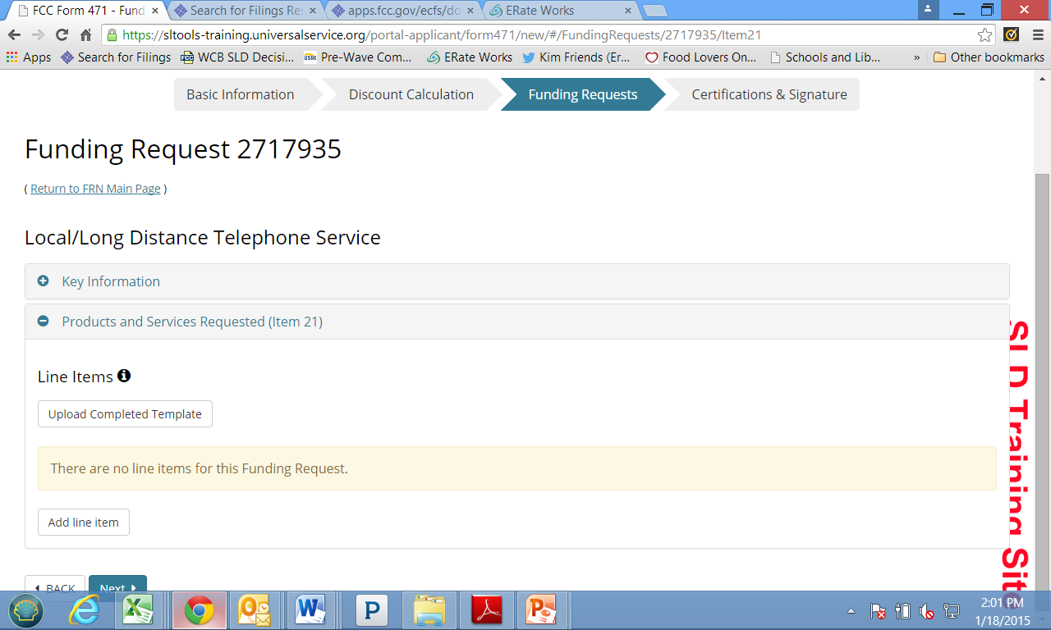
Item 21- Enter Details Manually
To begin adding details manually, click “Add line item”

Slide 69
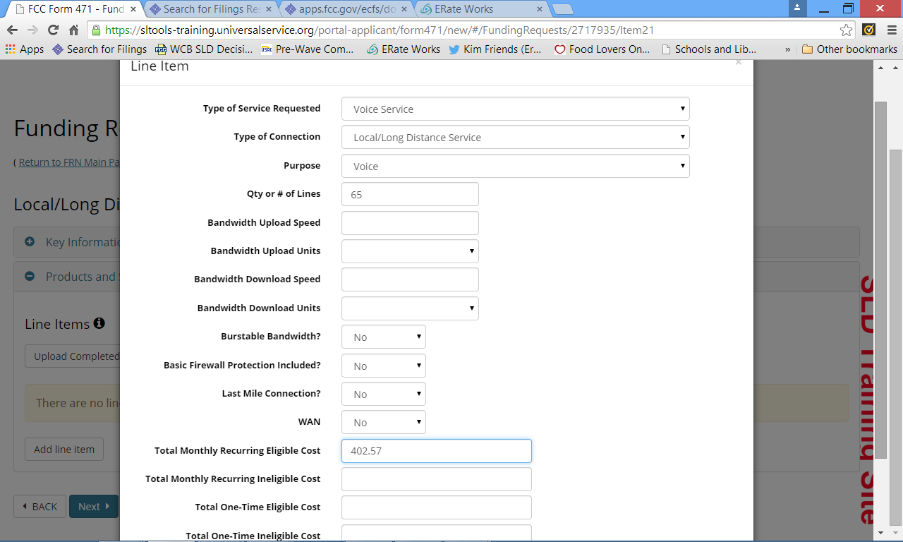
Item 21 – Enter Details Manually
Select items from the dropdown lists. The system will prompt you if you’ve left any pertinent information off when you click ‘Close’ at the bottom of the box

Slide 70
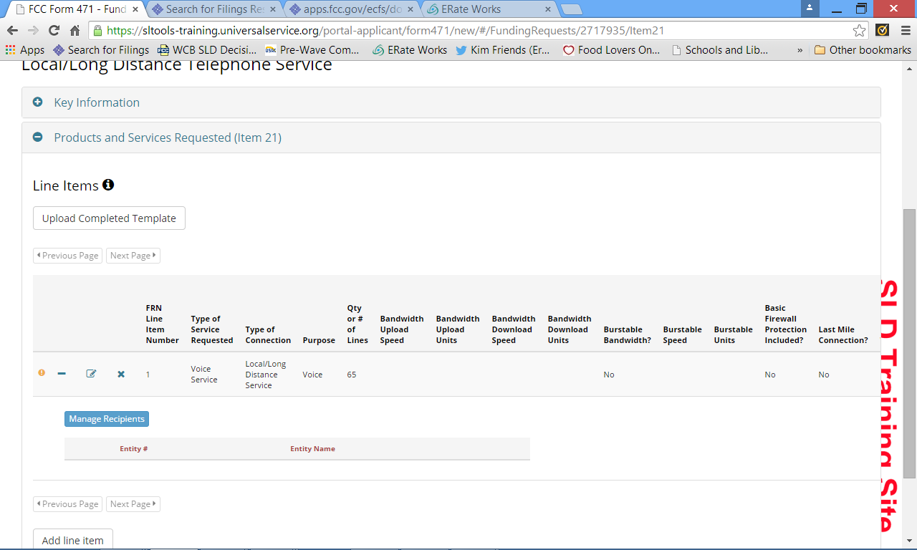
Item 21 – Next Step – Manage Recipients
Now you must tell the system which entities are receiving the service(s) on the line item you just created

Slide 71
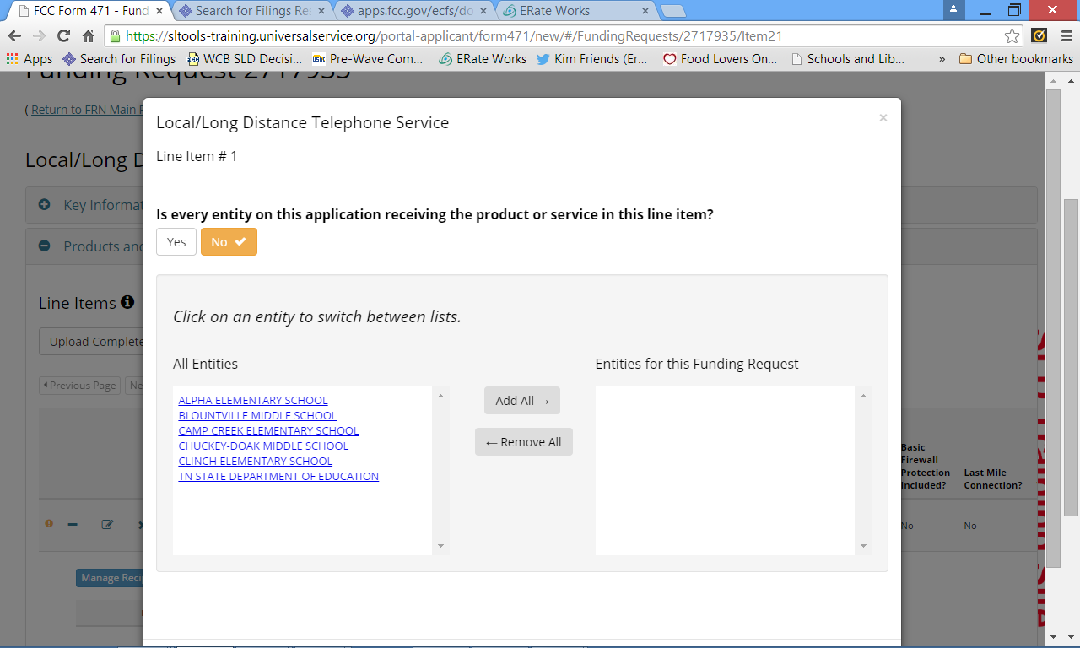
Manage Recipients
You can select YES or NO. If you select NO then you must click on each entity from the list that IS receiving the service(s) on the line item

Slide 72
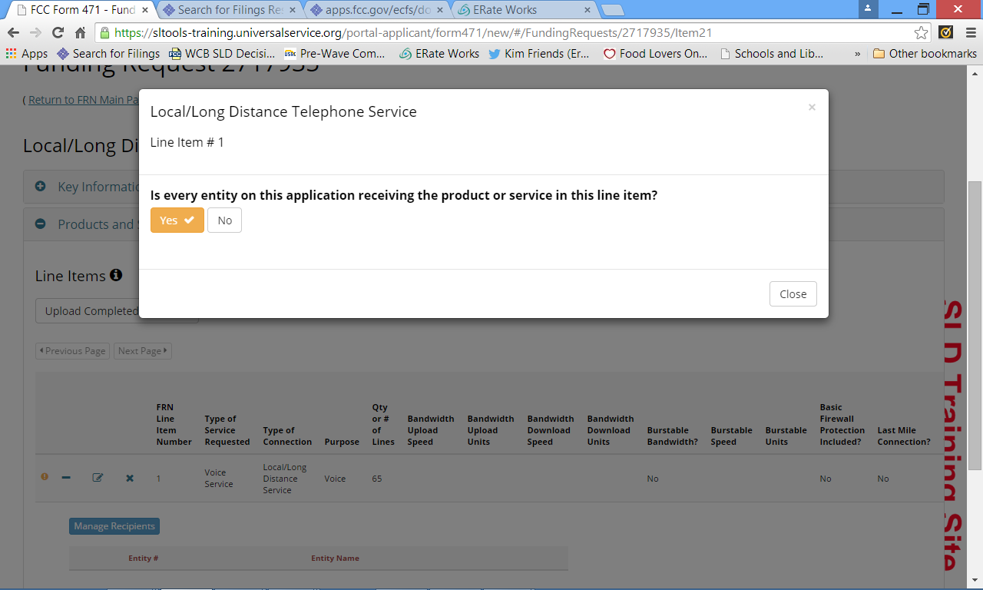
Manage Recipients
If you select YES, the system automatically adds all of the entities for you

Slide 73
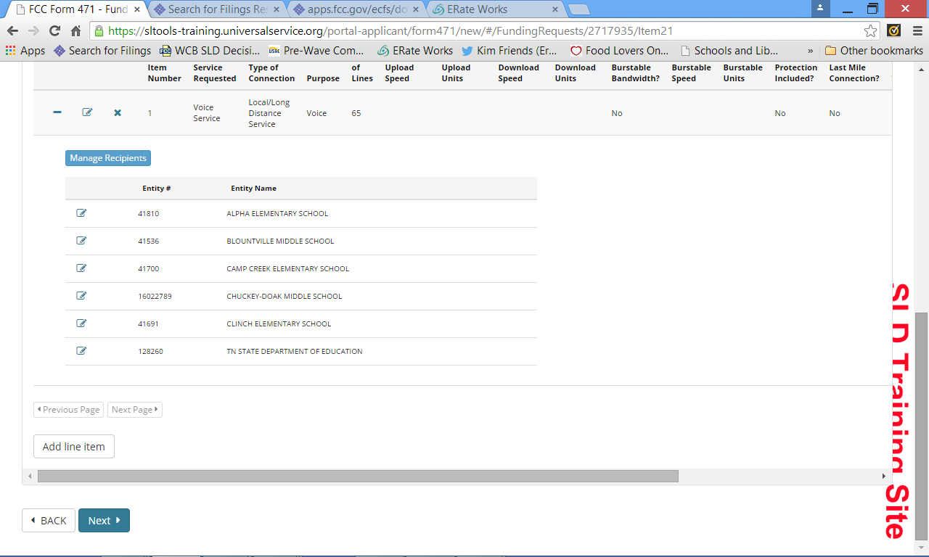
Manage Recipients Complete (C1 – Voice)
Since this is a VOICE services funding request, there is no need to include specific quantities of service per entity
You should only add a Line Item if there is another component to the same service. If it is a different service, you should ADD a funding request by clicking “NEXT”
If you wish to add another line item for THIS funding request, you do so by clicking here.

Slide 74
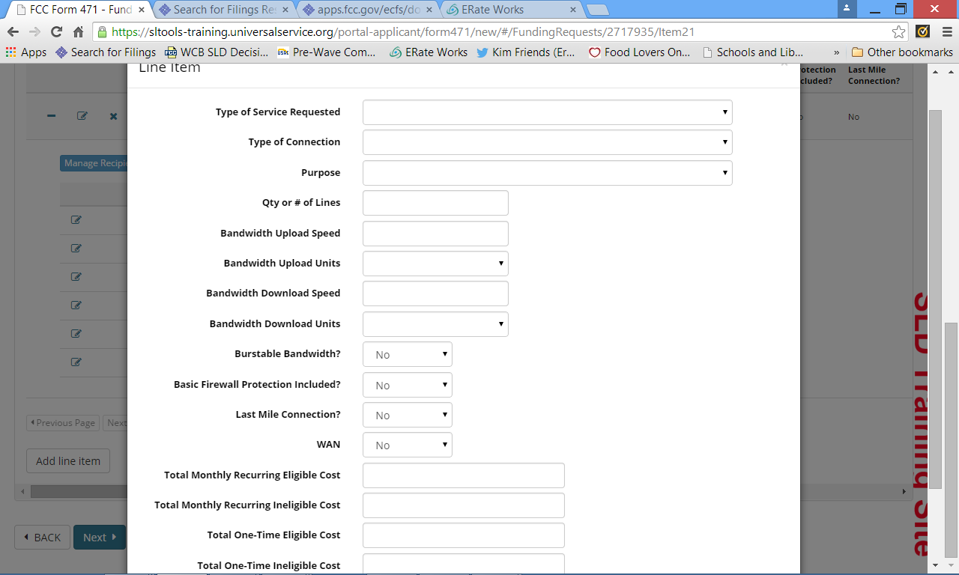
Adding a Line Item to a Funding Request
You should only add a Line Item if that line item is another component of the same service. If it is a different service, you should ADD a funding request. If adding a line item, select from the appropriate dropdown lists and complete as before

Slide 75
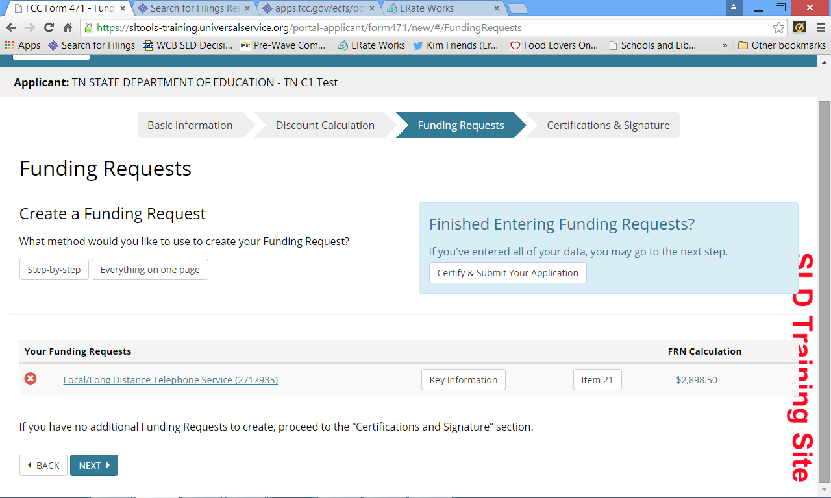
Add a NEW Funding Request
Start a new FRN by entering KEY INFORMATION for the NEW funding request. Let’s make this one INTERNET ACCESS

Slide 76
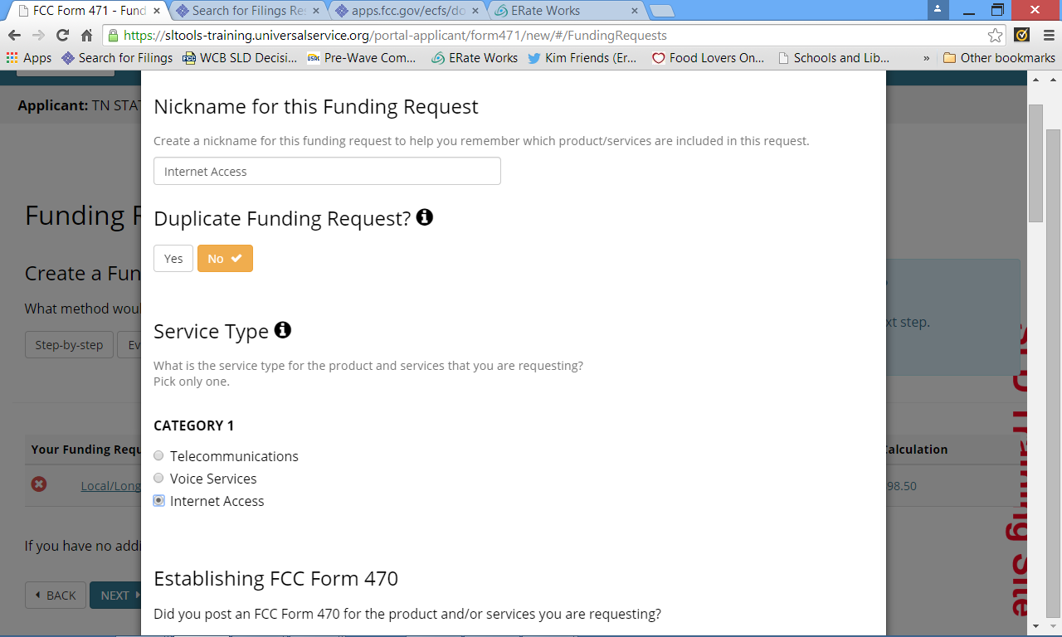
Add Funding Request Key Information
Just as before, the system will take you through the information it needs to create your new funding request.

Slide 77
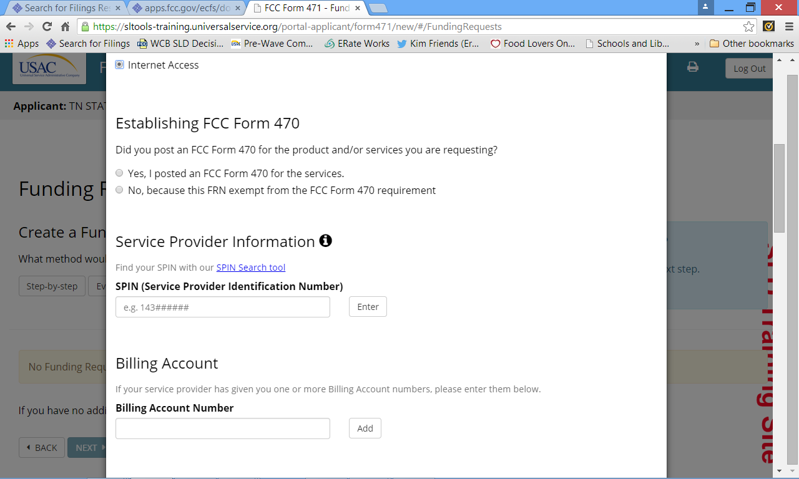
Add Funding Request Key Information
ONLY select this option if you are purchasing Internet Access that is exempt from competitive bidding because it is commercially available, is at least 100Mbps AND costs less than $3,600 per year.

Slide 78
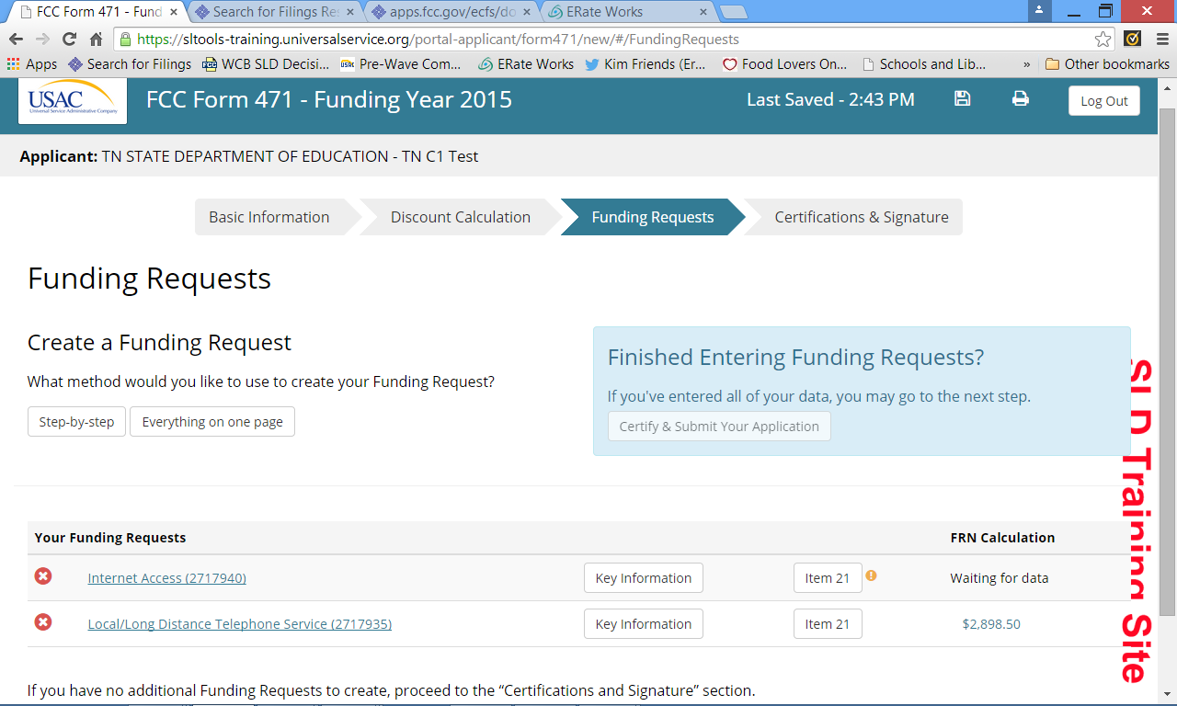
New FRN Added – Item 21 Needed

Slide 79
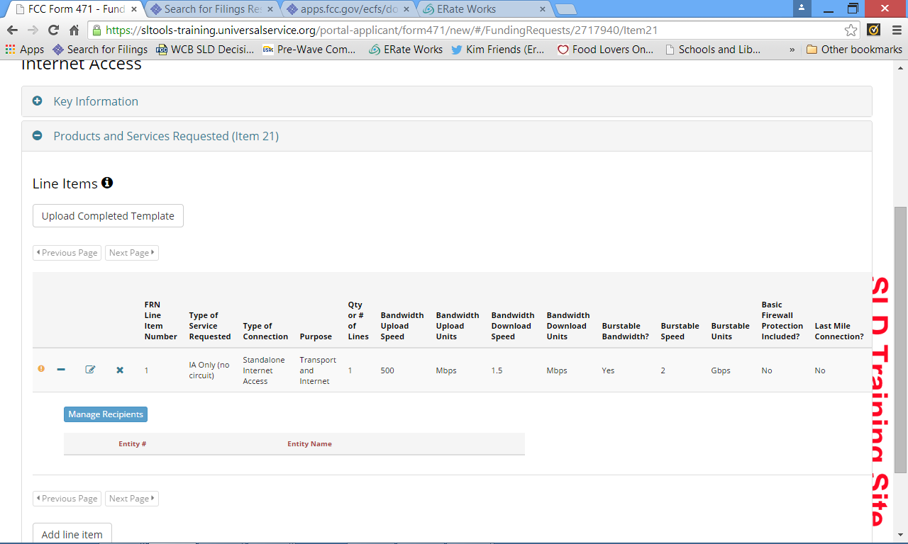
New FRN – Manage Recipients
Each funding request and each line item of that funding request require you to “Manage Recipients”

Slide 80
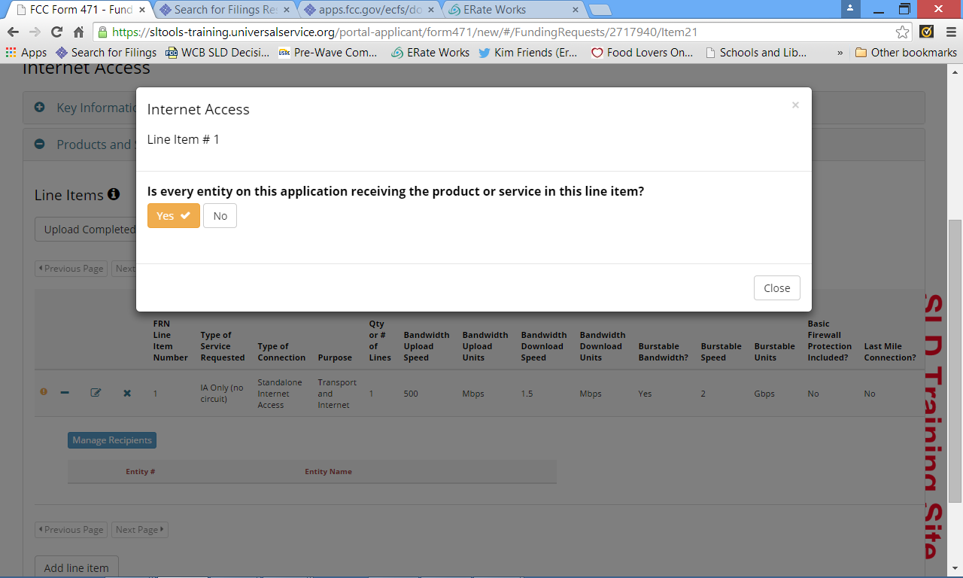
New FRN – Manage Recipients
Again, you select YES or NO – for MOST C1 requests, the answer will almost always be YES.

Slide 81
Add a Funding Request
Again, you will add a line item OR to add a new funding request (or simply move on), you click “NEXT”

Slide 82
Entered Key Information (for NEW FRN) – Need Item 21 - WAN
NOTE: This is a WAN FRN

Slide 83
New FRN – 2 line items – Manage Recipients for BOTH
NOTE: This FRN has 2 different line items, one for Monthly service and one for Miscellaneous, Installation

Slide 84
New FRN – 2 line items – Manage Recipients for BOTH
Since this is a CIRCUIT based FRN, we must not only Manage Recipients, but we must account for the total number of circuits indicated in the line item. When you see the yellow box populated, you must account for all of the items in the box.

Slide 85
New FRN – 2 line items – Manage Recipients for BOTH
Click on the little pencil box and the following pop-up will appear. Populate the # of lines for that entity, then click SAVE. You must do this manually for each recipient of service

Slide 86
New FRN – 2 line items – Manage Recipients for BOTH
Remember, we had 2 line items on this FRN so, we must also Manage Recipients for this line item. We should account for 2 installations

Slide 87
New FRN – 2 line items – Manage Recipients for BOTH
Since only 2 sites are receiving installation, we select NO, then select the two sites that are actually receiving the installation services.

Slide 88
New FRN – 2 line items – Manage Recipients for BOTH
NOTE: There is no need to indicate the quantity per site because this line item is NOT for circuits.

Slide 89
Review Application
This is the screen you will see to Review – expand all sections using the + sign, then you can click PRINT above
Click NEXT at the bottom of the expanded pages

Slide 90
Let’s Look at the Form 471, Block 5 for Category 2 Funding Requests and Templates!

Slide 91
Category 2
As with Category One applications, it’s really all about the up-front prep and planning you do.
There are Item 21 detail templates available for Category 2 funding requests
Item 21b (Internal Connections)
Item 21c (Managed Internal Broadband Services)
Item 21d (Basic Maintenance of Internal Connections)
Today, we will only discuss Item 21b

Slide 92
Item 21b (Internal Connections) Details Template

Slide 93
Item 21b (Internal Connections) Details Template

Slide 94
Item 21b (Internal Connections) Details Template

Slide 95
C2 Form 471 Application
You start a Category 2 application just the same way you start a Category 1 application using the steps outlined in slides 27-35
When you get to the page that looks like this, you select Category 2

Slide 96
Import Discount Calculations
This is done just the same way you imported the C1 discount calculations (using the template), but the application will now show you the amount of C2 budget that is available per school site based on the enrollment, U/R status and calculated Category 2 discount rate.

Slide 97
Import Discount Calculations
This column and information is not present on a C1 application. Note that the amount per site is a POST DISCOUNT amount (maximum amount available)

Slide 98
Import Discount Calculations

Slide 99
Connectivity Questions
Since this is a NEW Form 471, the connectivity questions must be answered again.

Slide 100
Create a C2 Funding Request
We recommend using this method because it most closely resembles the ‘old’ Form 471, Block 5

Slide 101
Enter Key Information

Slide 102
Manage Recipients
Upload completed Item 21b Template
Yes, you must Manage Recipients again
You have a ‘yellow box’ with data – note that it matches the total PRE-Discount cost you put on the line item

Slide 103
Manage Recipients (Site Based Line Item)

Slide 104
Manage Recipients (Site Based Line Item)

Slide 105
Manage Recipients (Site Based Line Item)

Slide 106
Manage Recipients (Site Based Line Item)
All DONE! Yellow box is now GREEN because you have accounted for all of the requested funding!

Slide 107
Check Budget Status
To check how much budget is left, click here.

Slide 108
Check Budget Status
Note the disclaimer!

Slide 109
Add C2 FRN Line Item or NEW FRN
Click ADD Line Item or NEXT (for a NEW FRN)

Slide 110
Add C2 FRN Line Item
Just like for line #1- use your Prep worksheet

Slide 111
Add C2 FRN Line Item – Managed Recipients
Using the same method described in slides 107-110, allocate budget per site

Slide 112
C2 FRN Complete
If you’re all ready, click Certify and Submit and follow the same instructions as in slides 84-93

Slide 113
C2 Centrally Located Equipment FRN

Slide 114
C2 Centrally Located Equipment FRN
Since you cannot select the NIF from a list of entities (because it has no budget), you must describe that this is a central piece of equipment here, in the narrative

Slide 115
Manage Recipients (Central Based Line Item)
Fill the Item 21b details in here, just like a site based FRN

Slide 116
Manage Recipients (Central Based Line Item)
Now, let’s Manage our recipients and cost allocate our budget

Slide 117
Manage Recipients (Central Based Line Item)
You can allocate necessary budget from your school sites via two options. This is a site based allocation

Slide 118
Manage Recipients (Central Based Line Item)
As you can see, a site based allocation automatically allocates the Pre-discount cost on the line item equally for you.

Slide 119
Manage Recipients (Central Based Line Item)
Let’s look at a student based allocation

Slide 120
Manage Recipients (Central Based Line Item)
As you can see, a student based allocation automatically allocates the Pre-discount cost on the line item BY STUDENT, for you

