Slide 1

E-rate Training Workshop for Beginners
Funding Year 2016
Presented by Julie Tritt Schell
PA E-rate Coordinator
for the Pennsylvania Department of Education
Fall 2015

Slide 2
Agenda
Entity Eligibilities
E-rate Productivity Center - EPC
Discount Calculations
Category 1 Eligible Services
Category 2 E-rate Budget Caps
Category 2 Eligible Services
Category 2 Bidding Options/Requirements
Application Process and Forms Overview
  File Form 470 in EPC
  Show Contract Wizard Screenshots
  Show Form 471 Screenshots
Morning break
Questions at end of each section
Lunch from 12 -12:30

Slide 3
Who is Here?
School Districts
IUs
Charter Schools
AVTSs
Non-public Schools
Libraries
Superintendents/Asst Supt
Business Managers
Technology Directors
Vendors
Who NOT on PA E-rate listserve?

Slide 4
What is E-rate?
Telecommunications Act of 1996 established “Universal Service Discount Program for Schools and Libraries”
Annual $3.9 billion program, adjusted for inflation
Funding years named for the year in which they begin
  FY 2016 = July 1, 2016 – June 30, 2017
  Application process begins 6-10 months ahead of start of next funding year
Provides 20-90% discounts on eligible services
  20-85% discounts on eligible equipment/services
Fund made up from charges on your phone bills
Not a typical grant program

Slide 5
Who Administers E-rate?
FCC (Federal Communications Commission)
  Created program and sets rules and policy
USAC (Universal Services Administrative Company)
  Created by FCC to run E-rate and other universal service programs
  Pays invoices
SLD
  Schools and Libraries Division
  Entity within USAC that runs E-rate
  Makes no policy decisions
  Reviews and approves applications

Slide 6
What is Julie’s Role?
Under contract with PDE to serve as PA E-rate Coordinator
  Provide outreach and training to schools and libraries in PA
  Represent PA before federal policymakers
  Maintain PA E-rate website and listserve
  Act as resource when E-rate administrator can’t help

Slide 7
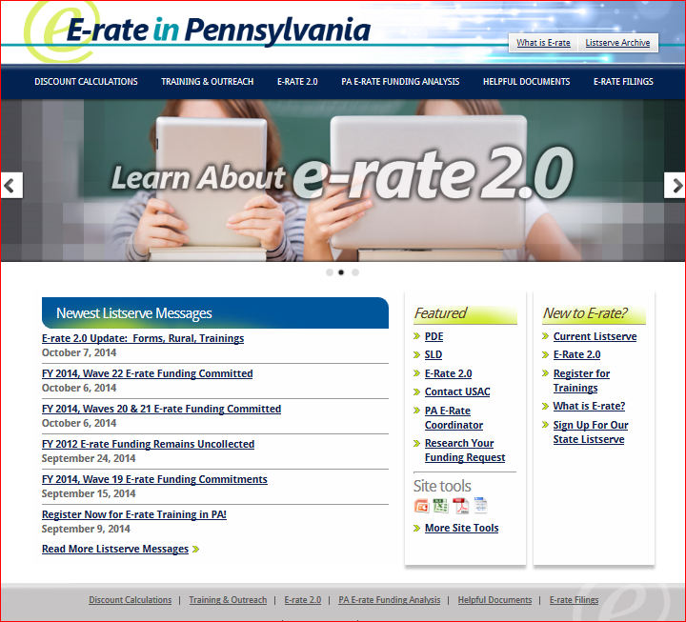
www.e-ratepa.org

Slide 8
Fair Warning!
E-rate is not a short, easy process
Read listserve messages
Read form certifications
Be prepared for an audit
Stay organized!

Slide 9
Who is Eligible?
Public libraries eligible for LSTA funding
Public and private K-12 schools
  For-profit schools not eligible
  Pre-k eligible in PA (age 3+)
  Head Start entities eligible in PA but only if operated by a public school entity
  Cannot have endowment exceeding $50 million
  Consortia comprised of eligible schools and/or libraries
What is a NIF?
Administrative buildings, bus barns, network operations buildings
Non-instructional facilities of schools and libraries are eligible for:
  Category 1 E-rate funding
  Category 2 E-rate funding if the NIF is the hub of the network

Slide 10
Eligible Residential Locations
Residential locations within schools serving (began in FY 2011):
  tribal students
  children with physical, cognitive, or behavioral disabilities
  juvenile justice students, or
  residential schools where 35% or more of their students are eligible for NSLP
Schools can be public or private
Category 1 services are eligible (uncertain whether Category 2 services are eligible)
Residential locations of cyber school students, employees, board members, etc. are not eligible

Slide 11

Questions about
Applicant eligibility?

Slide 12

What’s New for 2016?

Slide 13
What is EPC?
EPC = E-rate Productivity Center
New account and application management portal
Over the next 10 months, all E-rate forms, letters and interactions will phased in to the EPC Portal system
Advantages?
  All forms, submitted documentation and requests will be archived in a single location
  Forms will be pre-populated with information
  Lots of data will be entered into EPC prior to filing the application
  Supposed to provide streamlined reviews
You MUST be in EPC to apply for E-rate

Slide 14
Establishing Your Initial EPC Account
USAC created an EPC account in their database for each applicant entity and identified an Account Administrator
The AA can perform these functions:
  Create Users
  Assign Users’ Rights/Permissions
  Change AA to another user
  Join Consortia
  Link to Your Consultant
  Enter Enrollment/NSLP Data*
As of last week, ‘full and partial rights users’ also are able to perform some of these functions (*)

Slide 15
Who is the Account Administrator?
USAC initially established each applicant’s AA as the person who signed the FY 2015 Form 471
  unless it was a consultant
In July, each AA received an e-mail from USAC indicating that their EPC Account had been created (in the backend) and that they should establish their password
  If you are the AA and did not receive this e-mail, contact CSB at 888-203-8100 to have AA account set up in their system

Slide 16
How to Change the AA to Someone Else
Three methods:
  If the current AA has set up their password, they can log-in to the system and change AA authority to another User
  If the current AA has not yet set up their password, the AA can send an e-mail to SLDPR@GDIT.com requesting that the AA be changed to another person
    Must provide full contact information for new AA
  If the current AA is no longer with the organization, the new AA can send an e-mail to SLDPR@GDIT.com requesting that they be designated the new AA
    Be sure to explain that the original AA is gone
    Must provide full contact information for new AA
For 2 and 3, the new AA will then receive an e-mail from EPC inviting them to establish their EPC password

Slide 17
Setting Up Your EPC Account
Click on District Name (first entity on the list)
Then > Related Actions on left toolbar
Perform these functions using > Related Actions
Establish other users and giving them permissions (if any)
  Be sure those users then establish their passwords, and accept their terms and conditions
Review your school list to make sure all buildings are listed
Add your NIFs by creating a customer service case with USAC
Ensure that the addresses are accurate for each building, as well as the “profile” information for each school
Join a consortium, if applicable
Link to a consultant, if applicable
Update your enrollment/NSLP data
  May want to wait until the PDE data comes out in January
  NSLP data should already be in your portal from FY 2015

Slide 18
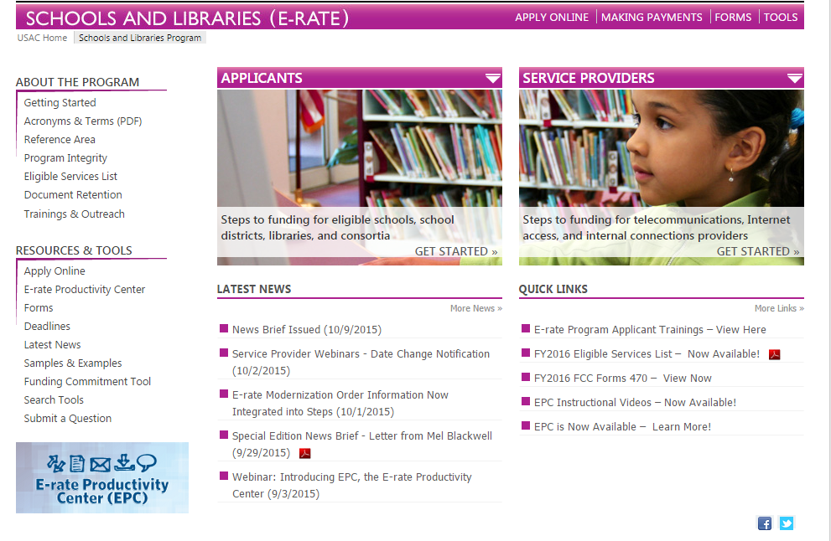
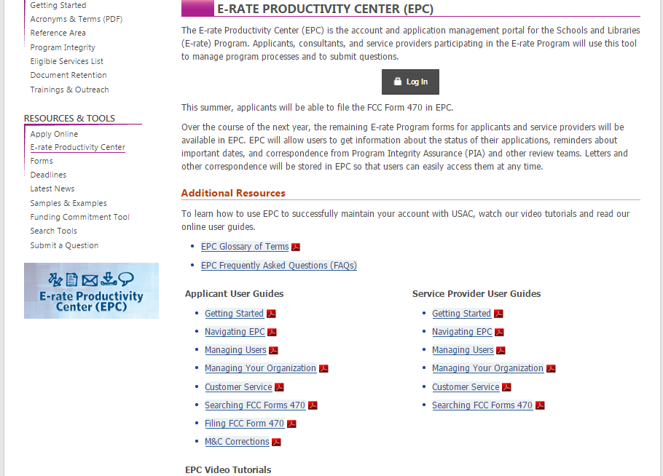
Accessing EPC...

Slide 19
Questions about EPC?
If you’re unsure if your account has been established, or run into problems...
Call USAC at 888-203-8100
  They are the only entity that can troubleshoot EPC problems
USAC’s EPC Website: www.usac.org/sl
  Contains FAQs
  User Guides
  Video Tutorials
PA EPC presentation is posted to the PA E-rate website
Let’s do EPC Demo...

Slide 20
Discount calculations

Slide 21
What is My E-rate Discount?*
Discount level for a school district or library system depends on:
1) Percentage of students who are eligible for National School
Lunch Program (NSLP)
    Doesn’t matter if school serves lunch or participates in NSLP
    AVTS and nonpublic schools use their own students’ data, not sending schools’ data
    October NSLP data on PA E-rate website by mid January
2) Urban or rural location of the school or library

Slide 22
Discount Calculation Changes
All discounts for both Category 1 and Category 2 are calculated on a district-wide simple average basis
Formula: Total district NSLP eligible students / total district enrollment
Rural/urban status of majority of buildings (physical addresses) will be used for entire district or library system
Discount rates do not change based on which entities within a district/system are receiving service
Maximum discount for Priority 2 is now 85%
  All other discounts stay the same

Slide 23
Urban/Rural Definition
Rural/Urban Definition - Individual school and library is designated as "urban" if located in an "Urbanized Area" or "Urban Cluster" with a population of 25,000 or more
  Any school or library not designated "urban" is considered "rural" and will receive the additional rural discount
2010 U.S. Census data is used to determine rural status
Can check urban/rural status using USAC tool at:
https://sltools.universalservice.org/portal-external/urbanRuralLookup/

Slide 24
School District Example
School | Urban/Rural | Enrollment | NSLP
DALLASTOWN EL SCH | R | 185 | 83
LOGANVILLE-SPRINGFIELD EL SCH | R | 434 | 77
YORK TWP EL SCH | R | 463 | 176
ORE VALLEY EL SCH | R | 554 | 191
DALLASTOWN AREA SHS | U | 1715 | 366
LEADERS HEIGHTS EL SCH | U | 164 | 33
DALLASTOWN AREA MS | U | 1003 | 282
DALLASTOWN AREA INTERMEDIATE | U | 1380 | 408
DALLASTOWN AREA SCHOOL DISTRICT | U | 5898 | 1616 | 27%

Slide 25
Category 1 Discount Matrix
INCOME Measured by % of students eligible for NSLP | URBAN LOCATION Discount | RURAL LOCATION Discount
If the % of students in your school that qualifies for the NSLP... | ...and you are in an URBAN area, your discount will be... | ...and you are in a RURAL area, your discount will be...
Less than 1% | 20% | 25%
1% to 19% | 40% | 50%
20% to 34% | 50% | 60%
35% to 49% | 60% | 70%
50% to 74% | 80% | 80%
75% to 100% | 90% | 90%

Slide 26
Library Discount Calculation
Independent Libraries (most PA libraries):
  Discounts based on the percentage of students eligible for the NSLP in the school district in which that library is located and whether the library is located in an urban or rural area
Libraries in a System:
  Discount based on the percentage of students eligible for the NSLP in the school district in which the main library system outlet/branch is located
  AND
  The percentage of buildings in rural areas
    If more than 50% are located in rural areas, then the rural discount should be used
Federated Library Systems
  Made up of several independent libraries
  Where System procures shared services, such as WAN/Internet
  System would file as a Consortium
    Obtain LOAs from each library before Form 470 is posted
    Likely would require additional EPC Portal/Log-in

Slide 27
Consortia Discount Calculations
Based on the simple average of all consortia members
Consortia are only entities that will have non-matrix discount
Consortia Members | District Discount
District A | 50%
District B | 60%
District C | 80%
Consortia Discount | 63%
 | (50+60+80)/3

Slide 28
Community Eligibility Provision
CEP program provides an alternative to NSLP household applications for free and reduced price meals in high poverty LEAs
  NSLP estimates are derived from existing data from other income-based programs instead of NSLP applications
  A school, group of schools, or the entire district must have an Identified Student Percentage of 40% or more and must offer both breakfast and lunch daily to qualify for CEP
For E-rate, CEP schools will use the 1.6 multiplier as is currently permitted by USDA and other federal programs
CEP schools must retain back-up calculations which may be requested during PIA and audits
Schools are capped at 100% NSLP eligibility for purposes of determining E-rate discount
PDE NSLP File (released each January) will show CEP schools, direct cert % and base year

Slide 29
Category 2 Discount Matrix
Maximum Category 2 discount is 85%
All other discount bands will remain the same
NSLP Eligibility | Urban | Rural
Less than 1% | 20% | 25%
1 – 19% | 40% | 50%
20 – 34% | 50% | 60%
35 – 49% | 60% | 70%
50 – 74% | 80% | 80%
75 – 100% | 85% | 85%

Slide 30
Alternative Measures to NSLP*
Participation in these programs also qualifies:
  Medicaid
  Food Stamps
  Supplementary Security Income (based on income)
  Federal public housing assistance (section 8)
  Low Income Home Energy Assistance (LIHEAP)
Not acceptable - Title 1, feeder schools method, principal’s estimate
Income surveys can be conducted
  Income survey results can not be extrapolated
  Discounts will only be based on the income surveys actually collected
  Survey results good for 2 years

Slide 31
EPC Impact?
All enrollment and NSLP data will be entered into EPC profile before filing the Form 471
  Will then be ported into Form 471 from profile
FY 2015 Block 4 data was already captured and is already in EPC profile
  Can update this data or use for FY 2016 application
    Enrollment/NSLP data good for 2 years
Libraries will not enter this data
  Will enter the school district in which the library is located
  Libraries cannot submit 471 without schools entering their enrollment/NSLP data

Slide 32
Questions about
Discount Calculations?

Slide 33
Internet access/broadband goals
&
CATEGORY 1 ELIGIBLE SERVICES

Slide 34
Internet Connectivity Goals
FCC has set Internet Connectivity Goals as follows:
Schools: Internet access of at least 100 Mbps per 1,000 students and staff (users) in the short term and 1 Gbps Internet access per 1,000 users in the long term
  Measurement will be at the district level for school districts and school level for schools that are not part of a district
Libraries: Internet access for libraries that serve fewer than 50,000 people of at least 100 Mbps and at least 1 Gbps for libraries that serve 50,000 people or more
Note: There are no penalties for not reaching these goals.

Slide 35
WAN Broadband Connectivity Goals
Schools: Dedicated data service scalable to 10 Gbps per 1,000 students in the long term
  FCC assumes that in most cases, a 1 Gbps fiber connection can be readily scaled to 10 Gbps with upgraded networking equipment
Libraries: If libraries are connected by a WAN, the measure will be the total number of libraries that have a connection capable of providing a data service scalable to at least 10 Gbps
There are no short term WAN connectivity goals
Again, there are no penalties associated with not meeting these goals

Slide 36
Funding Priorities/Categories
FCC established funding priorities because demand always exceeds cap
Category 1
  Telecommunications and Internet Access Services
    Mostly all ‘services’
      Only modulating electronics to light dark fiber can be purchased
    Services that go TO the building
Category 2
  Internal Connections, Basic Maintenance of IC, MIBS
    Services/equipment INSIDE the building

Slide 37
Category 1 Services – Not Eligible
Paging, webhosting, and hosted e-mail
Certain telephone service components
  Directory assistance charges
  Text messaging
  Custom calling services
  Direct inward dialing (DIDs)
  900/976 call blocking
  Inside wire maintenance plans
Free end-user equipment
  May not be bundled with the cost of voice
  Includes free cell phones and VOIP equipment
Wireless data plans (cellular and mobile broadband) subject to strict cost effective scrutiny

Slide 38
Wireless Data Plans
In buildings with Wi-Fi access: Not eligible
In buildings without Wi-Fi: Only eligible if they are the most cost effective option for providing internal broadband access for portable mobile devices
  Must prove either that installing a WLAN is not physically possible, or provide a comparison of the costs of individual data plans vs. installing a WLAN solution
  Be prepared for extensive cost effectiveness review from PIA
Library bookmobiles are excepted from heightened review

Slide 39
Phase-Down of Voice Services
Beginning in FY 2015, all voice services are being phased out by 20 discount percentage points/year
  This includes cellular voice, local and long distance, centrex, POTS, PRIs, hosted VOIP, and any circuit dedicated to voice service
  No voice services will be eligible beginning with FY 2019
  For FY 2016, all voice services will receive 40% less in E-rate discounts

Slide 40
Voice Phase Down by Discount & Year
Districtwide E-rate Discount | Phase Down Voice Discount
 | FY 2015 | FY 2016 | FY 2017 | FY 2018 | FY 2019
90% | 70% | 50% | 30% | 10% | No funding
80% | 60% | 40% | 20% | No funding | No funding
70% | 50% | 30% | 10% | No funding | No funding
60% | 40% | 20% | No funding | No funding | No funding
50% | 30% | 10% | No funding | No funding | No funding
40% | 20% | No funding | No funding | No funding | No funding
25% | 5% | No funding | No funding | No funding | No funding
20% | No funding | No funding | No funding | No funding | No funding
40

Slide 41
Category 1 Services – Eligible
Cable Modem/DSL
T-1, T-3, Fractional T-1
DS-1, DS-2, DS-3
OC-1, OC-3, OC-12, OC-n
Ethernet
Leased Lit Fiber
Leased Dark Fiber
Frame Relay
ISDN
Satellite Services
Telephone Dialup
Wireless Service (e.g. microwave)
Broadband over Power Lines
Purchased of Dark Fiber (self provisioned) – new for FY 2016

Slide 42
Dark Fiber Eligibility Changes
E-rate eligibility for leased lit fiber and dark fiber equalized this year
“Dark Fiber” is unlit fiber that is leased from a vendor
  Applicant must install the modulating electronics and light the fiber
Modulating electronics and equipment necessary to make the dark fiber service functional are now eligible to be purchased with Category 1 funds
Special construction charges for dark fiber may include the costs of installing fiber from the service provider’s network all the way into the applicant’s building
  Previously only cost of installing from curb into building was eligible

Slide 43
Construction and Ownership of Fiber - New
Commonly referred to as “self construction” or Build Your Own WAN (BYOW)
A RFP must be issued along with posting a Form 470
Applicants must solicit bids for both lit fiber, dark fiber service and construction in the same Form 470
  If an applicant previously posted a Form 470 for lit or dark services and did not receive any bids, then the applicant is only required to bid self-provisioning
  Bidding period must be longer than 28 days – recommended to be 6 weeks

Slide 44
Construction and Ownership of Fiber - New
If construction and ownership of dark fiber facilities is found to be most cost-effective, this option is new for E-rate funding in FY 2016
Cost effectiveness must be evaluated over the entire life cycle of the facilities and must include all related costs of service and total cost of ownership
If you are interested in this option, start ASAP
  Also, let me know so I can connect you with USAC’s new Fiber Consultant who will walk you through the process

Slide 45
Special Construction Charges
One time charges incurred for installation of new service
Special Construction includes:
  Construction of network facilities
  design and engineering
  project management
Policy is suspended of requiring charges > $500,000 to be amortized over 3 years
  Can be paid by E-rate in Year 1
Applicants are allowed to ask vendors for up to a 4 year payment plan for the non-discounted share of these costs
  Provision included on the new Form 470

Slide 46
Category 1: Eligible Internet Access
Both Internet and Internet transport charges are eligible
Internet Access also may include these features if they are provided as a standard component of a vendor’s Internet access service:
  Basic firewall protection (cannot be priced-out separately)
  Domain name service
  Dynamic host configuration
Examples of items that are ineligible components of Internet access:
  Applications, filtering, content, e-mail, and equipment such as computers, laptops, tablets and all other end-user devices

Slide 47
Bidding Exemption for Bundled Internet
“Commercially available” Broadband/Internet packages that cost less than $300 per month per building (prediscount) can be purchased without posting a Form 470
Minimum speed must be 100 mbps downstream and 10 mbps upstream
Cost must be based per building and cannot be averaged across multiple buildings
Annual cost of $3600 must include all equipment and installation charges and monthly recurring charges
Note: Very few applicants take advantage of this option

Slide 48
Category 1 Other Eligibility Issues
ELIGIBLE
INELIGIBLE
Installation
  Must be included on your application
Most taxes and surcharges
Payphone service
Non-published phone numbers
Certain fees and charges:
  Late fees or finance charges
  Paper statement fees
  Cost recovery fees
  Property tax fees

Slide 49
Equipment Eligible to be Bundled*
A single basic termination component, such as a CSU/DSU, cable modem, network interface device, or copper-to-fiber converter may be provided by the vendor at each applicant site.
If more than a single basic termination component is included, it is called On-Premise, Priority 1 Equipment and must meet the TN test:
  No applicant ownership – ever
  No exclusive use in contract
  Must be provided by the same vendor with the underlying service
  LAN must function without use of the equipment
  Service provider (not the applicant) maintains equipment
  Ask Julie if you’re unsure of your answers

Slide 50
Community Use of Services
Schools may permit general public to use the schools’ Internet access during non-operating hours – at the school
  Usage is permitted only during a school’s “non-operating” hours or summer
  School may not request E-rate funding for a higher level of service than would be required for educational purposes
  Schools may not charge for the use of the Internet access, but may charge reasonable fees to cover overhead costs from individuals that use the schools' services and facilities
    Organizations using a schools' services are permitted to recover related costs (e.g., “curriculum development and presentation costs”) from attendees

Slide 51
Community Use of Services
School not required to open facilities
Internet filtering rules must remain intact during use
Rule in no way permits schools to share their bandwidth with other ineligible entities, such as an off-site after-school program at the YMCA or community center
  Also does not permit partially eligible entities, such as a Diocesan office that provides services to both schools and the church, to stop cost allocating the ineligible portion of Internet used during school hours

Slide 52
Questions about
Internet/Broadband goals and CATEGORY 1 eligibility?

Slide 53
CATEGORY 2 E-rate budget caps

Slide 54
Category 2 Overview
Category 2 (previously called Priority 2) funds Wi-Fi and related infrastructure and equipment inside buildings
  And between buildings if schools are located on the same campus
Technology plans are no longer required
Intention is to have all schools and libraries obtain Category 2 funding over a period of 5 years

Slide 55
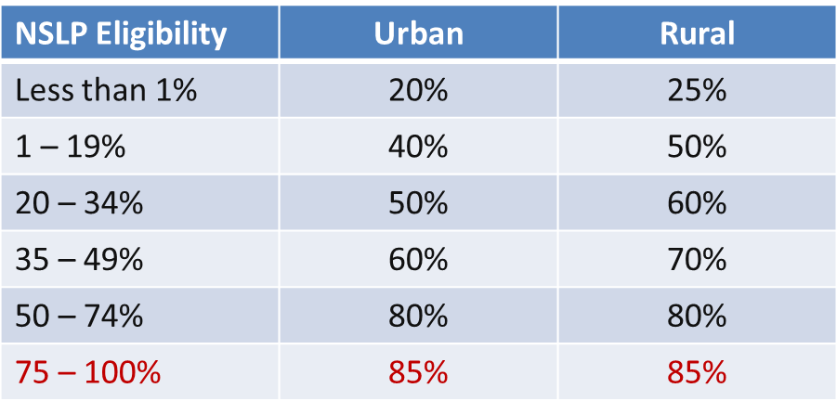
Category 2 Discounts
District-wide simple average calculation for both C1 and C2 requests (no more weighting)
Every school in the district receives the district-wide discount
Maximum E-rate discount is now 85%. All other discount bands remain the same:

Slide 56
Will There Be Funding Available?
Yes
Yes
Yes
FY 2016 cap will be $3.913 billion + additional $1 billion that has been set aside for C2 + inflation adjustment, bringing available funds to over $5 billion
  FCC has stated that they will fully fund all eligible C2 requests, regardless of demand

Slide 57
Category 2, 5-Year Budget Caps
Each school is entitled to a pre-discount cap of $150 per student, or a minimum building cap of $9200, over a rolling five years
  AVTS budget is based on maximum density of students
  Library budget is $2.30 per square foot, ($5.00 per square foot for urban libraries)
Money is allocated per school (not on a shared-district basis), and applicants cannot move funding from one school to another

Slide 58
Category 2, 5-Year Budget Caps
Money must be spent during funding year (cannot apply for full budget and spend down over multiple years)
  FY 2016 = April 1, 2016 – September 30, 2017
  There is no provision to allow applicants to spend funds and be reimbursed in a later year
Can use school’s entire budget all in a single year or can apply over multiple years

Slide 59
Category 2 – Enrollment Anomalies
  If enrollment increases, you receive benefit of extra students next year
  If enrollment decreases, you aren’t required to pay back funds
New schools may estimate the number of students who will be attending the new school and seek funding based on that estimate
  However, if an applicant overestimates the number of students who enroll in that school, it must return to USAC by the end of the next funding year any excess funding based on the actual number of enrolled students
Students who attend multiple schools, such as those that attend CTCs or Intermediate Units part-time, may be counted by both schools in order to ensure appropriate LAN/WLAN deployment for both buildings

Slide 60
Category 2 Funding Budgets - NIFs
Non-Instructional Facilities (NIFs) don’t have C2 budgets because there is no student population
If equipment is located in the NIF and serves a school(s), that school’s budget can be used to fund the equipment

Slide 61
Category 2 Budgets
Any funding commitments that include a school or library as a recipient of service in that funding year will count against your pre-discount budget for that entity
If not all committed funding is spent, you can file a Form 500 to return the remaining unused commitment to USAC
    If entities are sharing the service, USAC will need specific information so that they know how to apply the returned funds to specific entities
Limited C2 Budget Calculator:
http://www.fundsforlearning.com/schoolDistCalculator.php
USAC C2 Budget Calculator, including impact of previously-committed funds, will be available soon

Slide 62
Category 2 Funding Budget Example
The Budget Cap is the pre-discount price. E-rate discounts will then apply on top of the budget cap.
In this example, district would still owe 30% non-discounted share.
* Although 50 x $150 = $7,500, the minimum floor is invoked
because school has less than 62 students
School | Maximum Density Student Count | Budget Multiplier | 5-Year Budget Cap | E-rate Discount | E-rate Funding Cap | District's Share % | District's Share $
Plainfield Elementary | 50 | $150 | $9,200* | 70% | $6,440 | 30% | $2,760
Jacksonville Middle School | 105 | $150 | $15,750 | 70% | $11,025 | 30% | $4,725
Newville High School | 325 | $150 | $48,750 | 70% | $34,125 | 30% | $14,625

Slide 63
Questions about category 2 budgets?

Slide 64
What’s Eligible and Not Eligible for
Category 2 Funding?

Slide 65
Category 2 Ineligible Items
Servers (except caching)
Software
Storage Devices
Telephone Components
Video Components
VOIP Components
End-User Devices

Slide 66
Category 2 Eligible Items
Access Points
Cabling
Caching Servers *new*
Firewalls
Network Switches
Antennas
Routers
Racks and UPSs
  That support eligible equipment only
Wireless LAN Controllers
Improvements, upgrades and software necessary to support eligible broadband internal connections components
Basic Maintenance Services for eligible equipment
  Repair of equipment, cable maintenance, basic tech support, configuration changes
Cloud-based functionality of this equipment

Slide 67
Category 2 Eligible in FY 2015 & 2016
Managed Internal Broadband Services (MIBS) which cover the operation, management, or monitoring of a LAN or WLAN
    Could also include the leasing of equipment
    Paying an outside vendor to own/maintain the equipment
    Paying an outside vendor to maintain school-owned equipment
Eligible for $30/year/student
Unless FCC extends eligibility, these items will sunset eligibility at the end of FY 2016
  Exception to Sunset: Applicants that received funding approval in FY 2015 and FY 2016 for these items may continue to obtain funding for FY 2017-FY 2019

Slide 68
Category 2 Eligibility, etc...
Installation and configuration are eligible
  Do not have to be provided by the same vendor (new)
Also eligible:
  Taxes, surcharges and other similar reasonable charges
  Shipping charges
  Training on how to use eligible equipment
Multi-year licenses are eligible and can be requested in full in first year
Eligible equipment may be purchased and/or installed on or after April 1 prior to the beginning of the funding year
  Must be purchased/installed before September 30 of the following year

Slide 69
Category 2 Bidding
Will discuss Category 2 bidding options and requirements at end of the day

Slide 70
Questions about category 2 eligibility?

Slide 71
Category 2 E-rate Bidding Requirements
Applicants should not contact a potential vendor ahead of bidding to seek equipment list (E-rate rule)
  Service providers are allowed to answer general questions about the products and services they sell in response to applicant inquiries, but they may not prepare any part of a RFP or spec sheet that will be used by the applicant for conducting a competitive bid procurement.
  If you don’t know exactly what equipment you need, list general equipment needs (wireless controller, WAPs for 35 classrooms, and installation), and then perhaps a site walk-through
Equipment list MUST allow for equivalent manufacturer’s products to be bid (E-rate rule)
  “Cisco 48-port PoE Switch or equipment that is equivalent in functionality and quality”
  May include a requirement that equivalent equipment must be fully compatible with District’s existing XYZ equipment

Slide 72
Category 2 Bidding Options
Form 470
  Form 470 only
    Nonpublic schools and libraries (no RFP required)
    Must list “or equivalent” if listing manufacturer’s name or model # on Form 470
    RFP not required for nonpublic schools and libraries
  Form 470 and RFP
    Public school entities
    Most appropriate for wiring projects
IU 16 PEPPM Contract (public and nonpublic schools only)
    Before PEPPM Form 470/RFP was released in August 2015, each IU signed a “letter of agency” permitting IU 16 to competitively bid on behalf of the public and nonpublic schools within its IU in order to meet the new pre-470 LOA requirement
    Co-Stars contract is NOT E-rate eligible because it’s not competitively bid with price being the most heavily weighted factor

Slide 73
Category 2 Bidding: 470 plus RFP
Post Form 470 and RFP (public school entities)
  RFP required if cost of equipment exceeds $19,400 (state law)
  Form 470 and RFP bidding must be done concurrently and bidding window required to be open for at least 28 days before bids are due (E-rate rule)
  RFP must be published in at least 2 local newspapers of general circulation once/week for 3 consecutive weeks (state law)
  Assuming all RFP requirements have been met, schools must accept the lowest-price bid (state law)
  School board must approve contract prior to signing
    Contract must be signed before submitting Form 471
  Sample equipment RFP available and will be sent to the listserve
  If issuing an RFP, it MUST be uploaded at the time the 470 is posted
    All addenda also must be uploaded to the EPC Portal at time of issuance

Slide 74
Category 2 Bidding: PEPPM Mini-Bid
Conduct PEPPM Mini-Bid
  No Form 470 required (PEPPM filed Form 470 when contracts were being competitively bid)
  More appropriate for equipment/installation, rather than cabling project
  New: Sign contract with the vendor and use those contract dates – not PEPPM dates (new)
    Can be as simple as signing vendor quote
    Be sure to include these items:
    Contract signing date (must be before 471 filing date)
    Contract term: 4/1/2016 through 9/30/2017
    Purchase is contingent upon E-rate funding and local funding approval
  School board must approve contract prior to signing
    Vendor contract must be signed before submitting Form 471

Slide 75
Category 2 Bidding: PEPPM Mini-Bid
  More on PEPPM Bidding:
  Cannot just go to PEPPM list and select vendor and equipment you want/need
  Must then request ‘mini-bids’ from all vendors in that category
  A ‘category list’ will be sent to the PA E-rate listserve soon along with instructions and equipment list template (slightly different than last year)
  Can list preferred manufacturer, but must seek bids for “equivalent” products
  Minimum 2 week bidding period suggested (new)
  Then conduct bid evaluation among all product lines that offer the ‘category’ of service, including equivalents
  Can consider other factors besides price
    Price of eligible equipment must be the most heavily weighted factor
  New EPC Contract wizard requires you to list # of bids received (new)
    Keep these losing bids because you may be asked to submit them

Slide 76
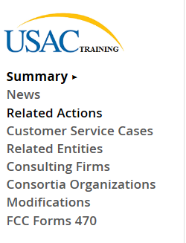
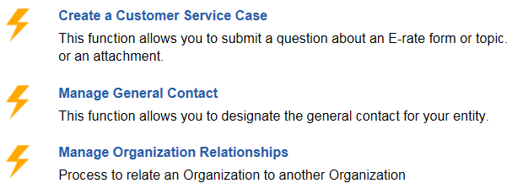
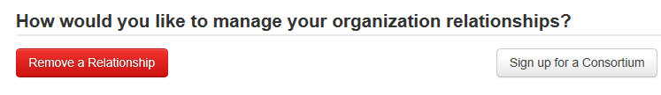
Join the PEPPM Consortium in EPC
!! Before issuing your PEPPM Mini-Bid, please log-in to EPC and join the PEPPM Consortium !!

Slide 77
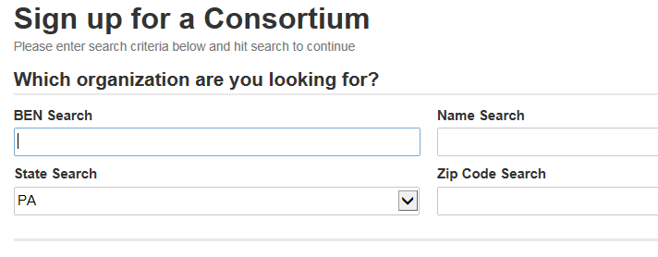
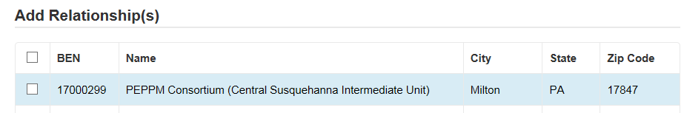
Join the PEPPM Consortium in EPC
PEPPM
X

Slide 78
Example: PEPPM Mini-Bid Category List
Find ‘category’ then send equipment list to all vendors with x
Manufacturer | PEPPM Awarded Vendor Name | Wireless Equipment/Services | Cabling/Connectors | Caching Servers | Firewall Equipiment | Switches | Routers | UPS | Racks | Awarded Vendor Contact Name | Awarded Vendor Contact Email
ACE Computers | Ace Computers |  |  | x |  |  |  |  |  | John Samborski | johns@acecomputers.com
Adtran, Inc. | ADTRAN | X |  |  |  | X | X |  |  | Patrick Foster | patrick.foster@adtran.com
Aerohive Networks | Aerohive Networks | X |  |  |  | X | X |  |  | Zach Harris | sales-operations@aerohive.com
Alcatel-Lucent | Alcatel-Lucent Enterprise USA, Inc. |  |  |  |  | X | X |  |  | Neal Tilley | neal.tilley@alcatel-lucent.com
Allied Telesis, Inc. | En-Net Services, LLC | X |  |  | X | X | X |  |  | Ed Floyd | efloyd@en-netservices.com
APC | ePlus Technology, Inc. |  | X |  |  |  |  | X | X | Nick D’Archangelo | ndarchangelo@eplus.com
Arista Networks | Carahsoft Technology Corporation |  |  |  |  | X |  |  |  | Jack Dixon | Jack.Dixon@Carahsoft.com
Aruba Networks Corporation | Aruba Networks | X |  |  |  | X |  |  |  | Andrew Tanguay | atanguay@arubanetworks.com
Atlona Technologies | Sage Technology Solutions, Inc. |  | X |  |  | X |  |  |  | James Van Fossen | jvanfossen@sagetechs.com
Avaya | Avaya, Inc. | X |  | X |  | X | X | X |  | David Smith | smith153@avaya.com
B&B Electronics | En-Net Services, LLC |  | X |  |  |  |  |  | X | Ed Floyd | efloyd@en-netservices.com

Slide 79
Bidding: PEPPM Bid Evaluation Example
Evaluation Criteria | Maximum # Points | Vendor 1 | Vendor 2 | Vendor 3
Price of Eligible Equipment/Services | 40 | 40 | 30 | 30
Ability to Integrate Equipment into Existing Network | 25 | 25 | 25 | 25
Previous Experience with the District/Knowledge of District's Infrastructure | 25 | 25 | 5 | 10
Quality of References | 10 | 10 | 10 | 10
 |  | 100 | 70 | 75

Slide 80
PEPPM vs RFP
PEPPM
Don’t have to post Form 470/Issue RFP
Don’t have to advertise in newspaper
DO have to conduct mini-bid of every vendor that sells equipment in that category
Don’t have to wait full 28 days during mini-bid process
Can consider non-cost factors as long as costs of E-rate eligible equipment/services are most heavily weighted factor
Can require compatibility and interoperability with existing equipment
More appropriate for equipment/installation, rather than cabling project
RFP/470
Must post 470 and upload RFP
More appropriate for cabling projects, in addition to equipment/installation
Can provide greater specificity about requirements
Can require compatibility and interoperability with existing equipment
Can list binary disqualification factors
Don’t have to solicit bids from any vendor
Cannot consider non-cost factors during bid evaluation. If all RFP criteria have been met, must select lowest bid

Slide 81
Category 2 Bidding Timeline
Post 470/Release RFP/Issue PEPPM Mini-Bid by Dec 1
Bids due Dec 29
Evaluate bids Dec 30 – Jan 15
February board approvals of contracts
Sign contracts by February 27
Upload contracts to EPC Contract Wizard by March 1
Complete 471 no later than March 5

Slide 82
Accessing EPC for 470 Postings

Slide 83
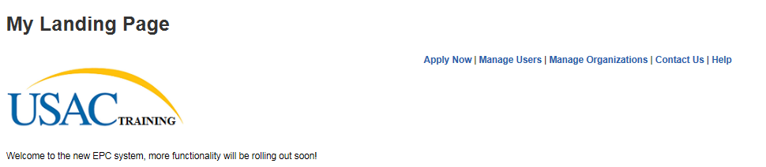

Slide 84
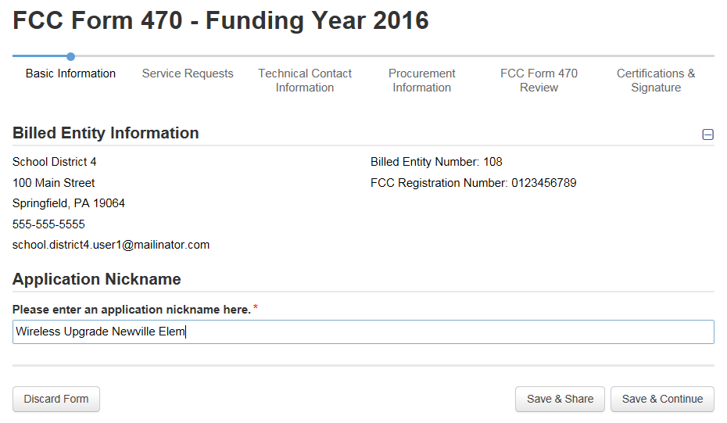
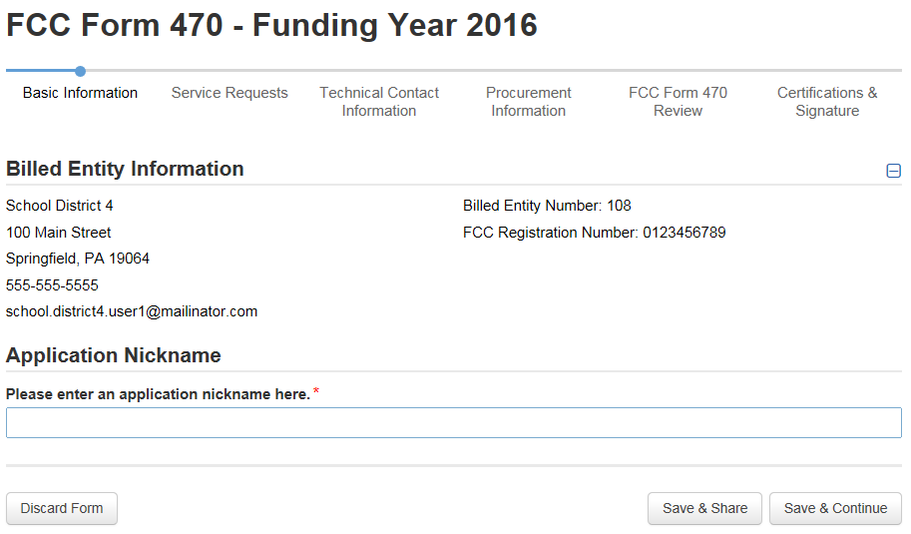
Use a very descriptive nickname.

Slide 85
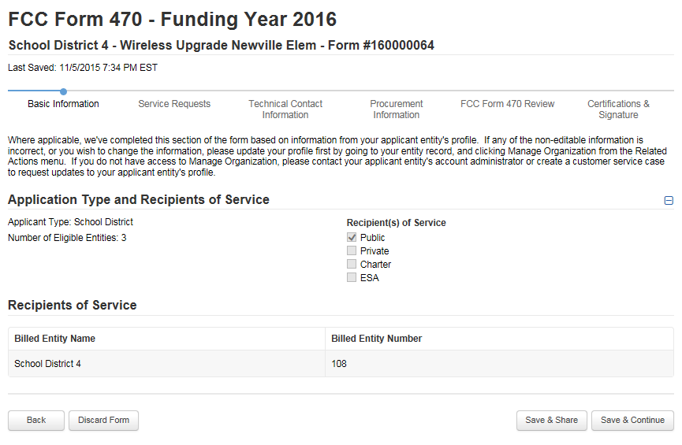
Note: You can’t modify anything on this page.

Slide 86
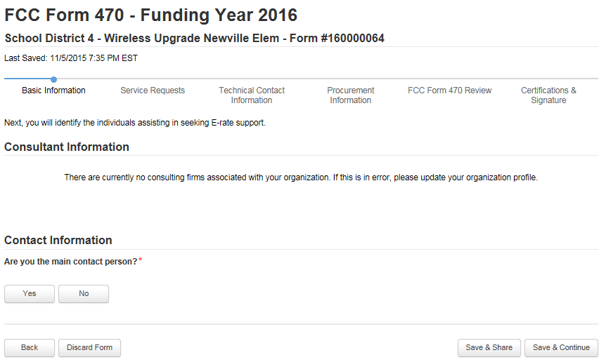

Slide 87
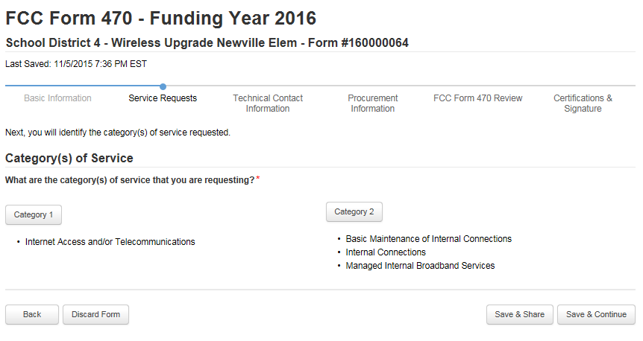

Slide 88
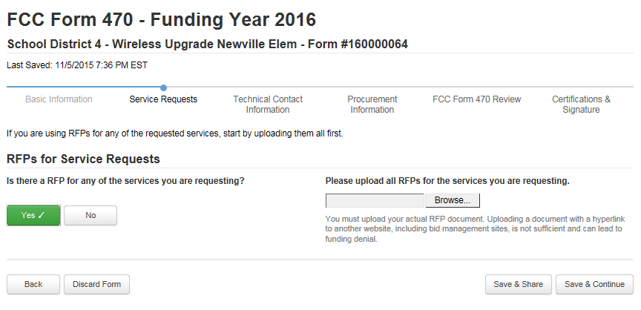

Slide 89
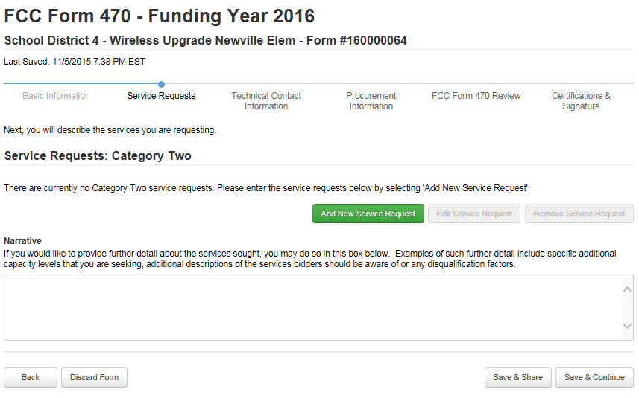

Slide 90
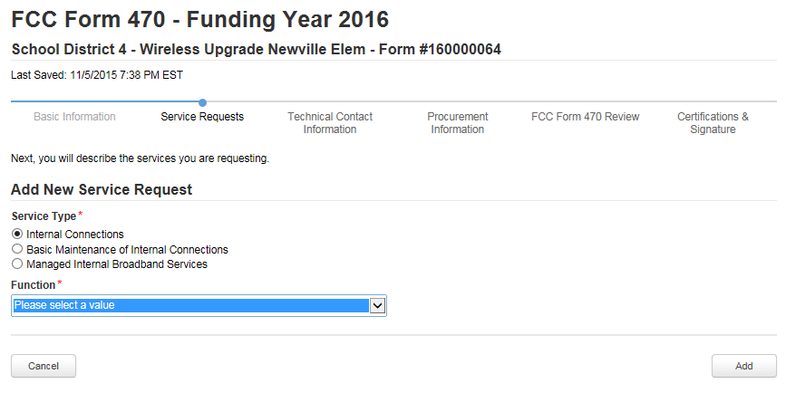
Antennas, Connectors, Related Components
Cabling
Caching
Firewall Services and Components
Racks
Routers
Switches
UPS/Battery Backup
Wireless Access Points (WAPs)
Wireless Controller

Slide 91
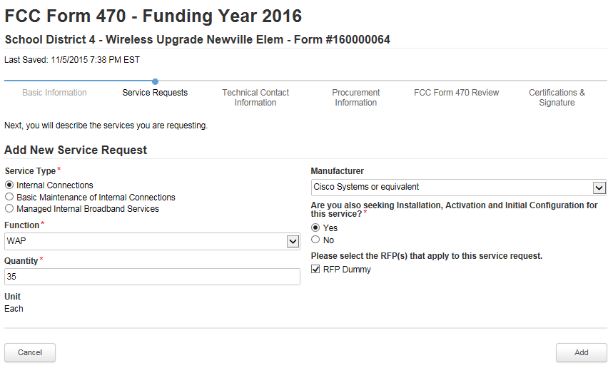

Slide 92
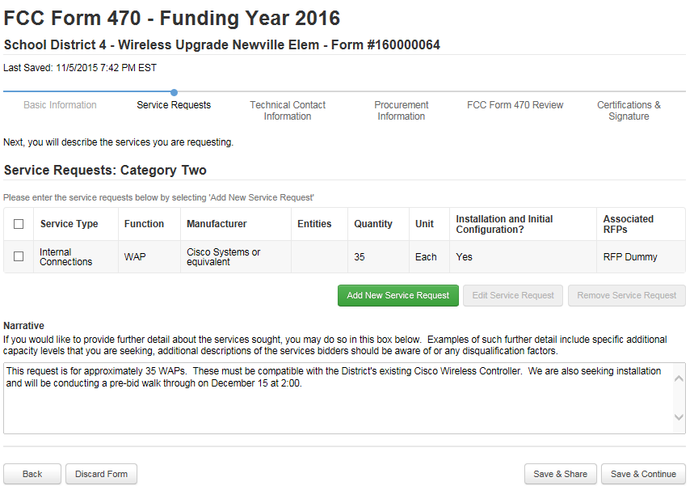
Use the Narrative to provide further details related to your funding request.

Slide 93
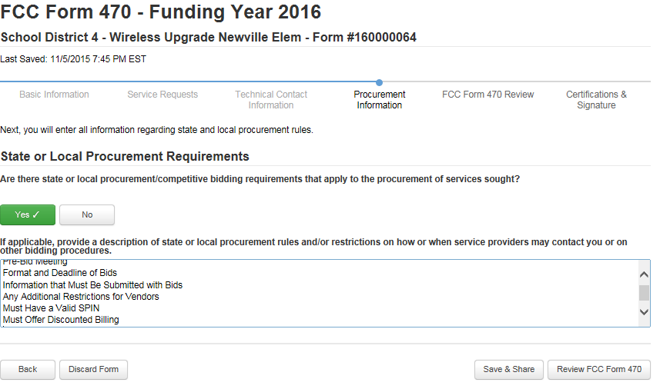
Use the State and Local Procurement Requirements box to list any bidding restrictions you want to place on vendors. Vendors must...

Slide 94
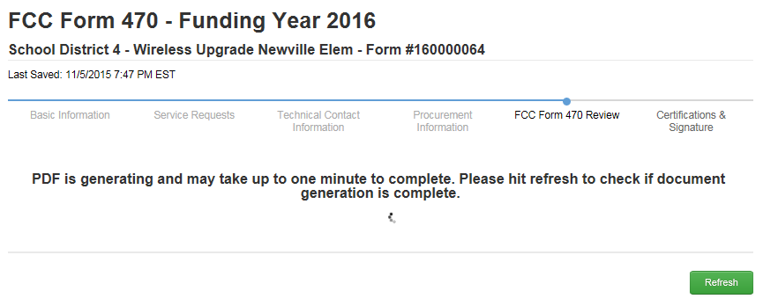

Slide 95
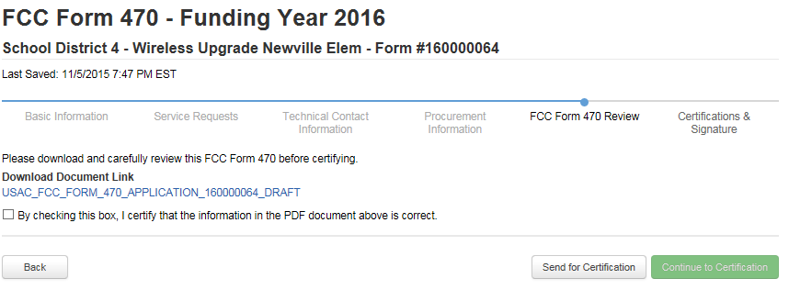

Slide 96
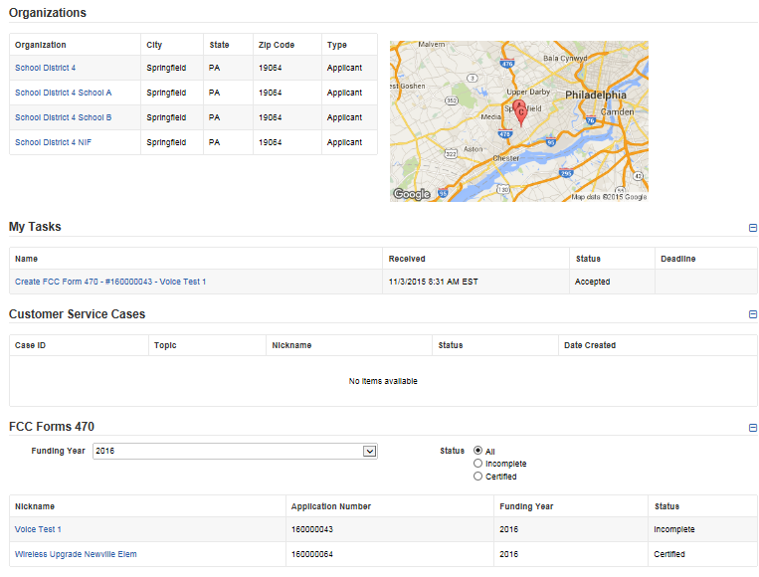
Landing Page. See Posted 470 at the bottom.

Slide 97
Category 2 Bidding: PEPPM Mini-Bid
Conduct PEPPM Mini-Bid
  No Form 470 required (PEPPM filed Form 470 when contracts were being competitively bid)
  More appropriate for equipment/installation, rather than cabling project
  New: Sign contract with the vendor and use those contract dates – not PEPPM dates (new)
    Can be as simple as signing vendor quote
    Be sure to include these items:
    Contract signing date (must be before 471 filing date)
    Contract term: 4/1/2016 through 9/30/2017
    Purchase is contingent upon E-rate funding and local funding approval
  School board must approve contract prior to signing
    Vendor contract must be signed before submitting Form 471

Slide 98
Category 2 Bidding: PEPPM Mini-Bid
  More on PEPPM Bidding:
  Cannot just go to PEPPM list and select vendor and equipment you want/need
  Must then request ‘mini-bids’ from all vendors in that category
  A ‘category list’ will be sent to the PA E-rate listserve soon along with instructions and equipment list template (slightly different than last year)
  Can list preferred manufacturer, but must seek bids for “equivalent” products
  Minimum 2 week bidding period suggested (new)
  Then conduct bid evaluation among all product lines that offer the ‘category’ of service, including equivalents
  Can consider other factors besides price
    Price of eligible equipment must be the most heavily weighted factor
  New EPC Contract wizard requires you to list # of bids received (new)
    Keep these losing bids because you may be asked to submit them

Slide 99
Example: PEPPM Mini-Bid Category List
Find ‘category’ then send equipment list to all vendors with x
Manufacturer | PEPPM Awarded Vendor Name | Wireless Equipment/Services | Cabling/Connectors | Caching Servers | Firewall Equipiment | Switches | Routers | UPS | Racks | Awarded Vendor Contact Name | Awarded Vendor Contact Email
ACE Computers | Ace Computers |  |  | x |  |  |  |  |  | John Samborski | johns@acecomputers.com
Adtran, Inc. | ADTRAN | X |  |  |  | X | X |  |  | Patrick Foster | patrick.foster@adtran.com
Aerohive Networks | Aerohive Networks | X |  |  |  | X | X |  |  | Zach Harris | sales-operations@aerohive.com
Alcatel-Lucent | Alcatel-Lucent Enterprise USA, Inc. |  |  |  |  | X | X |  |  | Neal Tilley | neal.tilley@alcatel-lucent.com
Allied Telesis, Inc. | En-Net Services, LLC | X |  |  | X | X | X |  |  | Ed Floyd | efloyd@en-netservices.com
APC | ePlus Technology, Inc. |  | X |  |  |  |  | X | X | Nick D’Archangelo | ndarchangelo@eplus.com
Arista Networks | Carahsoft Technology Corporation |  |  |  |  | X |  |  |  | Jack Dixon | Jack.Dixon@Carahsoft.com
Aruba Networks Corporation | Aruba Networks | X |  |  |  | X |  |  |  | Andrew Tanguay | atanguay@arubanetworks.com
Atlona Technologies | Sage Technology Solutions, Inc. |  | X |  |  | X |  |  |  | James Van Fossen | jvanfossen@sagetechs.com
Avaya | Avaya, Inc. | X |  | X |  | X | X | X |  | David Smith | smith153@avaya.com
B&B Electronics | En-Net Services, LLC |  | X |  |  |  |  |  | X | Ed Floyd | efloyd@en-netservices.com

Slide 100
Bidding: PEPPM Bid Evaluation Example
Evaluation Criteria | Maximum # Points | Vendor 1 | Vendor 2 | Vendor 3
Price of Eligible Equipment/Services | 40 | 40 | 30 | 30
Ability to Integrate Equipment into Existing Network | 25 | 25 | 25 | 25
Previous Experience with the District/Knowledge of District's Infrastructure | 25 | 25 | 5 | 10
Quality of References | 10 | 10 | 10 | 10
 |  | 100 | 70 | 75

Slide 101
PEPPM vs RFP
PEPPM
Don’t have to post Form 470/Issue RFP
Don’t have to advertise in newspaper
DO have to conduct mini-bid of every vendor that sells equipment in that category
Don’t have to wait full 28 days during mini-bid process
Can consider non-cost factors as long as costs of E-rate eligible equipment/services are most heavily weighted factor
Can require compatibility and interoperability with existing equipment
More appropriate for equipment/installation, rather than cabling project
RFP/470
Must post 470 and upload RFP
More appropriate for cabling projects, in addition to equipment/installation
Can provide greater specificity about requirements
Can require compatibility and interoperability with existing equipment
Can list binary disqualification factors
Don’t have to solicit bids from any vendor
Cannot consider non-cost factors during bid evaluation. If all RFP criteria have been met, must select lowest bid

Slide 102
Category 2 Bidding Timeline
Post 470/Release RFP/Issue PEPPM Mini-Bid by Dec 1
Bids due Dec 29
Evaluate bids Dec 30 – Jan 15
February board approvals of contracts
Sign contracts by February 27
Upload contracts to EPC Contract Wizard by March 1
Complete 471 no later than March 5

Slide 103
After the FCDL Arrives....
Purchase Orders
  One PO for each FRN (if possible)
Submit the Form 486!
Invoicing (applicant choice of discounted bills)
  After equipment received/discounted portion paid
Create and Maintain Asset Inventory
  Sample available
Maintenance records
  Require detailed invoices (what, when, where)

Slide 104
Purchasing Prior to FCDL...
May purchase Category 2 equipment as early as April 1 prior to the start of the funding year -- even with no FCDL
  Only make early purchases if they are NOT contingent on E-rate funding and you plan to pay for your equipment in full and seek E-rate reimbursement after your Funding Commitment Letter arrives
Be sure your PO is for the FULL amount, not the non-discounted share
Submit Form 486 until AFTER the FCDL arrives
Submit Form 472 BEAR to USAC once your FCDL arrives, and after you have paid your vendor invoice.

Slide 105
Equipment Transfer Rules
Equipment MUST stay at the location indicated on the Form 471 for a period of 3 years after the date of purchase
  After that, the equipment can be transferred to other eligible entities
  Asset Inventory must be updated
If a location closes within 3 years, equipment from that closed location can be transferred to another eligible entity
  USAC must be notified of such equipment transfers using the Form 500
  Asset Inventory must be updated
After 5 years from the date of installation, equipment can be disposed of, sold, transferred, traded, etc. with no USAC notification required
  If equipment is sold, no funding is required to be returned to USAC

Slide 106
Equipment Substitution Rules
To change approved equipment, either due to clerical error on your Item 21, or because the vendor is now substituting a newer/different model number, you must submit what USAC refers to as a "Service Substitution Request"
Service Substitution must generally have the same functionality (i.e. data distribution, wireless distribution, cabling, etc)
If the service substitution results in a change in the pre-discount price, the E-rate funding commitment will be adjusted to the lower cost
File Form 500 to return “commitment” to school’s C2 budget

Slide 107
Questions?
The end!

Slide 108
Application Process Overview*
Bid All Services – Form 470
Bid Evaluation/Sign Contracts
Request E-rate Funding – Form 471
Application Review – PIA
Funding Commitment – FCDL
Turn on Funding/CIPA Compliance – Form 486
Receive Services
Submit Invoice to USAC – Form 472 BEAR
  If paying invoices in full
  Vendor submits invoice to USAC if you receive discounted bills

Slide 109
Let’s Begin...
Form 486
Forms 472 (BEAR) or 474 (SPI)
Bid Evaluation
Form 470 / Competitive Bidding
Application Review and FCDL
Form 471

Slide 110
Step 1: Posting the Form 470*
Purpose of the Form 470
    Opens the competitive bidding process
    Identifies and describes types and quantities of services and equipment that you need
    Notifies potential bidders that you are seeking proposals for the listed services/equipment
    Descriptions cannot be manufacturer-specific
    Disqualification factors must be listed in Form 470 or RFP
      IF YOU WANT E-RATE DISCOUNTS, THE SERVICE OR EQUIPMENT MUST HAVE BEEN POSTED ON A FORM 470

Slide 111
Requests for Proposal
New requirement to upload RFP, if one is being issued
  In fact, must upload before describing the service
  Can’t come back and upload at the end of the form
  If addenda are issued, they also must be uploaded to the 470, post submission using the Related Actions link in the left toolbar
E-rate defines a Request for Proposal as any supplemental documentation that an Applicant shares with Vendors in addition to posting a Form 470 (no matter what its called)
E-rate does not mandate the use of a RFP except for dark fiber or construction of fiber procurements

Slide 112
Step 1: Posting the Form 470
Filed by entity that will be negotiating with vendors
Must be filed online in EPC
All 470’s posted on SLD web site for vendors to view
Deadline: Form 470 must be posted online at least 29 days before the Form 471 window close (example: March 18 close = Feb 18 deadline)
  Don’t wait this long
  File 470 by Thanksgiving, if possible

Slide 113
When Must a Form 470 be Used?
Every year, unless a multi-year contract was signed
Must be posted before any contract is signed
  Even if no competition in your area or if bidding under state law
  Bidding via E-rate does not exempt you from bidding under state law, but can be done simultaneously
May file single or multiple 470s, it’s up to you
Hint: File all services under single 470

Slide 114
Important Reminder!
  Be sure to tell everyone at your school or library involved with procurement that they can’t sign contracts for E-rate eligible services without first posting a Form 470!

Slide 115
New Form 470 for FY 2016
Form 470 is new and must be filed in EPC
Much simpler than previous years
  Much of “profile/contact” information is ported from EPC profile
EPC Full Rights Users can create/submit form
  Partial Rights Users can create but must have Full Rights User submit the form
Form 470s being accepted now!
  Try to post by Thanksgiving
  PA Form 470 training on Wed., Nov 18
Form 470 Receipt Notification Letter will no longer be mailed
  Instead, a notice of the 470 posting will appear in your EPC Newsfeed

Slide 116
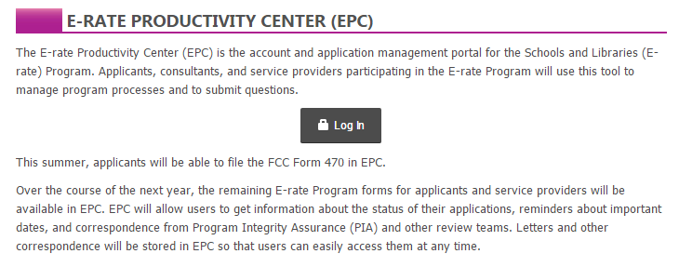
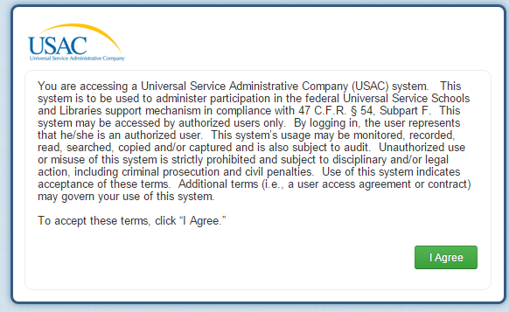
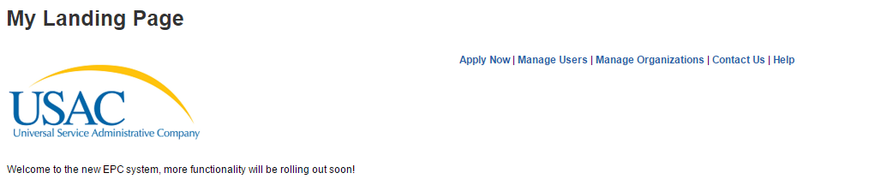
Let’s File a 470 in EPC

Slide 117
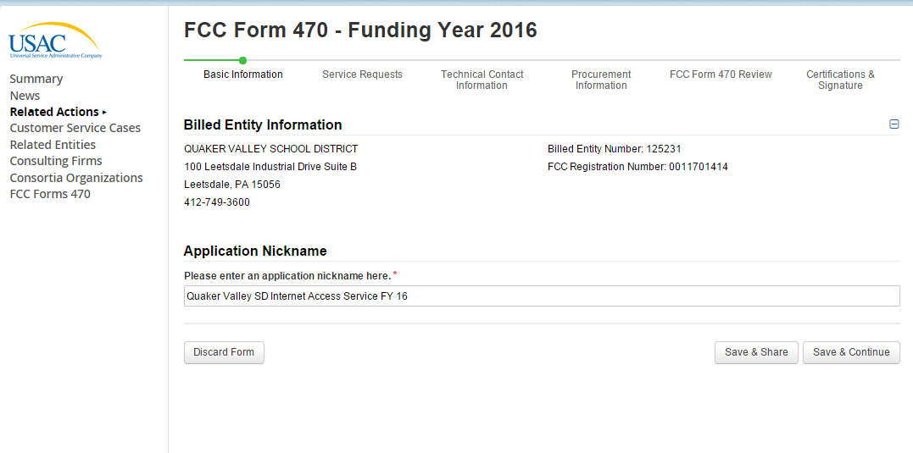
Use a well-described nickname for easier identification.

Slide 118
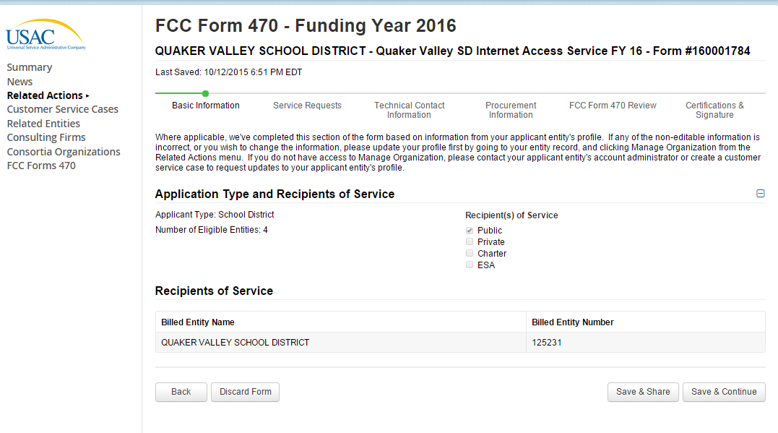
Notice the new numbering convention for the 470’s.
This is pre-populated from the EPC Profile.

Slide 119
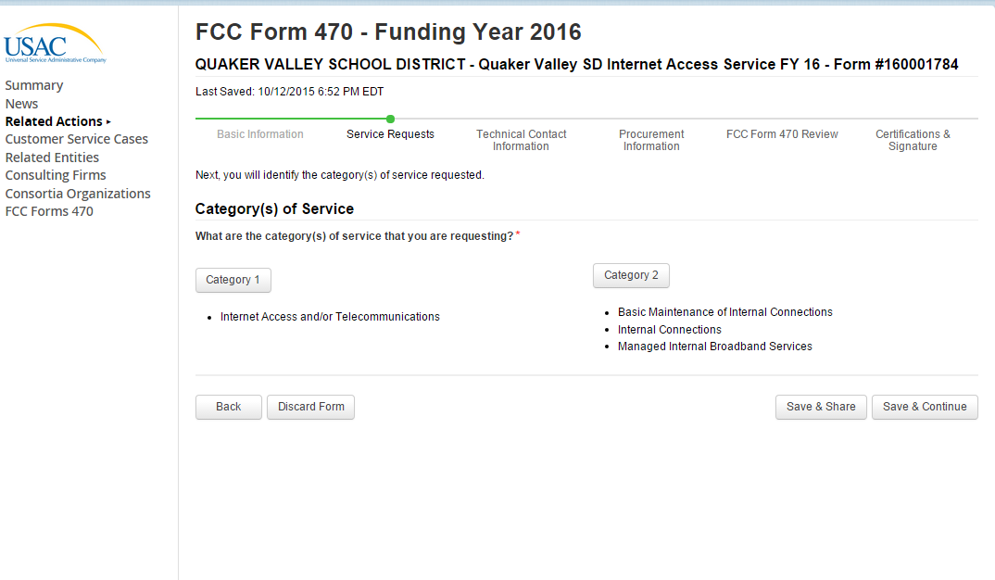

Slide 120
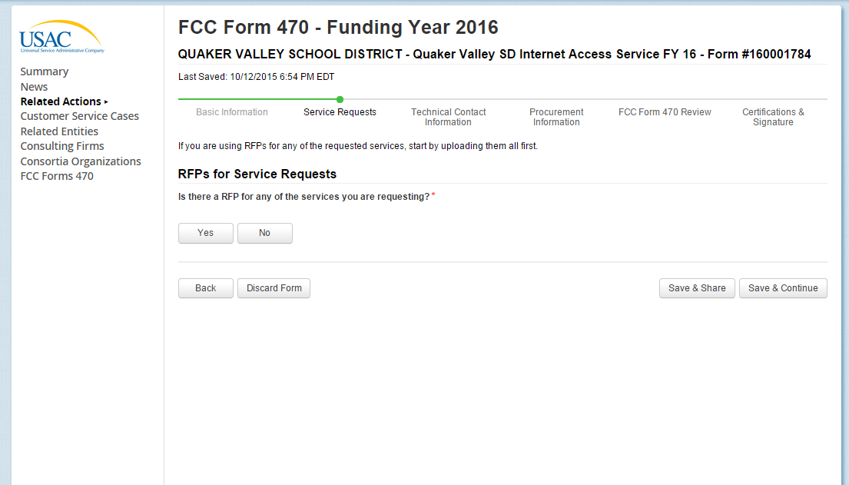

Slide 121
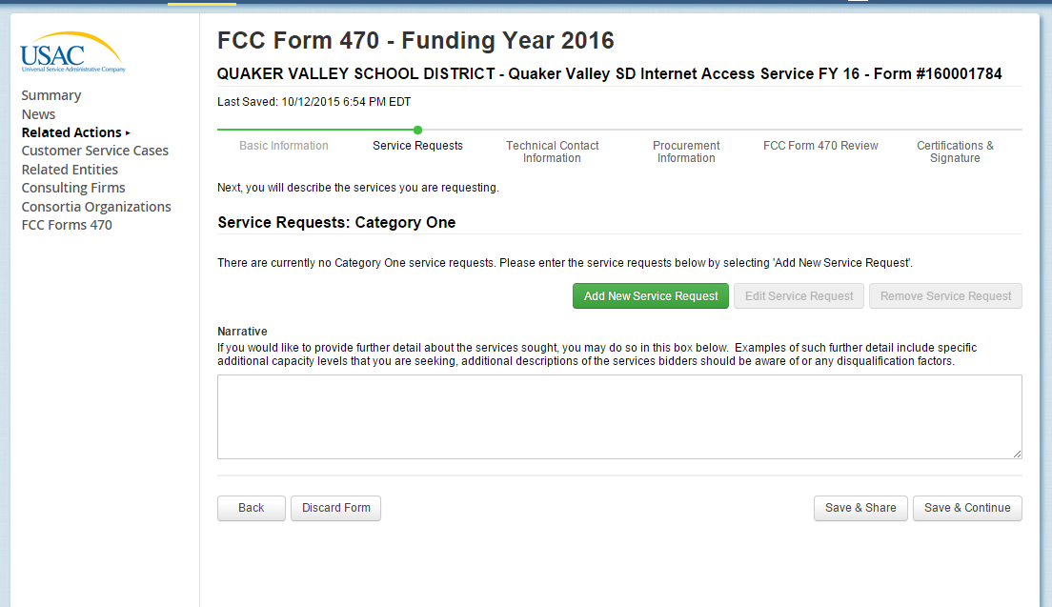

Slide 122
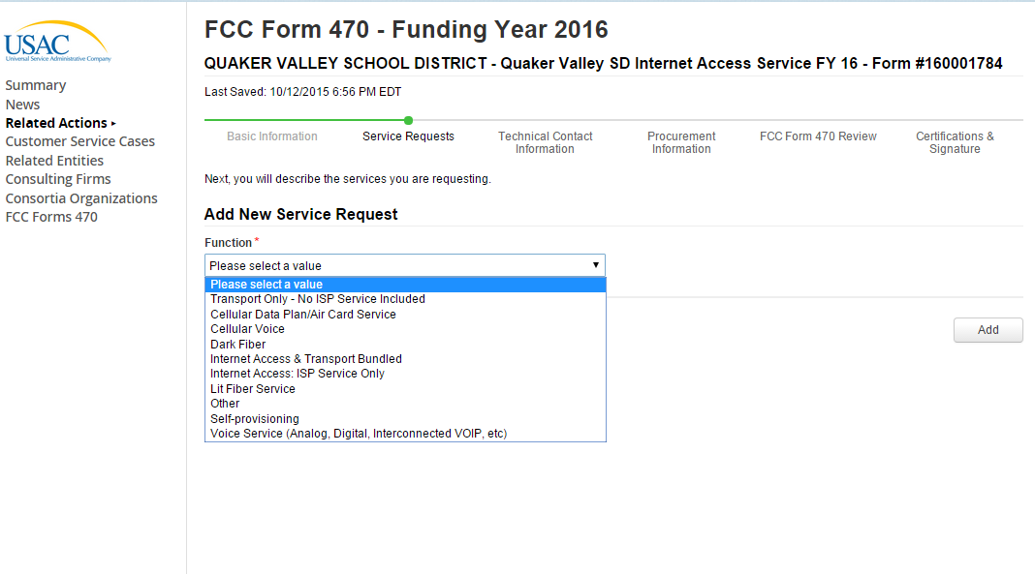

Slide 123
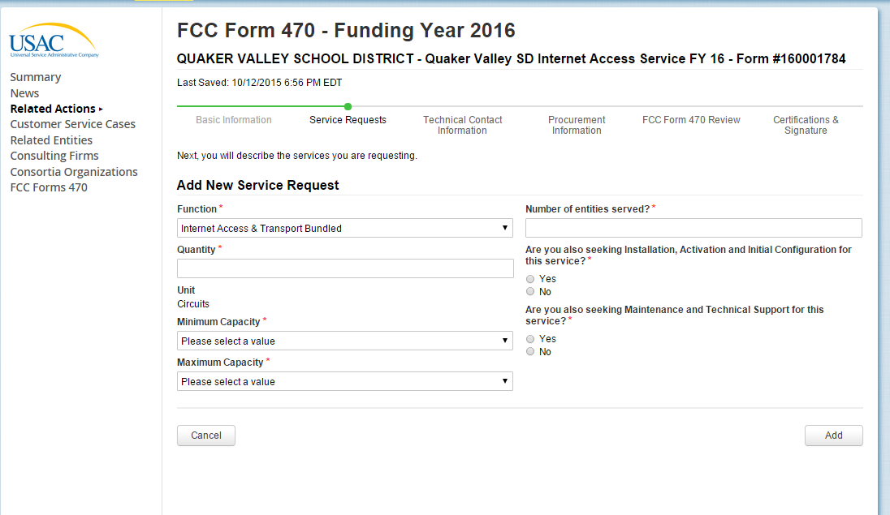

Slide 124
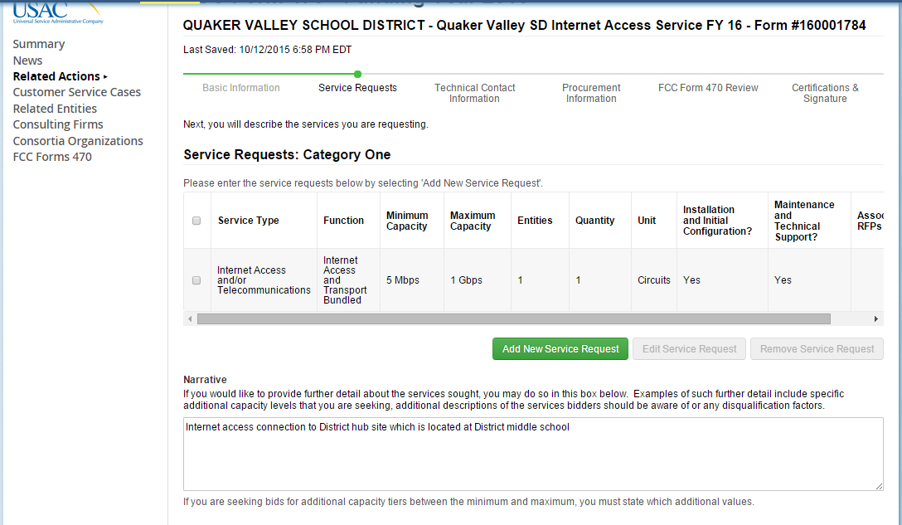
Use the narrative box to describe your services more fully. For example, if you want pricing for 50 and 100 mb of Internet, list that here.

Slide 125
Competitive Bidding*
After the Form 470 has been posted online, vendors submit proposals to the school or library
  Proposals must be accepted for a minimum of 28 calendar days, but applicants may accept proposals after this date
Vendors will contact you if they need additional information
When contacted by a vendor, you must indicate your willingness to receive a proposal for services listed on Form 470
  Do NOT say you are just going to stay with your current vendor

Slide 126
Competitive Bidding Rules
You are allowed to....
  change your mind and not purchase a service that is listed on Form 470
  have pre-Form 470 discussions with vendors as long as that doesn’t lead to one bidder having “inside” information
  attend product demonstrations
  encourage and seek vendors to bid
  do research to determine what cost-effective solutions are available
You are not allowed to...
  Have a relationship with service providers that would unfairly influence the outcome of the competition
  Furnish service providers with inside competitive information
  Provide information to only some bidders
  Have ownership interest in a service provider’s company competing for services
  Violate gifts rules

Slide 127
Competitive Bidding Rules
You are not required to...
  meet with any vendor during or after the 470 bidding period
  respond to “generic” or “spam” e-mails such as: “I saw your 470, please call me to discuss your needs”
  respond to inquiries for services you did not request
Let’s discuss: Form 470 Download/Vendor Spam Database

Slide 128
Service Providers Cannot...
Help prepare the Form 470
Help write or provide a RFP to applicant
Be a contact person on Form 470
Sign any applicant forms
Be involved with bid evaluation in any way
Provide funding for the applicant's non-discount portion or waive the applicant's non-discount portion
Coerce or pressure the applicant to use a specific service provider
Provide gifts to applicants that violate the gift restrictions

Slide 129
Service Providers Can...
Answer general questions about the products and services they sell in response to applicant inquiries
Provide information to applicants to assist with responding to USAC questions regarding their application
Provide assistance with service substitutions and other post-commitment activities

Slide 130
Questions about the Form 470, Competitive bidding or gift rules Issues?

Slide 131
Step 2: Bid Evaluation
Form 470 / Competitive Bidding
Bid Evaluation
Form 471
Application Review and FCDL
Form 486
Forms 472 (BEAR) and 474 (SPI)

Slide 132
Step 2: Bid Evaluation*
After 470 is posted for at least 28 days, billed entity must review all bids received for all services
  Keep documentation of criteria used to select vendor
  Keep all winning and losing bids
  Keep bid evaluation matrix
  Retain all correspondence between applicant and all vendors (winning and losing)
Price of eligible services/equipment MUST be the most heavily weighted factor during bid evaluation
Create Bid Evaluation Matrix*

Slide 133
Bid Evaluation
Applicants can consider other criteria besides price in bid evaluation. Examples:
  History with vendor
  Quality of proposed solution
  Cost of ineligible items
    New vendors’ cell phones
  Cost to switch vendors
  References
Cannot consider “free services”
  “I’ll give you 5 free months of service if you sign a contract with me.”

Slide 134
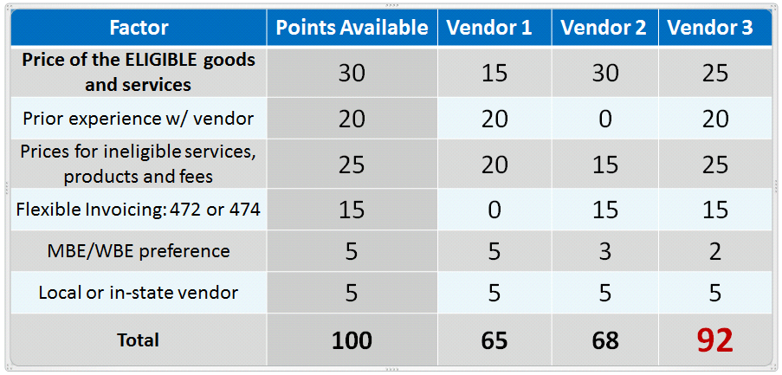
Bid Evaluation Matrix Example*

Slide 135
Received No Bids?*
Document via an email or file memo that no bids were received
Existing Services: can continue to receive services from existing service provider
New Services/Procurement: Solicit bid from willing vendor (who is not your brother-in-law)
  Make sure price is cost-effective
  Check marketplace options from other vendors in your area or nearby areas
  Save research and information to justify buying service from this vendor

Slide 136
Vendor Selection*
Vendor selection must be done before you submit Form 471
Be careful not to make any decisions, sign anything or file any forms during 28-day waiting period
Contracts must be signed and dated by applicant
  Unless receiving services on month-to-month basis
Cannot select 2 vendors to provide the same service
  USAC believes there should always be one bidder that is more ‘cost effective’ than any other

Slide 137
Vendor Selection*
List extensions and expiration date in contract (cannot be open-ended)
  For example, 3-year contract, with two 1-year renewals is ok and will not require new 470 until the end of 5 years
  3 year contract that automatically renews is not ok and will require new 470 at the end of 3 years
Include out-clauses if you can’t pay without E-rate
Have C1 contracts begin July 1 and end June 30, 20XX to coincide with E-rate funding year
Have C2 contracts begin April 1 and end September 30, 20XX to coincide with the C2 funding year allowable installation dates

Slide 138
Questions about
Bid Evaluation or Vendor Selection?

Slide 139
Step 3: Filing the Form 471
Form 486
Forms 472 (BEAR) and 474 (SPI)
Bid Evaluation
Form 470 / Competitive Bidding
Application Review and FCDL
Form 471

Slide 140
Step 3: Filing the 471
Purpose of the Form 471
  Formally requests E-rate funding commitments from USAC
  Shows discount calculations
  Shows which entities are receiving service
  Lists which 470 was used to bid services, provides contract signing dates, contract amounts, etc
  Asks detailed questions about services or equipment
Filed by entity that actually pays the bills (the billed entity)

Slide 141
When and How Many to File
471 Application Window: Likely early January – Mid March
Do NOT miss this March deadline!
Can file a single 471 for all C1 requests
  Multiple Category 1 471s are ok
  Put any cellular data plan requests on separate 471
Category 2 requests must be placed on a separate 471
  All requests can go on single 471 because all buildings have same district-wide discount

Slide 142
New Form 471 for FY 2016
Form 471 is new and must be filed in EPC
Survey questions have been eliminated
More detailed service questions
  Want to know if Internet includes circuit
  Want to know if circuit is fiber or copper based
Block 4 will automatically be pre-populated from EPC profile for each school
Contracts must be uploaded into EPC prior to completing the Form 471
Data transparency is the most important part of the new 471
Form 471 Receipt Acknowledgement Letter (RAL) will no be mailed
  Instead, it will be posted in EPC

Slide 143
New Form 471 for FY 2016
471 Window dates will be announced in December
Window expected to open early January, close mid-late March
Be sure to file your 470s in enough time to have the contracts placed on your February board meeting agendas
I will schedule a separate 471 webinar when the draft form becomes available

Slide 144
New EPC Contract Wizard Requirement
All C2 requests must have signed contracts
All contracts must be uploaded into EPC prior to completing the Form 471
  All contract related information (470 #, contract signing dates, expiration dates, vendor, spin, etc.) will be done outside of 471 in EPC
  Then just refer to that contract in the 471
  Contract can be as simple as a vendor quote that is signed by the school. Be sure to include:
    Contract signing date (must be before 471 filing date)
    Contract term: 4/1/2016 through 9/30/2017
    Purchase is contingent upon E-rate funding and local funding approval

Slide 145
Creating Contracts in EPC
Prototype - Subject to Change

Slide 146
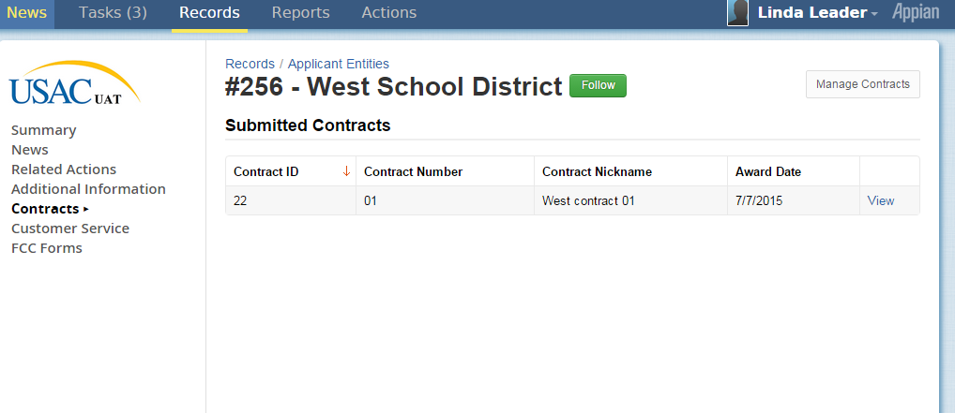
See Contracts from School District’s record

Slide 147
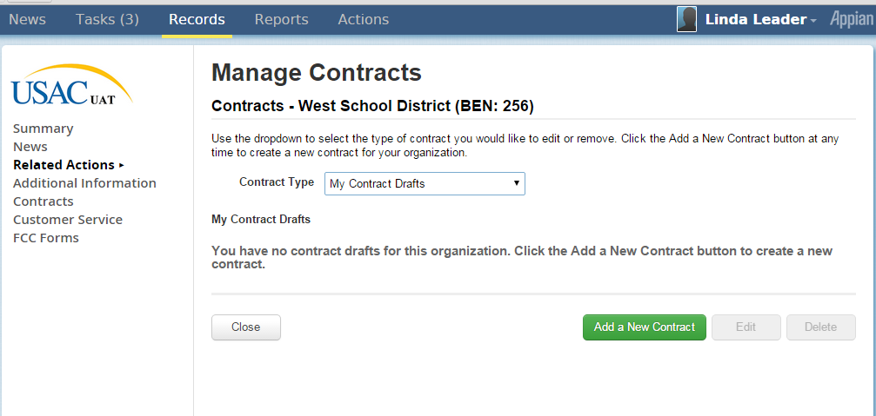
Add New Contract from Drafts

Slide 148
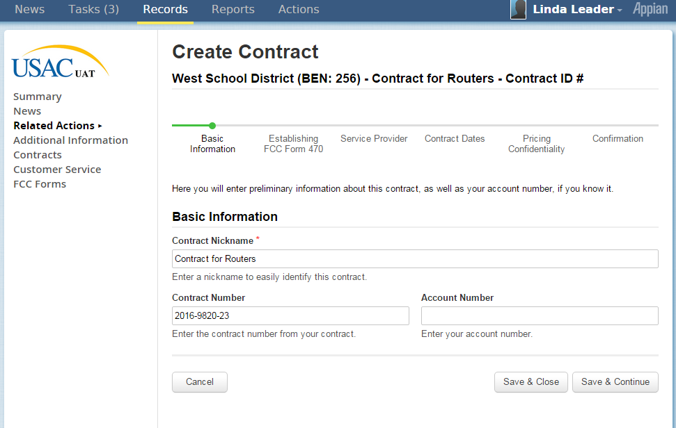
Add Basic Information about Contract

Slide 149
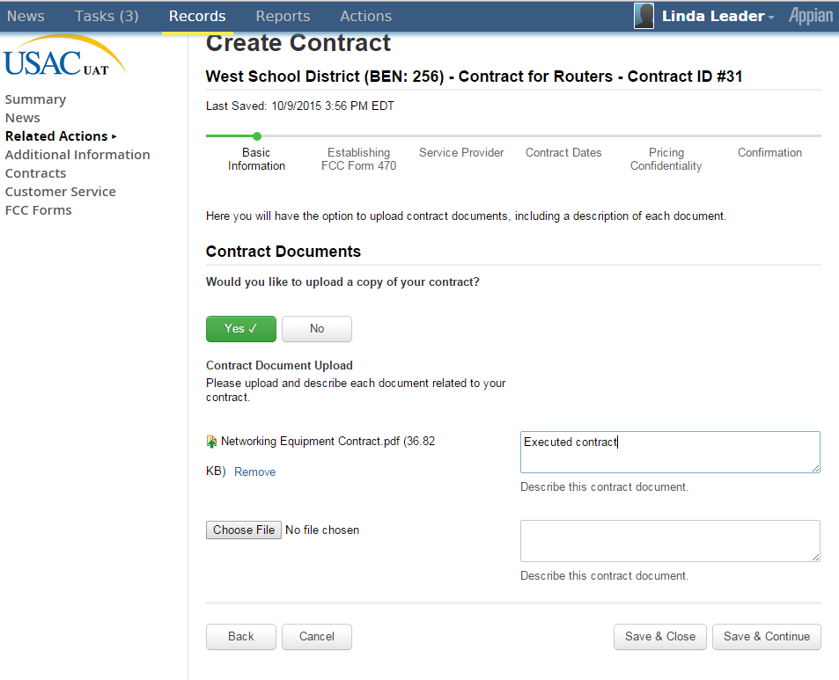
Upload Copy of Contract

Slide 150
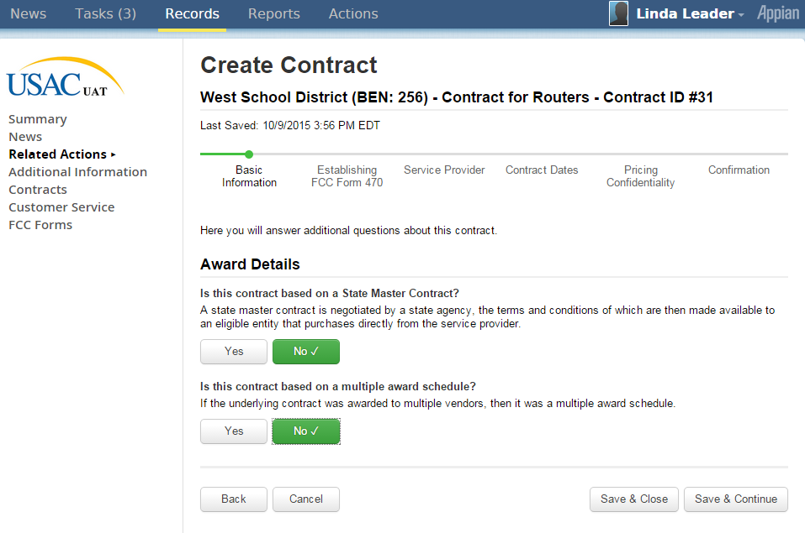
Contract Detail Questions

Slide 151
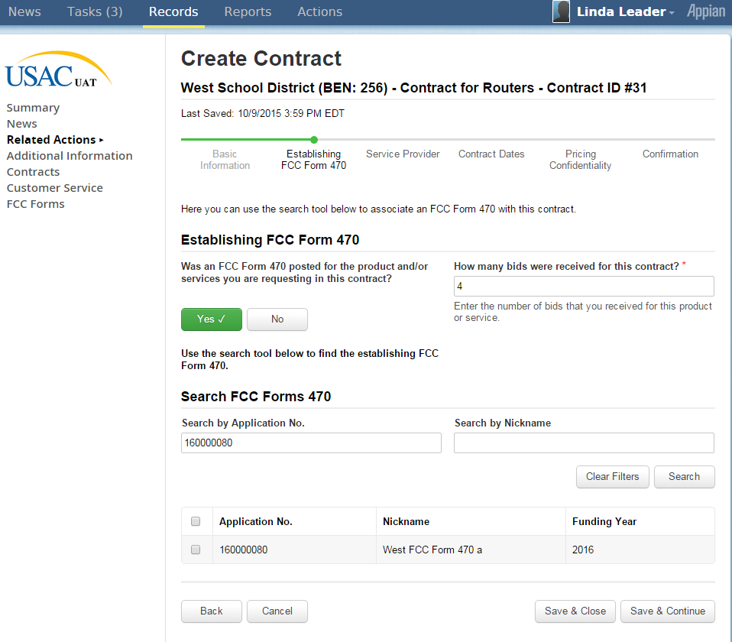
Associate FCC Form 470 with Contract

Slide 152
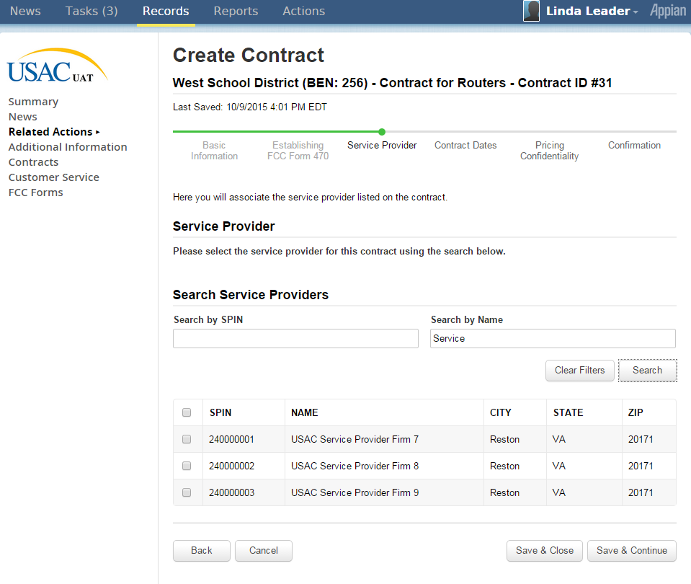
Associate Service Provider with Contract

Slide 153
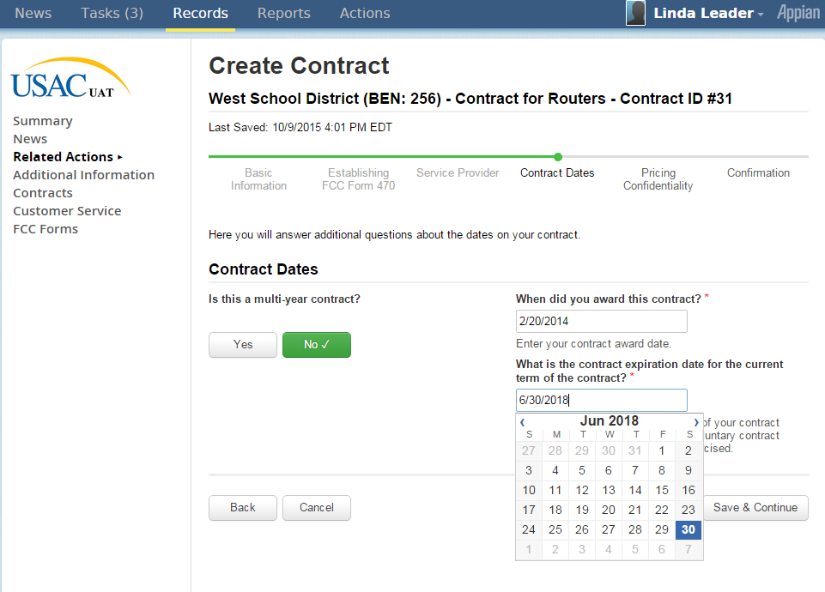
Contract Dates

Slide 154
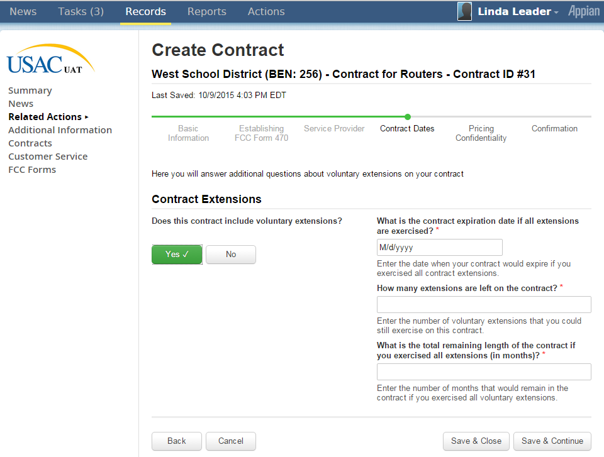
Contract Extensions

Slide 155
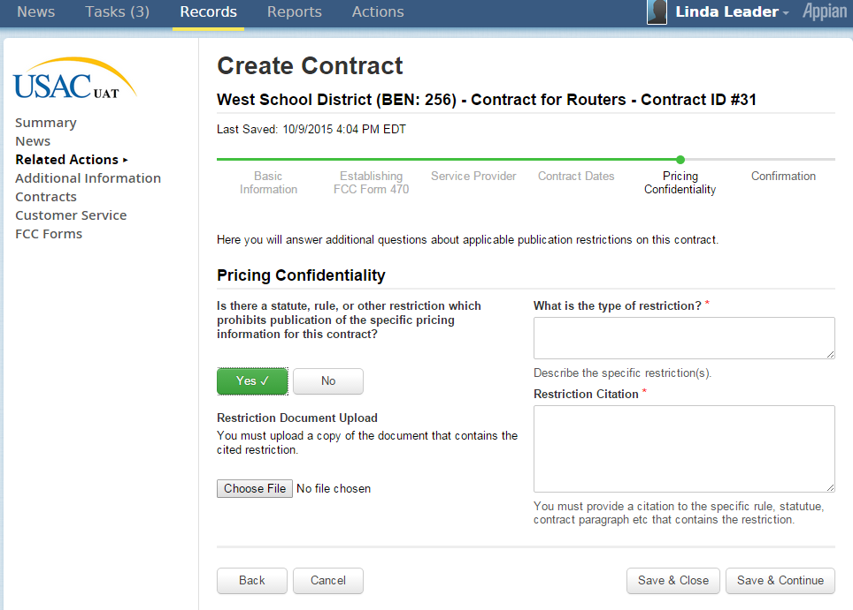
Pricing Confidentiality

Slide 156
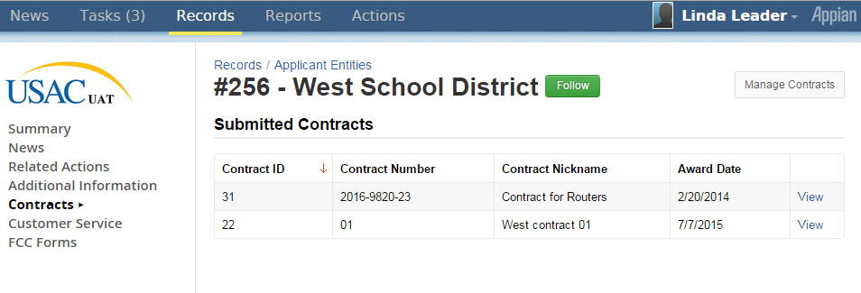
After confirmation by User, Contract Now Appears in EPC Portal Profile

Slide 157
Draft Screen Shots of New Form 471
THESE ARE LIKELY TO CHANGE AND ARE BEING PROVIDED TO SHARE THE LOOK AND FEEL OF THE NEW FORM 471 INSIDE THE EPC PORTAL

Slide 158
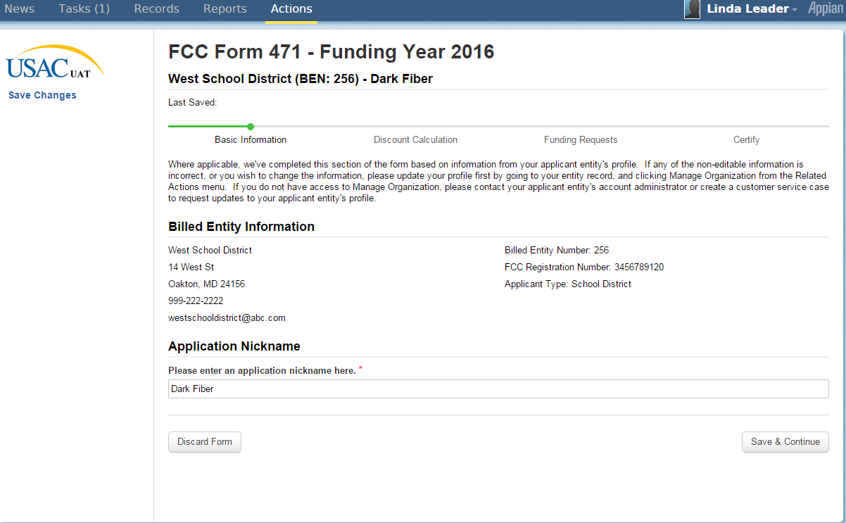
Basic Information = Old Block 1. Information is taken from EPC Profile
Create your own application nickname here.

Slide 159
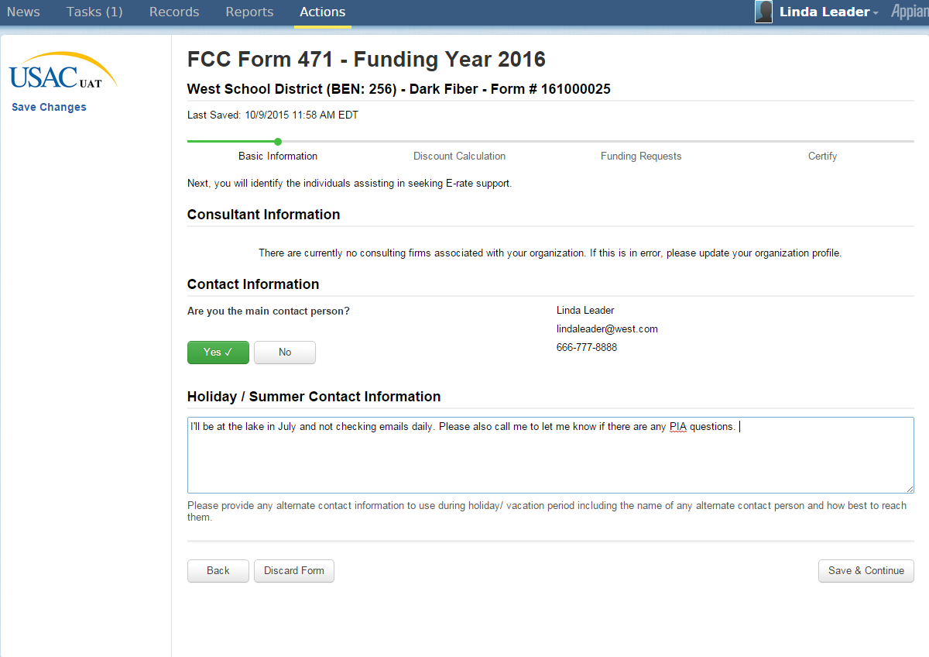
Contact Information

Slide 160
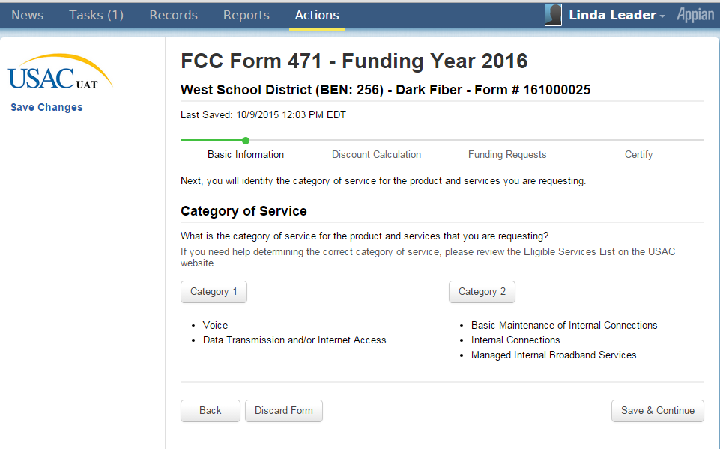
Select Category of Service (C1 or C2) – Can Only Choose One Option
471 Category 1 Example

Slide 161

Select Category of Service (C1 or C2)
471 Category 1 Example
Category 1
Category 2

Slide 162

Old Block 4 – Discount Calculations and Recipients of Service
Entities, Enrollment and NSLP information imported from EPC Portal.
If necessary, make changes and add entities in EPC portal.
All of this information is “hard coded” from EPC.

Slide 163

Detailed Student Count/NSLP information

Slide 164

Old Block 5 – Funding Request. First task is to assign a nickname to the FRN.
Nickname link (hard to read)

Slide 165

Nickname and Service Type Selection
Choices here are either:
Data Transmission and/or Internet Access OR
Voice Service

Slide 166

NEW – Associate a Contract. If contract information is uploaded in EPC Portal, select from there. If not, go to EPC Portal and input information
See Separate Slides on EPC Contract Wizard
Associate a Contract

Slide 167

Detailed Contract Information for FRN

Slide 168

Narrative Explanation of FRN
Text Box for you to enter description about FRN.

Slide 169

Revised Questions to Ask About Purpose of C1 FRNs

Slide 170

Specific Information about each Line Item (similar to FY 2015 Form 471)

Slide 171

Firewall Protection Question / Questions about whether Connection is Directly to a Building or Supports Service to a Building

Slide 172

Old Block 5 – Price Information for each FRN Line Item
Note that the Form asks for Total Costs & Ineligible Costs.
Eligible Monthly Cost is a computed value – similar to FY 2014 and prior years)

Slide 173

Completed FRN Calculations

Slide 174

Manage Recipients – Identify Recipients of Service for Each Line Item

Slide 175

471 Category 2 Example
Note that the Nickname given to the 471 is “Routers”

Slide 176

Select Category 2 Type of Application
Hard to read: Button says Category 2

Slide 177

Old Block 4 – Discount Calculations and Recipients of Service
Like Category 1, Entities, NSLP and Enrollment is imported from EPC
Make data corrections, revisions and additions in EPC

Slide 178

Funding Request – Old Block 5
Assign a FRN Nickname

Slide 179

FRN Nickname and Service Type for C2 FRN

Slide 180

NEW – Associate a Contract. If contract information is uploaded in EPC Portal, select from there. If not, go to EPC Portal and input information

Slide 181

Narrative Description of C2 FRN

Slide 182

Old Block 5 – Item 21 Details per Line Item
Type of Internal Connection / Type of Product / Quantity / Make Model / Leased? Y/N

Slide 183

Error Messaging When Fields are Left Blank

Slide 184

Old Block 5 – Price Information for each FRN Line Item

Slide 185

Block 5 – Link Line Item to Recipients of Service

Slide 186

Manage Entities when Less Than All Entities Receive Service -
Costs Shared Equally Among Entities

Slide 187

Cost Allocation for Single School (formerly known as “Manage Entities”)

Slide 188

Single FRN Line Item Completed
Could add more FRN line items by clicking Add New FRN Line Item

Slide 189

Completed FRN
Can add new FRN (Add Funding Request) or Continue to Certification

Slide 190

Tasks Toolbar - Where to Re-Start Incomplete Form to finish

Slide 191

471 Certification

Slide 192

Once all of the Certification boxes are checked, click Certify to Submit/Certify Form

Slide 193

Certification Confirmation Screen after Clicking Certify

Slide 194

471 RAL Appears in News Feed

Slide 195
M/C Error Examples
Using wrong Form 470 number or wrong billed entity number
Using wrong name or service provider identification number (SPIN)
Using wrong expiration date for a contract
Requesting recurring service when the service is one time charge
Requesting one time service when the service is recurring
Inaccurately reporting the prediscount amount on Block 5
Leaving off a building from Block 4
Referring to wrong Block 4 worksheet for a funding request
Listing wrong service category in Block 5
Simple math errors
Failing to enter an item from the source list (e.g., NSLP data, uploading Block 4 data, FRN, etc.)

Slide 196
Requesting a M&C Correction
PIA will ask if this is a ministerial/clerical error
  Explain how the error occurred
  Provide a reasonable explanation
  Provide documentation that was in existence as of the date of submission of Form 470 or Form 471
Explain that the error occurred when consulting “source list”
PIA must approve the explanation before the change will be made

Slide 197
Questions on Form 471, Item 21, M/C Errors?

Slide 198
Step 4: Application Review
Form 486
Forms 472 (BEAR) and 474 (SPI)
Bid Evaluation
Form 470 / Competitive Bidding
Application Review and FCDL
Form 471

Slide 199
Step 4: PIA Review
Program Integrity Assurance (PIA) Review
Checks for rule compliance
  eligible services
  eligible entities
  appropriate discount
Most applicants receive a PIA contact
  Applicants have 15 days to respond
  FY 2016 may have more streamlined reviews
If they are going to deny an FRN, they will tell you so and give you 1 more chance to submit new information
Ask Julie if you are unsure of your answers
Check application status on SLD website
  May be in EPC?

Slide 200
Next: SLD Issues FCDL*
FCDL = Funding Commitment Decision Letter
Tells you which funding requests of Form 471 are approved or denied
Will only be available in EPC Portal
  Notice will come via e-mail to check EPC
Provides information for the next form - Form 486
Can appeal within 60 days if you don’t agree with your decision*
  Appeal to SLD if they made an error
    Can then appeal to the FCC if USAC denies
  Appeal to FCC for waivers and policy issues
Watch PA E-rate listserve for weekly wave notices!

Slide 201
Step 5: Filing the Form 486
Form 486
Forms 472 (BEAR) and 474 (SPI)
Bid Evaluation
Form 470 / Competitive Bidding
Application Review and FCDL
Form 471

Slide 202
Step 5: Filing the Form 486*
Purpose of Form
  Signifies that it’s OK for SLD to pay any invoices for that FRN
  Certifies CIPA compliance
Deadline: Must be postmarked no later than:
  120 calendar days after the Service Start Date featured on the Form 486 or
  120 calendar days after the date of the Funding Commitment Decision Letter
whichever is later.
For FY 2016, submit in EPC
  Use 07/01/2016 as service start date for FY 2016 (Year 19)
USAC then issues Form 486 Approval Letter to vendor and applicant (in EPC for FY 2016)

Slide 203
CIPA Requirements
Any school or library receiving either Internal connections or Internet access must...
Filter all Internet access
Have an Internet Safety Policy that addresses required elements
  Policy must have been adopted after public hearing
Recipients only receiving telecommunications services are exempt from E-rate CIPA compliance
Consortium members submit Form 479 to consortium leader certifying compliance in order for consortium lead to submit Form 486

Slide 204
CIPA Requirements
Effective 7/1/2012:
Schools’ (not libraries) Internet Safety Policies must include "... educating minors about appropriate online behavior, including interacting with other individuals on social networking websites and in chat rooms and cyberbullying awareness and response."
This means that schools are required to teach online safety to students as a prerequisite to receiving E-rate funding
Local boards determine delivery of online safety/cyberbullying education
  Can’t be once every 3 years
Establish policy, follow policy and document implementation

Slide 205
CIPA Documentation
Notice of public hearing or public meeting (such as school board meeting) where CIPA policy was considered
  Agenda for meeting – show opportunity for public input/comment before adoption of CIPA policy
  Other documentation for opportunity for public comment
Filtering records, purchase order
Documentation of cyberbullying/appropriate online behavior education for all minors

Slide 206
Questions on PIA Review, FCDLs, Form 486, CIPA?

Slide 207
Step 6: Getting Paid!
Form 486
Forms 472 (BEAR) and 474 (SPI)
Bid Evaluation
Form 470 / Competitive Bidding
Application Review and FCDL
Form 471

Slide 208
How and When Do You Actually Receive E-rate Funding?!
Applicant has a choice
  Discounts on bills (vendor invoices USAC)
  or
  Reimbursement process (applicant pays bills in full, then invoices USAC)
Must select one or the other for entire year
If you want discounted bills, call provider and file Form 486 as soon as you are funded
  Vendors sometimes have additional forms to complete to proceed with discounted bills

Slide 209
Discounted Billing Method
Discounts appear on applicant’s bill
Service provider submits Form 474 to USAC after providing discounted bill
  the Service Provider Invoice Form (SPIF)
Providers usually get reimbursed by USAC within 30 days from date of submission
Applicants do nothing except make sure they are receiving the discounts they deserve on bills
  Do the math!

Slide 210
Reimbursement Method - BEAR
Applicant pays bill in full
Applicant submits Form 472 – BEAR Form for reimbursement*
  Quarterly, semi-annually, or at end of year
  Complete one BEAR for each SPIN
Calculated based on eligible charges on actual bills
  Not AP register or amount committed
  Subtract ineligible charges
Deadline:
  October 28 (following close of funding year) for recurring services;
  January 28 for non-recurring services/equipment
  Can request 1 extension if submitted by original invoice deadline

Slide 211
Reimbursement Method - BEAR
CURRENT PROCESS (through 7/1/2016)
SLD approves BEAR and sends approval letter to vendor and copy of letter to applicant
SLD then sends check to vendor
Vendor must send check to applicant within 20 business days of date on BEAR approval letter
Call SLD if you don’t get a check in a timely manner after receiving approval letter

Slide 212
Online and Paper BEARs*
Online (preferred):
  Applicant and Vendor must have PINs to file online BEARs
  Applicant completes BEAR Online
  BEAR is electronically sent to vendor
  Vendor certifies or denies
  If approved, applicant receives e-mail and BEAR is automatically sent to USAC for payment
  If denied, applicant receives e-mail and must refile the BEAR from scratch
Paper
  Applicant completes pages 1 – 4 and faxes to vendor
  Vendor signs page 4 and returns to applicant
  Applicant mails pages 1-4 to USAC
  Applicant must include check remittance information on page 4

Slide 213
Direct BEAR Reimbursement Payments
NEW PROCESS (Beginning 7/1/2016)
Applicants using the BEAR process will submit BEARs directly to USAC without service provider approval
USAC will send funds directly to applicants (will not pass through the service providers)
All reimbursements from USAC will be made using electronic funds transfer (EFT)
Applicants will need to provide bank account information to USAC in order set up EFT arrangements
  This will be done by completing the Form 498 in EPC, beginning in January
  Must be done by an school or library official – details coming

Slide 214
Direct BEAR Payments
When completing the Form 498 in EPC Portal, the school or library “official” will need entity’s EIN number and DUNs Number
  Most entities already have DUNs Number
  You can search for your organization, by name, through D&B’s online D-U-N-S database: https://iupdate.dnb.com/iUpdate/companylookup.html or call (866) 705-5711 to speak to a representative
  If your organization does not have one, you can apply online through Dun & Bradstreet’s website: http://www.dnb.com/get-a-duns-number.html

Slide 215
Ineligible Charges on Bills
When determining the amount to list on a BEAR, create a quick spreadsheet showing each month’s total charges, and total ineligible charges
What are the ineligible charges?
  Varies by vendor, but these are known to be ineligible:
  Universal Service Administrative Fee
    USF fees themselves ARE eligible
  Late payment or finance charges
  USF Cost Recovery Fees, Property Tax Fees
  Paper statement fees
  Equipment charges (on P1 bills)
  Directory listing fees, non-published phone number fees
  Payphone service
Here’s an example of what your spreadsheet may look like:

Slide 216
Verizon Account: | 215-235-1232 | Ineligible Directory Listing Fee | Total Eligible Charges
July | $200.10 | $2.75 | $197.35
Aug | $200.20 | $2.75 | $197.45
Sept | $200.30 | $2.75 | $197.55
Oct | $200.20 | $2.75 | $197.45
Nov | $201.30 | $2.75 | $198.55
Dec | $203.30 | $2.75 | $200.55
Jan | $202.20 | $2.75 | $199.45
Feb | $201.30 | $2.75 | $198.55
Mar | $200.30 | $2.75 | $197.55
Apr | $203.20 | $2.75 | $200.45
May | $200.10 | $2.75 | $197.35
June | $203.50 | $2.75 | $200.75
Total Charges | $2,416.00 | $33.00 | $2,383.00
Ineligible Charges | $33.00
Eligible Charges | $2,383.00
E-rate Discount | 65%
E-rate Reimb. | $1,548.95

Slide 217
New Strict Invoicing Deadlines
Only one 120 day invoice deadline extension will be granted if the request is made on or before the original invoice deadline (which is typically October 28 following the funding year)
Late invoice deadline extension requests will not be granted by USAC
Requests for extensions made after invoice deadline must be requested via a waiver request to the FCC
  FCC will only grant requests where applicants can prove truly extraordinary circumstances to justify a waiver

Slide 218

The Form 472 BEAR
http://www.sl.universalservice.org/menu.asp

Slide 219
Quarterly Disbursement Reports
Sent only to applicants
  Authorized person
  Billed Entity (BEN) address
Contains all invoice (Form 472 and Form 474) payment authorization amounts for the Billed Entity approved during that quarter for all funding years
Review to ensure you agree with disbursements

Slide 220
Optional Form 500*
File Form 500 to either:
  Change a service start date or a contract expiration date
  Cancel or reduce a funding commitment
  Notify USAC of equipment transfer (new)
  Request service delivery deadline extension (new)
Warning: reductions or cancellations of funding commitments are irreversible
Not required, but strongly suggested to file Form 500 if FRN not needed, large amount of commitment is not used, and to recoup unused C2 funding for another year

Slide 221
Questions on Form 472 Reimbursements, Discounted Billing, Form 500?

Slide 222
FY 2016 (Year 19) Coming Soon!
There is no color for FY 2016 because everything will be in EPC!
For services rendered 7/1/2016 - 6/30/2017
471 application window dates will be announced in December
Expected to:
  OPEN early January 2016
  CLOSE mid- late March 2016
Form 470’s being accepted now!

Slide 223
FY 2015 (Year 18) Details
For services rendered 7/1/2015 - 6/30/16
  FY 2015 is YELLOW
92% of PA FRNs funded as of 11/7/2015
File the 486 after FCDL arrives
Request discounted bills from vendors, if desired
Is your Form 486 due? Check the list!

Slide 224
FY 2014 (Year 17) Not Over Yet!
Funding Year ended June 30, 2014 for recurring services
  FY 2014 was BLUE
Deadline for submitting BEARs (Form 472s) was October 28, 2015
Deadline for submitting invoices for non-recurring services is January 28, 2016
Do you have funding remaining? Check the list!
File for waiver request to FCC if you haven’t submitted your BEAR and have extraordinary circumstances
  Ask Julie for sample waiver request, if needed

Slide 225
Questions about Funding Years and What’s Due When?

Slide 226
But wait!
There’s more!

Slide 227
Changing Service Providers*
Two types of SPIN changes:
Corrective: Mostly for data-entry errors
  Can be done pre-and post-commitment
Operational: When actually switching vendors
  Can only be done post commitment and for legitimate reason
Can request to split an FRN*
  Allocate $ to 2 providers in same funding year
  Don’t forget to file 486 for new FRN

Slide 228
Allowable SPIN Changes
Can no longer switch vendors because of lower price
  Some vendors were abusing lax SPIN change rules and not bothering to participate in 470 bidding process
Legitimate reasons include:
  Breach of contract
  Service provider is unable to perform
  Bankruptcy
  Delayed provision of new service
Must select vendor that received the next highest point value in the original bid evaluation, assuming there was more than one bidder
  USAC will require you to submit bid evaluation as proof

Slide 229

E-Certification/PINs*
FOR ALL FORMS PRIOR TO FY 2016:
E-rate PINs can be used to file E-rate forms online
PIN assigned to a person and is specific to that entity while employed at that entity
  Not given to an entity
No way to request a PIN
Must sign a paper certification of a 470, 471 or 486
  SLD will mail them a PIN in a small white mailer
  Can still submit these forms online, but cert page must be signed and mailed to USAC
PIN then may be used to 470, 471, 486, and BEAR Forms

Slide 230
EPC Username/Passwords
FOR ALL FY 2016 FORMS:
All FY 2016 forms will be filed in EPC
Old E-rate PIN system is becoming obsolete
Replaced by EPC Username (e-mail) and Password

Slide 231
Paying Your Share
Applicants are required to pay non-discounted portion of cost
Cannot be waived by the vendor
Vendor cannot provide a “grant”
Funding must be in budget or draft budget
Must keep all invoices and copies of cancelled checks for 10 years after last day to receive service

Slide 232
Can You Request Extensions?
Depends on the form and requirement
  Form 470 – no
  Form 471 – no
  Form 486 – no
    but they will send a reminder letter and you can then file if you missed the original deadline
  Form 472 BEAR – yes
  Service delivery – recurring services – no
    Services must be delivered between July 1 – June 30
  Service delivery – non-recurring services – yes
    Installations and equipment purchases have until Sept 30
    If applicant needs more time, they must request extension prior to Sept 30
  PIA inquiries – conditional

Slide 233
Appeals*
All appeals, except for requests of waiver of FCC rules, must first be filed with USAC
Requests for rule waivers should continue to be filed directly with the FCC because USAC does not have authority to waive FCC rules
Considered a streamlining measure because there will be fewer appeals submitted to the FCC and shorter wait time to receive appeal decision
  USAC metric is to process 90% of appeals within 90 days

Slide 234
Data Retrieval Tool*
Most data on SLD website, using DRT
Download by state, by SPIN, by entity, etc
Updated nightly
Shows:
  Entity info / 471# / FRN # / 470 # / SPIN
  Whether FRN funded
  Whether 486 was submitted
  Last date to invoice
  Original requested amount & committed amount
  Discount
  Invoice paid and by what mode
  etc.
E-rate Central Database Tool*

Slide 235
What Should Always
Be On Your Mind?

Slide 236
Document Retention*
The document retention requirement has been expanded from 5 years to 10 years from the last date to receive service or service delivery deadline, whichever is later
For multi-year contracts, contract documentation and bids must be kept from 10 years from the last date of service under the contract
Amend E-rate document retention policy
Alert business office that vendor bills must be kept for 10 years from the end of the funding year
Electronic records storage is permissible

Slide 237
Documents to Retain*
Tech plan and approval letter
Consultant agreements
RFP and proof of publication date
All vendor correspondence
Winning and losing bids
Professional development records
Bid evaluation documentation
Proof of authorization to sign E-rate forms
Filtering records and payments
NSLP forms
AUP and proof of public meeting
Proof of online safety training
Signed contracts
NSLP documentation
Budgets
Purchase orders
Packing slips
Asset or inventory records
Installation records
All Invoices
Front and back of checks as proof of payment to vendor (non-discounted share)
Proof of receipt of payment from vendor (BEAR checks)

Slide 238
E-rate Help
SLD
  Client Service Bureau (CSB)
    E-rate “Help Desk” where applicant & service providers can get answers to questions
    Accessed via 888-203-8100
  Submit a ‘Customer Service Case’ on SLD website
PA E-rate Coordinator
  E-mail jtschell@comcast.net
  www.e-ratepa.org

Slide 239
Questions?

