Slide 1
E-rate Training Workshop for Veteran PA Applicants What’s New for FY 2016
Presented by Julie Tritt Schell
PA E-rate Coordinator
for the Pennsylvania Department of Education
October 2015

Slide 2
Let’s Recap What Changed in FY 2015
Note: The slides related to the FY 2015 changes have been moved to the end of this presentation.
Discount calculations
District-wide NSLP eligibility calculations
Community Eligibility Program (CEP) 1.6 multiplier provision
Rural/Urban definition changes
Category 1
Phase out of voice (40% discount reduction for FY 2016)
Elimination of webhosting, paging, hosted e-mail, DIDs and custom calling features, and most cellular data
Category 2
Elimination of voice/video equipment and most servers
Addition of cloud functionality and Managed Internal Broadband Service (MIBS)
Category 2 building 5-year funding caps
Maximum discount reduced from 90% to 85%
Early purchase of C2 equipment (as of April 1 prior to funding year)
Expanded document retention requirements (now 10 years)
Strict new invoicing deadlines
Must submit BEARs or extension requests before October 28

Slide 3
What’s New for FY 2016?

Slide 4
Direct BEAR Reimbursement Payments
Beginning July 1, 2016, applicants using the BEAR process will submit BEARs directly to USAC without service provider approval
USAC will send funds directly to applicants (will not pass through the service providers)
All reimbursements from USAC will be made using electronic funds transfer (EFT)
Applicants will need to provide bank account information to USAC in order set up EFT arrangements
This will be done by completing the Form 498 in EPC, beginning in January
Must be done by an school or library official – details coming

Slide 5
Direct BEAR Payments
When completing the Form 498 in EPC Portal, the school or library “official” will need entity’s EIN number and DUNs Number
Most entities already have DUNs Number
You can search for your organization, by name, through D&B’s online D-U-N-S database: https://iupdate.dnb.com/iUpdate/companylookup.html or call (866) 705-5711 to speak to a representative
If your organization does not have one, you can apply online through Dun & Bradstreet’s website: http://www.dnb.com/get-a-duns-number.html

Slide 6
Dark Fiber Eligibility Changes
E-rate eligibility for leased lit fiber and dark fiber equalized this year
“Dark Fiber” is unlit fiber that is leased from a vendor
Applicant must install the modulating electronics and light the fiber
Modulating electronics and equipment necessary to make the dark fiber service functional are now eligible to be purchased with Category 1 funds
Special construction charges for dark fiber may include the costs of installing fiber from the service provider’s network all the way into the applicant’s building
Previously only cost of installing from curb into building was eligible

Slide 7
Construction and Ownership of Fiber - New
Commonly referred to as “self construction” or Build Your Own WAN (BYOW)
A RFP must be issued along with posting a Form 470
Applicants must solicit bids for both lit fiber, dark fiber service and construction in the same Form 470
If an applicant previously posted a Form 470 for lit or dark services and did not receive any bids, then the applicant is only required to bid self-provisioning
Bidding period must be longer than 28 days – recommended to be 6 weeks
If construction and ownership of dark fiber facilities is found to be most cost-effective, this option is new for E-rate funding in FY 2016
Cost effectiveness must be evaluated over the entire life cycle of the facilities and must include all related costs of service and total cost of ownership

Slide 8
Special Construction Charges
One time charges incurred for installation of new service
Special Construction includes:
Construction of network facilities
design and engineering
project management
Policy is suspended of requiring charges > $500,000 to be amortized over 3 years
Can be paid by E-rate in Year 1
Applicants are allowed to ask vendors for up to a 4 year payment plan for the non-discounted share of these costs
Provision included on the new Form 470

Slide 9
What’s New for 2016?
E-rate Productivity Center

Slide 10
What is EPC?
EPC = E-rate Productivity Center
New account and application management portal
Over the next 10 months, all E-rate forms, letters and interactions will phased in to the EPC Portal system
Advantages?
All forms, submitted documentation and requests will be archived in a single location
Forms will be pre-populated with information
Lots of data will be entered into EPC prior to filing the application
Supposed to provide streamlined reviews
You MUST be in EPC to apply for E-rate

Slide 11
Establishing Your Initial EPC Account
USAC created an EPC account in their database for each applicant entity and identified an Account Administrator
The AA can perform these functions:
Create Users
Assign Users’ Rights/Permissions
Change AA to another user
Join Consortia
Link to Your Consultant
Enter Enrollment/NSLP Data*
As of last week, ‘full and partial rights users’ also are able to perform some of these functions (*)

Slide 12
Who is the Account Administrator?
USAC initially established each applicant’s AA as the person who signed the FY 2015 Form 471
unless it was a consultant
In July, each AA received an e-mail from USAC indicating that their EPC Account had been created (in the backend) and that they should establish their password
If you are the AA and did not receive this e-mail, contact CSB at 888-203-8100 to have AA account set up in their system

Slide 13
How to Change the AA to Someone Else
Three methods:
If the current AA has set up their password, they can log-in to the system and change AA authority to another User
If the current AA has not yet set up their password, the AA can send an e-mail to SLDPR@GDIT.com requesting that the AA be changed to another person
Must provide full contact information for new AA
If the current AA is no longer with the organization, the new AA can send an e-mail to SLDPR@GDIT.com requesting that they be designated the new AA
Be sure to explain that the original AA is gone
Must provide full contact information for new AA
For 2 and 3, the new AA will then receive an e-mail from EPC inviting them to establish their EPC password

Slide 14
Setting Up Your EPC Account
Click on District Name (first entity on the list)
Then > Related Actions on left toolbar
Perform these functions using > Related Actions
Establish other users and giving them permissions (if any)
Be sure those users then establish their passwords, and accept their terms and conditions
Review your school list to make sure all buildings are listed
Add your NIFs by creating a customer service case with USAC
Ensure that the addresses are accurate for each building, as well as the “profile” information for each school
Join a consortium, if applicable
Link to a consultant, if applicable
Update your enrollment/NSLP data
May want to wait until the PDE data comes out in January
NSLP data should already be in your portal from FY 2015

Slide 15
Questions about EPC?
If you’re unsure if your account has been established, or run into problems...
Call USAC at 888-203-8100
They are the only entity that can troubleshoot EPC problems
USAC’s EPC Website: www.usac.org/sl
Contains FAQs
User Guides
Video Tutorials
PA EPC presentation will be posted to the PA E-rate website soon...

Slide 16
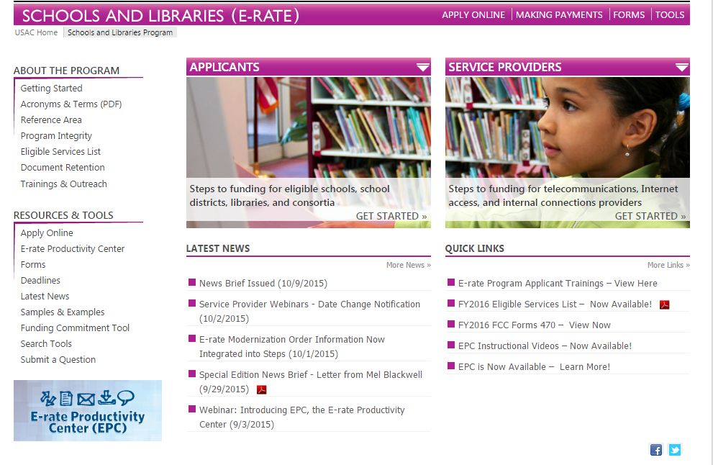
Accessing EPC...

Slide 17
New Form 470 for FY 2016
Form 470 is new and must be filed in EPC
Much simpler than previous years
Much of “profile/contact” information is ported from EPC profile
EPC Full Rights Users can create/submit form
Partial Rights Users can create but must have FRU submit the form
Form 470s being accepted now!
Try to post by Thanksgiving
PA Form 470 training on Wed., Nov 18
Form 470 Receipt Notification Letter will no be mailed
Instead, a notice of the 470 posting will appear in your EPC Newsfeed

Slide 18
Describing Services and Equipment
New Form 470 has drop down service/equipment menu
Must specific minimum and maximum quantity
Provide additional information in narrative box

Slide 19
Requests for Proposal
New requirement to upload RFP, if one is being issued
In fact, must upload before describing the service
Can’t come back and upload at the end of the form
If addenda are issued, they also must be uploaded to the 470, post submission using the Related Actions link in the left toolbar
E-rate defines a Request for Proposal as any supplemental documentation that an Applicant shares with Vendors in addition to posting a Form 470 (no matter what its called)
E-rate does not mandate the use of a RFP except for dark fiber or construction of fiber procurements

Slide 20
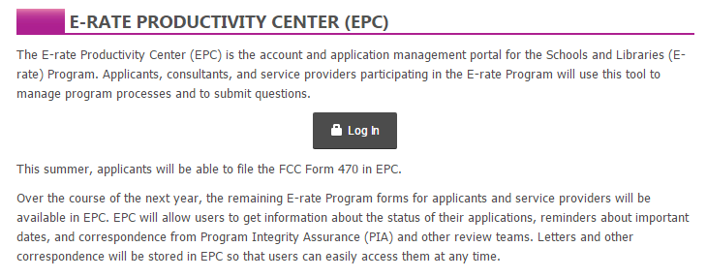
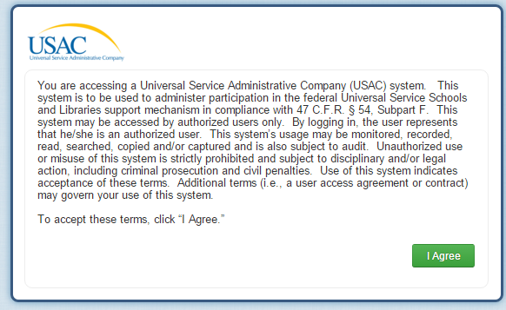
470 – File Inside Your EPC Portal

Slide 21
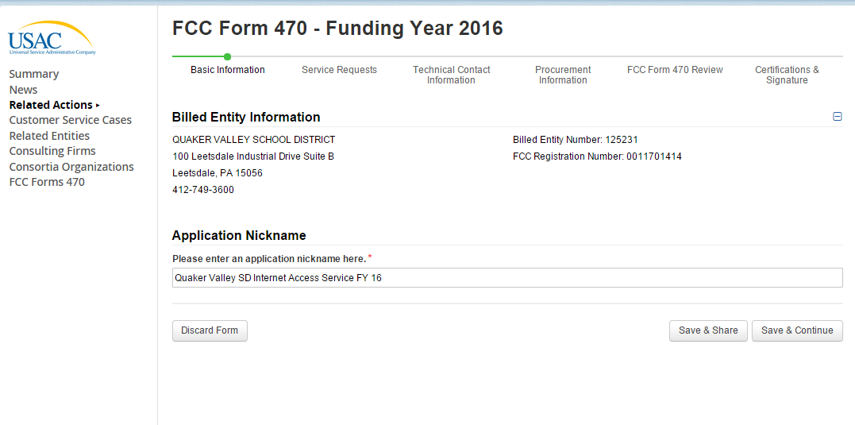
Use a well-described nickname for easier identification.

Slide 22
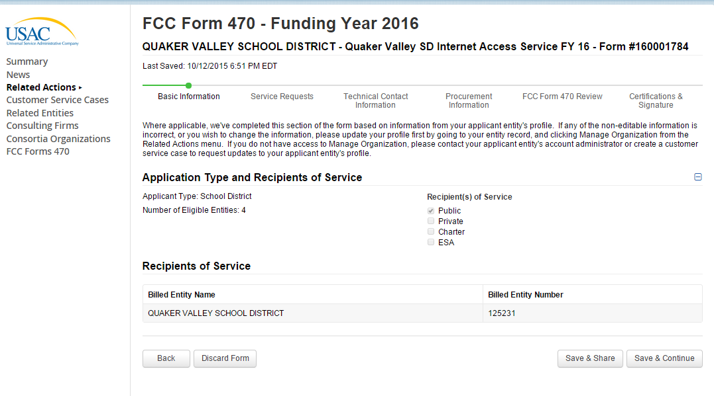
Notice the new numbering convention for the 470’s.
This is pre-populated from the EPC Profile.

Slide 23
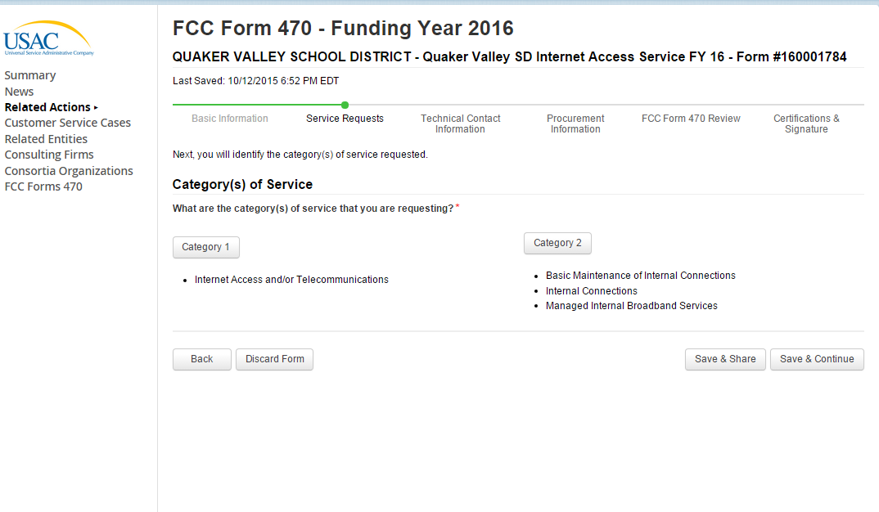

Slide 24
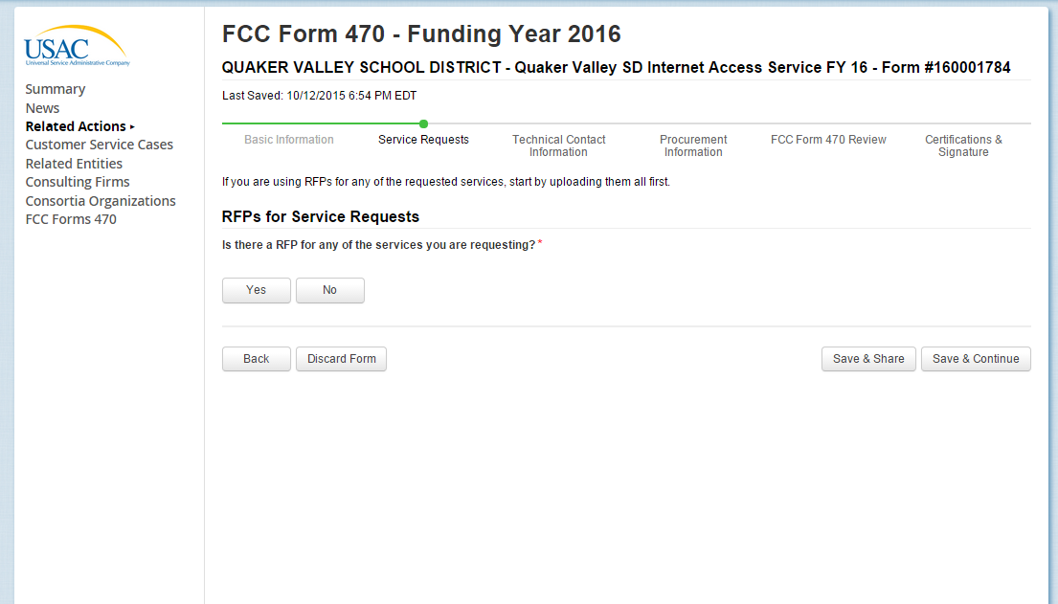

Slide 25
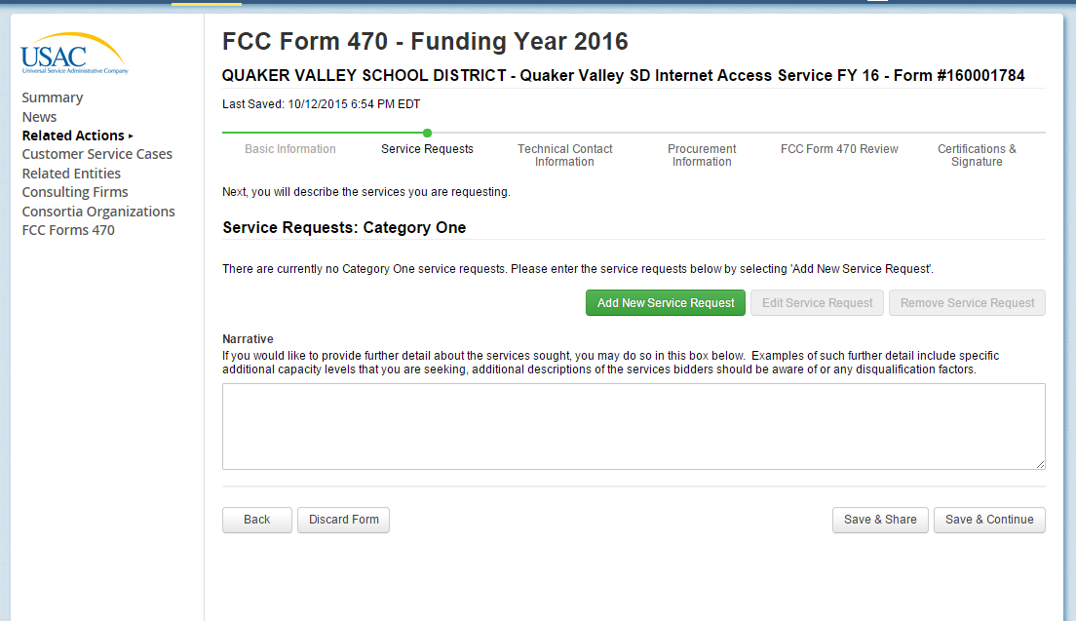

Slide 26
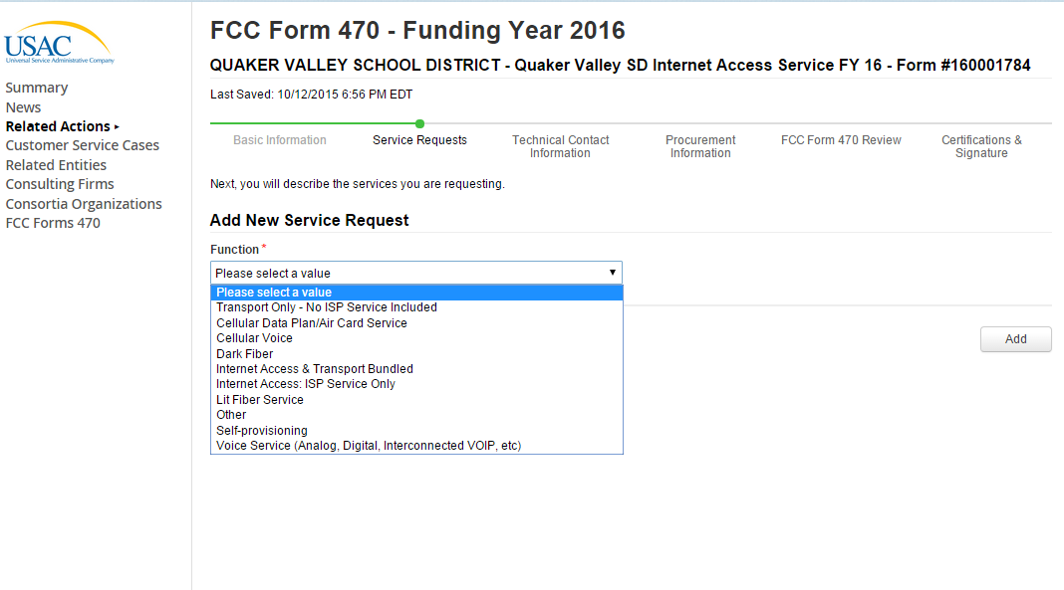

Slide 27
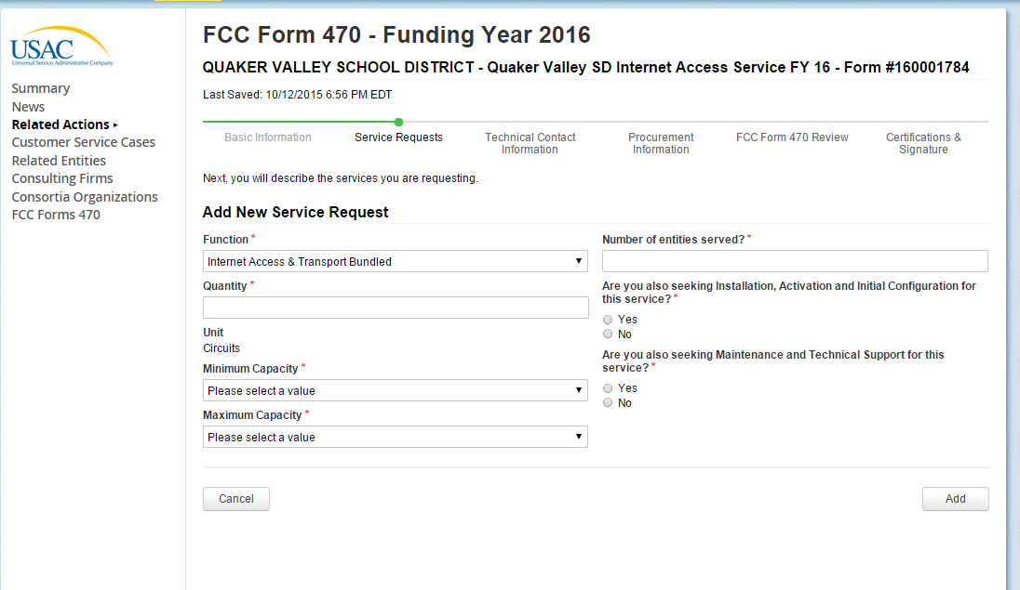

Slide 28
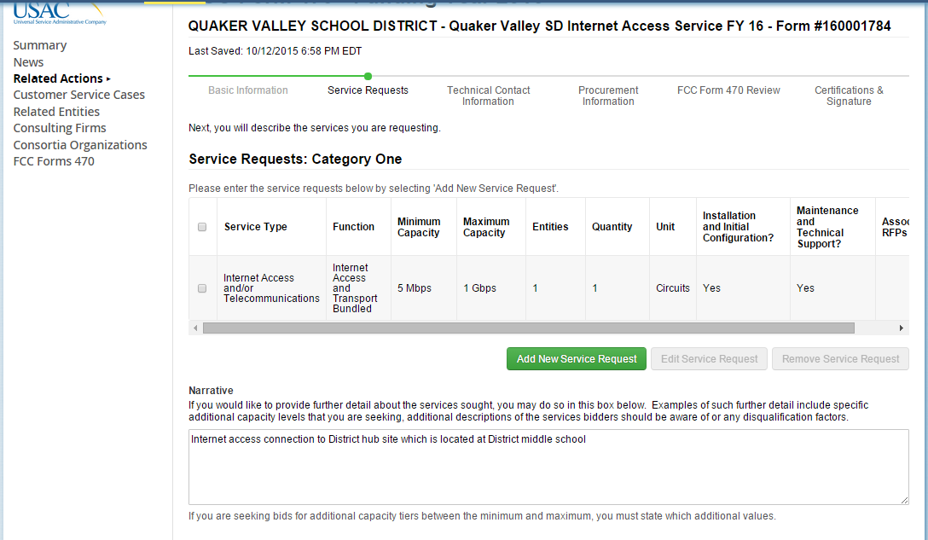
Use the narrative box to describe your services more fully. For example, if you want pricing for 50 and 100 mb of Internet, list that here.

Slide 29
FY 2016 Form 470 Pace Thus Far...

Slide 30
New Form 471 for FY 2016
Form 471 is new and must be filed in EPC
Survey questions have been eliminated
More detailed service questions
Want to know if Internet includes circuit
Want to know if circuit is fiber or copper based
Block 4 will automatically be pre-populated from EPC profile for each school
Contracts must be uploaded into EPC prior to completing the Form 471
All contract related information (dates, etc) will be done outside of 471 in EPC
Then just refer to that contract in the 471
Data transparency is the most important part of the new 471
Form 471 Receipt Acknowledgement Letter (RAL) will no be mailed
Instead, it will be posted in EPC

Slide 31
New Form 471 for FY 2016
471 Window dates will be announced in December
Window expected to open early January, close mid-late March
Be sure to file your 470s in enough time to have the contracts placed on your February board meeting agendas
I will schedule a separate 471 webinar when the draft form becomes available

Slide 32
Let’s Talk Category 2 Bidding...

Slide 33
Category 2 Options for PA Applicants
First, a detailed C2 webinar will be held on November 6 at 10 am
Registration required (go to e-ratepa.org)
No vendors permitted
Second, all Category 2 funding requests will be funded, regardless of discount
Assuming you’ve followed all of the E-rate rules

Slide 34
Category 2 Bidding: 3 Options
Post Form 470 only (nonpublic schools and libraries)
No RFP required. Be sure to list “or equivalent” if listing manufacturer’s name or model # on Form 470
Post Form 470 and RFP (public school entities)
Most appropriate for wiring projects
Use IU 16 PEPPM Contract
Can be used by public and nonpublic schools only (E-rate rule)
Before PEPPM Form 470/RFP was released in August 2015, each IU signed a “letter of agency” permitting IU 16 to competitively bid on behalf of the public and nonpublic schools within its IU in order to meet the new pre-470 LOA requirement

Slide 35
Category 2 Bidding: Option # 2
Post Form 470 and RFP (public school entities)
RFP required if cost of equipment exceeds $19,400 (state law)
Form 470 and RFP bidding must be done concurrently and bidding window required to be open for at least 28 days before bids are due (E-rate rule)
RFP must be published in at least 2 local newspapers of general circulation once/week for 3 consecutive weeks (state law)
Equipment list MUST allow for equivalent manufacturer’s products to be bid (E-rate rule)
“Cisco 48-port PoE Switch or equipment that is equivalent in functionality and quality”
Assuming all RFP requirements have been met, schools must accept the lowest-price bid (state law)
School board must approve contract prior to signing
Contract must be signed before submitting Form 471

Slide 36
Category 2 Bidding: Option # 3
Conduct PEPPM Mini-Bid
No Form 470 required (PEPPM filed Form 470 when contracts were being competitively bid)
More appropriate for equipment/installation, rather than cabling project
New advice: Sign separate contract with the vendor and use those contract dates – not PEPPM dates (new)
Cannot contact PEPPM bidder ahead of bidding to seek equipment list
If you don’t know exactly what equipment you need, list general equipment needs (wireless controller, WAPs for 35 classrooms, and installation), and then perhaps a site walk-through

Slide 37
Category 2 Bidding: Option # 3
More on PEPPM Bidding:
Cannot just go to PEPPM list and select vendor and equipment you want/need
A ‘category list’ will be sent to the PA E-rate listserve soon
Must then request ‘mini-bids’ from all vendors in that category
Can list preferred manufacturer, but must request bids for “equivalent” products
Minimum 2 week bidding period suggested (new)
Then conduct bid evaluation among all product lines that offer the ‘category’ of service, including equivalents
New EPC Contract wizard requires you to list # of bids received (new)

Slide 38
Example: PEPPM Mini-Bid Category List
Manufacturer | PEPPM Vendor Name | Wireless Equip. | Cabling/ Connectors | Caching Servers | Firewall Equip. | Switches | Routers | UPS | Racks | Managed Wi-Fi Service
Aerohive Networks | Aerohive Networks | x
Alcatel-Lucent | Alcatel-Lucent USA, Inc. |  |  |  |  | x
Allied Telesis, Inc. | En-Net Services, LLC |  |  |  |  | x
Checkpoint | ePlus Technology, Inc. |  |  |  | x
Cisco | ePlus Technology, Inc. | x |  |  |  | x | x

Slide 39
PEPPM vs RFP
PEPPM
Don’t have to post Form 470/Issue RFP
Don’t have to advertise in newspaper
DO have to conduct mini-bid of every vendor that sells equipment in that category
Don’t have to wait full 28 days during mini-bid process
Can consider non-cost factors as long as costs of E-rate eligible equipment/services are most heavily weighted factor
Can require compatibility and interoperability with existing equipment
More appropriate for equipment/installation, rather than cabling project
RFP
Must post 470
More appropriate for cabling projects, in addition to equipment/installation
Can provide greater specificity about requirements
Can require compatibility and interoperability with existing equipment
Can list binary disqualification factors
Don’t have to solicit bids from any vendor
Cannot consider non-cost factors during bid evaluation. If all RFP criteria have been met, must select lowest bid

Slide 40
Category 2 Bidding Timeline
Post 470/Release RFP/Issue PEPPM Mini-Bid by Dec 1
Bids due Dec 29
Evaluate bids Dec 30 – Jan 15
February board approvals of contracts
Sign contracts by February 27
Upload contracts to EPC Contract Wizard by March 1
Complete 471 no later than March 5

Slide 41
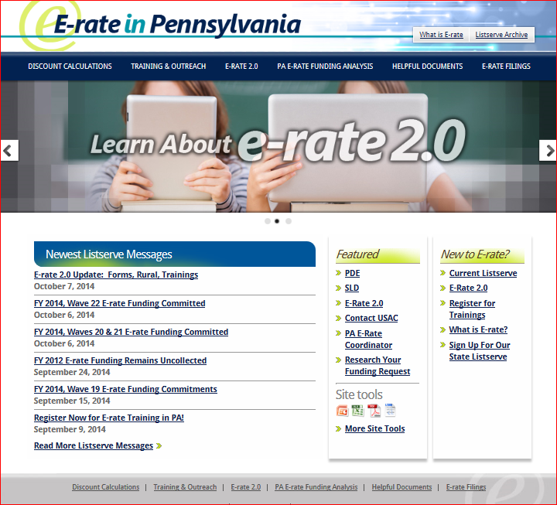
Want E-rate Training?
Beginners training:
November 11 – IU 7
November 13 – IU 15
November 15 – IU 24
Category 2 Training:
November 6 @ 10 am
Registration required
Form 470 Training:
November 18 @ 10 am
Form 470 Window is OPEN NOW
Form 471 Filing Window will open from January – mid March

Slide 42
Let’s Recap What Changed in FY 2015
Discounts
District-wide simple average calculation for both C1 and C2 requests (no more weighting)
Rural/Urban Definition - Individual school and library is designated as "urban" if located in an "Urbanized Area" or "Urban Cluster" with a population of 25,000 or more
Any school or library not designated "urban" is considered "rural" and will receive the additional rural discount
Community Eligibility Program (CEP) - Schools opting into CEP will benefit from the 1.6 multiplier as is currently permitted by USDA and other federal programs
Translation: Generally higher E-rate discounts
If you have a CEP school, this must be designated in the new EPC Portal Profile for that school
In the PDE NSLP file, I will indicate which are CEP schools, and then list the % of directly certified students in a separate column

Slide 43
Let’s Recap What Changed in FY 2015
Category 1 Services (previously Priority 1)
Phase-out of voice services by 20%/year
Many smaller voice services no longer eligible (DIDs, custom calling services, text messaging, directory assistance, etc.)
Webhosting, paging, hosted e-mail no longer eligible
Equipment is prohibited from being bundled at no cost with an eligible service
This includes free cellular phones, iPads/tablets, and VOIP equipment

Slide 44
Let’s Recap What Changed in FY 2015
Cellular Data/Mobile Broadband
Cellular data plans and mobile broadband services (such as wireless services to an iPad or aircards) are no longer eligible in buildings that have Wi-Fi access
In buildings without Wi-Fi: These services are only eligible upon a showing that individual data plans are the most cost effective option for providing internal broadband access for portable mobile devices
Must prove either that installing a WLAN is not physically possible, or provide a comparison of the costs of individual data plans vs. installing a WLAN solution
Be prepared for extensive cost effectiveness review from PIA

Slide 45
Let’s Recap What Changed in FY 2015
Category 2 Equipment/Services (previously Priority 2)
Voice and video equipment – not eligible
Servers – not eligible (except caching servers)
Cloud functionality of eligible equipment
Including licenses
New service: Managed Internal Broadband Services (MIBS)
Paying an outside vendor to own/maintain the equipment
Paying an outside vendor to maintain school-owned equipment
Eligible for $30/year/student

Slide 46
Let’s Recap What Changed in FY 2015
Category 2 Building Budget Caps
Each school is entitled to a pre-discount cap of $150 per student, or a minimum building cap of $9200, on a rolling five years
AVTS budget is based on maximum density of students
Library budget is $2.30 per square foot, ($5.00 per square foot for urban libraries)
Money must be spent during funding year (cannot apply for full budget and spend down over multiple years)
Can use entire budget all in a single year or space out over multiple years
If enrollment increases, you receive benefit of extra students next year

Slide 47
Let’s Recap What Changed in FY 2015
Category 2 Building Budget Caps
Money is allocated per school (not on a district-wide basis), and applicants cannot move funding from one school to another
For central equipment in separate Network Operations Centers (NOCs), applicants must allocate a portion of each school’s $150 budget toward the purchase of such equipment
All competitive bidding requirements will continue to apply and applicants can only apply for what they need
Students who attend multiple schools, such as those that attend CTCs or Intermediate Units part-time, may be counted by both schools

Slide 48
Category 2 Funding Budget Example
The Budget Cap is the pre-discount price. E-rate discounts will then apply on top of the budget cap.
In this example, district would still owe 30% non-discounted share.
* Although 50 x $150 = $7,500, the minimum floor is invoked
because school has less than 62 students
School | Enrollment | Budget Multiplier | 5-Year Budget Cap | E-rate Discount | E-rate Funding Cap
Plainfield Elementary | 50 | $150 | $9,200* | 70% | $6,440
Jacksonville Middle School | 105 | $150 | $15,750 | 70% | $11,025
Newville High School | 325 | $150 | $48,750 | 70% | $34,125

Slide 49
Let’s Recap What Changed in FY 2015
Maximum Category 2 discount will change from 90% to 85%
All other discounts remain the same
Installation and configuration are eligible
Do not have to be provided by the same vendor (new)
Multi-year licenses are eligible and can be requested in full in first year
Eligible equipment may be purchased and/or installed on or after April 1 prior to the beginning of the funding year
Must be purchased/installed before September 30 of the following year

Slide 50
Category 2 Budgets
Any funding commitments that include a school or library as a recipient of service in that funding year will count against your pre-discount budget for that entity
If not all committed funding is spent, you can file an Form 500 to return the remaining unused commitment to USAC
If entities are sharing the service, USAC will need specific information so that they know how to apply the returned funds to specific entities
C2 Budget Calculator:
http://www.fundsforlearning.com/schoolDistCalculator.php

Slide 51
Let’s Recap What Changed in FY 2015
Expanded Document Retention Rules
The document retention requirement has been expanded from 5 years to 10 years from the last date to receive service or service delivery deadline, whichever is later
Example: For FY 2015, the last date to receive service is June 30, 2016. All documents related to FY 2015 must be kept through June 30, 2026
For multi-year contracts, contract documentation and bids must be kept 10 years from the last date of service under the contract
Example: A 5 year contract started July 1, 2015 expires June 30, 2020. All documents related to this contract must be kept through June 30, 2030
Be sure to coordinate this new requirement with your business office

Slide 52
Let’s Recap What Changed in FY 2015
Strict BEAR deadlines
One 120 day invoice deadline extension will be granted if the request is made on or before the original invoice deadline (which is typically October 28 following the funding year)
Late invoice deadline extension requests will not be granted by USAC

