Slide 1

E-rate Category 2 Training Workshop for PA Applicants
Presented by Julie Tritt Schell
PA E-rate Coordinator
for the Pennsylvania Department of Education
January 2016

Slide 2
Agenda: Category 2
Funding Availability
Discount Calculations - 5-Year Budget Caps
Equipment/Service Eligibility
Competitive Bidding
  Do’s and Don’ts
  EPC/new Form 470 demo
  PEPPM Mini-bids Step by Step
New EPC Contract Wizard Requirement
Timeline for Bidding/Applying
After the FCDL...
  Purchase Orders
  Invoicing
  Inventories
  Maintenance records
  Moving equipment
  Equipment substitutions
Purchasing equipment prior to FCDL
Copies of 470 and Contract Module Screenshots (for later viewing)

Slide 3
Category 2 Overview
Category 2 (previously called Priority 2) funds Wi-Fi and related infrastructure and equipment inside buildings
  And between buildings if schools are located on the same campus
Technology plans are no longer required
Intention is to have all schools and libraries obtain Category 2 funding over a period of 5 years

Slide 4
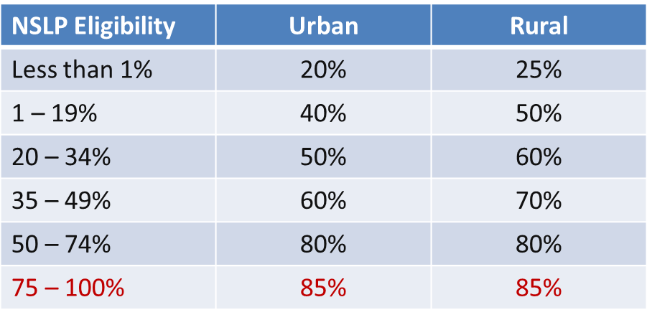
Category 2 Discounts
District-wide simple average calculation for both C1 and C2 requests (no more weighting)
Every school in the district receives the district-wide discount
Maximum E-rate discount is now 85%. All other discount bands remain the same:

Slide 5
Will There Be Funding Available?
Yes
Yes
Yes
FY 2016 cap will be $3.913 billion + additional $1.9 billion that has been set aside for C2 + inflation adjustment, bringing available funds to almost $6 billion
  FCC has stated that they will fully fund all eligible C2 requests, regardless of demand

Slide 6
Category 2, 5-Year Budget Caps
Each school is entitled to a pre-discount cap of $150 per student, or a minimum building cap of $9200, over a rolling 5-years
  5 years begins in first year a school is committed C2 funding
  Budgets based on maximum density of students
  Library budget is $2.30 per sq. ft ($5.00 for urban libraries)
Money is allocated per school (not on a shared-district basis)
  Cannot move money from one school to another
Money must be spent during funding year
  Cannot apply for full budget and spend down over multiple years
  Funding Year 2016 = 4/1/2016 – 9/30/2017
Can use school’s entire budget in a single year or can apply in multiple years

Slide 7
Category 2 Funding Budget Example
The Budget Cap is the pre-discount price. E-rate discounts will then apply on top of the budget cap.
In this example, district would still owe 30% non-discounted share.
C2 Budget Calculator:
http://www.fundsforlearning.com/schoolDistCalculator.php
* Although 50 x $150 = $7,500, the minimum floor is invoked
because school has less than 62 students
School | Maximum Density Student Count | Budget Multiplier | 5-Year Pre-Discount Budget Cap | E-rate Discount | E-rate Funding Cap | District's Share % | District's Share $
Plainfield Elementary | 50 | $150 | $9,200* | 70% | $6,440 | 30% | $2,760
Jacksonville Middle School | 105 | $150 | $15,750 | 70% | $11,025 | 30% | $4,725
Newville High School | 325 | $150 | $48,750 | 70% | $34,125 | 30% | $14,625

Slide 8
Category 2 – Enrollment Anomalies
  If enrollment increases, you receive benefit of extra students next year
  If enrollment decreases, you aren’t required to pay back funds
New schools may estimate the number of students who will be attending the new school and seek funding based on that estimate
  However, if an applicant overestimates the number of students who enroll in that school, it must return to USAC by the end of the next funding year any excess funding based on the actual number of enrolled students
Students who attend multiple schools, such as those that attend CTCs or Intermediate Units part-time, may be counted by both schools in order to ensure appropriate LAN/WLAN deployment for both buildings

Slide 9
Category 2 Funding Budgets (Cont’d)
All competitive bidding requirements will continue to apply and applicants can only apply for what they need
Form 471 application is required to be submitted each year

Slide 10
Category 2 Funding Budgets - NIFs
Non-Instructional Facilities (NIFs) don’t have C2 budgets because there is no student population
If equipment is located in the NIF and serves other schools, those schools’ budgets can be used to fund the equipment
  Allocation is up to the applicant to decide (how much to take from each school’s C2 budget
  Just have a reasonable methodology

Slide 11
Returning $ to a Category 2 Budget
Any funding commitments that include a school or library as a recipient of service in that funding year will count against the pre-discount budget for that entity
If not all committed funding is spent, you must file a Form 500 to “decommit” the remaining unused commitment to USAC in order to be able to apply for those funds in subsequent years
    If entities are sharing the service, USAC will need specific information so that they know how to apply the returned funds to specific entities
  USAC does not process Form 500s quickly, so if you need to decommit FY 2015 funds to use in FY 2016, file the Form 500 NOW

Slide 12
Questions about
Category 2 Budgets?

Slide 13
What’s Eligible and Not Eligible for
Category 2 Funding?

Slide 14
Category 2 Ineligible Items
All Voice Components
VOIP Components
Servers (except caching)
Software
Storage Devices
Telephone Components
Video Components
End-User Devices

Slide 15
Category 2 Eligible Items
Access Points
Structured Cabling
Caching Servers *new*
Firewalls
Network Switches
Antennas
Routers
Racks and UPSs
  That support eligible equipment only
Wireless LAN Controllers
Improvements, upgrades and software necessary to support eligible broadband internal connections components
Basic Maintenance Services for eligible equipment
  Repair of equipment, cable maintenance, basic tech support, configuration changes
Cloud-based functionality of this equipment

Slide 16
Category 2 Eligible in FY 2015 & 2016
Managed Internal Broadband Services (MIBS) which cover the operation, management, or monitoring of a LAN or WLAN
    Could also include the leasing of equipment
    Paying an outside vendor to own/maintain the equipment
    Paying an outside vendor to maintain school-owned equipment
Eligible for $30/year/student
Unless FCC extends eligibility, these items will sunset eligibility at the end of FY 2016
  Exception to Sunset: Applicants that received funding approval in FY 2015 and FY 2016 for these items may continue to obtain funding for FY 2017-FY 2019

Slide 17
Category 2 Eligibility, etc...
Installation and configuration are eligible
  Do not have to be provided by the same vendor (new)
Also eligible:
  Taxes, surcharges and other similar reasonable charges
  Shipping charges
  Training on how to use eligible equipment
Multi-year licenses are eligible and can be requested in full in first year
Eligible equipment may be purchased and/or installed on or after April 1 prior to the beginning of the funding year
  Must be purchased/installed before September 30 of the following year

Slide 18
Questions about
What’s Eligible for Category 2 Funding?

Slide 19
Category 2 Procurement Options/Requirements

Slide 20
E-rate Bidding Requirements
Applicants should not contact a potential vendor ahead of bidding to seek equipment list (E-rate rule)
  Service providers are allowed to answer general questions about the products and services they sell in response to applicant inquiries, but they may not prepare any part of a RFP or spec sheet that will be used by the applicant for conducting a competitive bid procurement.
  If you don’t know exactly what equipment you need, list general equipment needs (wireless controller, WAPs for 35 classrooms, and installation), and then perhaps a site walk-through
Equipment list MUST allow for equivalent manufacturer’s products to be bid (E-rate rule)
  “Cisco 48-port PoE Switch or equipment that is equivalent in functionality and quality”
  May include a requirement that equivalent equipment must be fully compatible with District’s existing XYZ equipment

Slide 21
Prevailing Wage Requirements
Required for PA Public Schools
Projects over $25,000
Typically applies to structured cabling projects
  Does not apply to equipment-only purchases
Obtain PW Determination for the project
  http://www.portal.state.pa.us/portal/server.pt?open=514&objID=622703&mode=2
  They will e-mail you PW Det. within 2 business days
  Include PW statement in RFP and attach PW Determination as Appendix to RFP
If you’ve already issued your 470/RFP and didn’t include PW, you can upload this as an addendum to your 470 as long as an RFP was uploaded initially

Slide 22
Category 2 Bidding Options
Form 470
  Form 470 only
    Nonpublic schools and libraries (no RFP required)
    Must list “or equivalent” if listing manufacturer’s name or model # on Form 470
  Form 470 and RFP
    Public school entities
    Most appropriate for wiring projects
    RFP required for projects over $19,400
IU 16 PEPPM Mini-Bid Process (public and nonpublic schools only)
    Before PEPPM Form 470/RFP was released in August 2015, each IU signed a “letter of agency” permitting IU 16 to competitively bid on behalf of the public and nonpublic schools within its IU in order to meet the new pre-470 LOA requirement
    Co-Stars contract is NOT E-rate eligible because it’s not competitively bid with price being the most heavily weighted factor
    Do NOT post 470 if you’re using PEPPM

Slide 23
Using the Form 470 for Category 2 Procurements...

Slide 24
New Form 470 for FY 2016
Form 470 is new and must be filed in EPC
Much simpler than previous years
  Much of “profile/contact” information is ported from EPC profile
EPC Full Rights Users can create/submit form
  Partial Rights Users can create but must have Full Rights User submit the form
Form 470s being accepted now
  Plenty of time to file, wait 28 days and sign contracts
Form 470 Receipt Notification Letter will no longer be mailed
  Instead, a notice of the 470 posting will appear in your EPC Newsfeed

Slide 25
Form 470 plus RFP
Post Form 470 and RFP (public school entities)
  RFP required if cost of equipment/services exceeds $19,400 (state law)
  Form 470 and RFP bidding must be done concurrently and bidding window required to be open for at least 28 days before bids are due (E-rate rule)
  RFP must be published in at least 2 local newspapers of general circulation once/week for 3 consecutive weeks (state law)
  Assuming all RFP requirements have been met, schools must accept the lowest-price bid (state law)
  School board must approve contract prior to signing
    Contract must be signed before submitting Form 471
  If issuing an RFP, it MUST be uploaded at the time the 470 is posted
    All addenda also must be uploaded to the EPC Portal at time of issuance

Slide 26
Adding Addenda to RFP in EPC
Any additional information given to bidders after 470/RFP posted (site maps, changes to bid, etc.) must be uploaded into EPC
  > Click on relevant 470 at bottom of Landing Page
  > Related Actions
  > Add an RFP Document
    Note: Use ‘Generated Documents’ to save a copy of posted 470

Slide 27
Let’s File a Category 2 Form 470 in EPC...
Note: Screenshots of this filing are at the end of this PP handout for later referencing

Slide 28
Using the PEPPM Contract and Conducting a Mini-Bid for Category 2 Procurements...

Slide 29
Category 2 Bidding: PEPPM Mini-Bids
Conduct PEPPM Mini-Bid
  No Form 470 required (PEPPM filed Form 470 when contracts were being competitively bid)
  More appropriate for equipment/installation, rather than cabling project
  New: Sign contract with the vendor and use those contract dates – not PEPPM dates (new)
    Can be as simple as signing vendor quote
    Be sure to include these items:
    Contract signing date (must be before 471 filing date)
    Contract term: 4/1/2016 through 9/30/2017
    Purchase is contingent upon E-rate funding and local funding approval
  School board must approve contract prior to signing
    Vendor contract must be signed before submitting Form 471

Slide 30
Category 2 Bidding: PEPPM Mini-Bids
  More on PEPPM Bidding:
  Cannot just go to PEPPM list and select vendor and equipment you want/need
  Must then request ‘mini-bids’ from all vendors in that category
  A ‘category list’ will be sent to the PA E-rate listserve soon along with instructions and equipment list template (slightly different than last year)
  Can list preferred manufacturer, but must seek bids for “equivalent” products
  Minimum 2 week bidding period suggested (new)
  Then conduct bid evaluation among all product lines that offer the ‘category’ of service, including equivalents
  Can consider other factors besides price
    Price of eligible equipment must be the most heavily weighted factor
  New EPC Contract wizard requires you to list # of bids received (new)
    Keep these losing bids because you may be asked to submit them

Slide 31
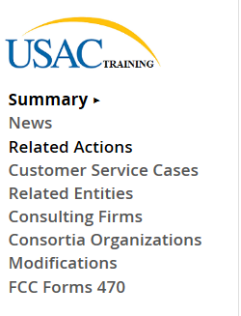
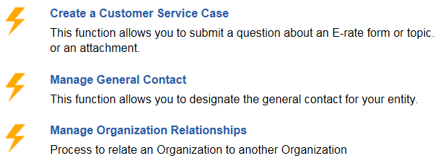
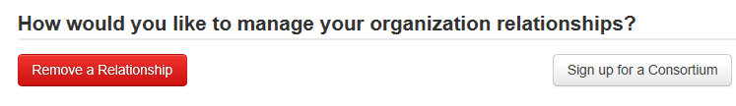
Step 1: Join the PEPPM Consortium in EPC
!! Before issuing your PEPPM Mini-Bid, please log-in to EPC and join the PEPPM Consortium !!

Slide 32
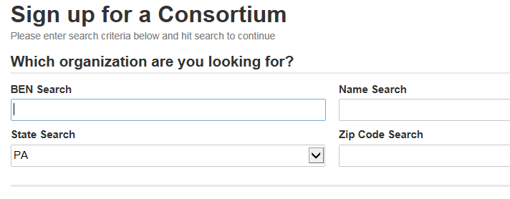
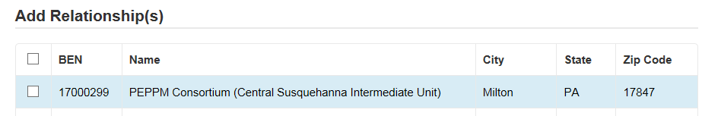
Step 1: Join the PEPPM Consortium in EPC
PEPPM
X

Slide 33

Step 2: Create Equipment/Services List
Use the template to create list of equipment and services you are seeking in your bid
Include installation, if needed
May list preferred manufacturer, but cover e-mail must allow for equivalent product lines to be submitted
Include any “compatibility” or “interoperability” requirements
Attach equipment list to cover e-mail

Slide 34
Step 3: Compose E-mail to PEPPM Vendors
Use template and personalize to your needs:
  Include additional disqualification factors
  Include pre-bid meeting info, if applicable
  Give due date for bids
  Explain that equivalent bids may be submitted
  Mention that if the awarded vendor uses authorized resellers that they forward this mini-bid to those resellers or notify you if they will not so YOU can send to authorized resellers

Slide 35
Step 4: Determine All Vendors in “Category”
Must conduct mini-bid among all product lines in that “category”
  So if bidding switches, you must send the mini-bid request to all awarded switching vendors on the list
  Categories mirror E-rate Eligible Services List
Use PEPPM Category Guide
  Filter by Category
Resellers:
  If sending to resellers, you are not required to send to ALL resellers on the list (tab 2)
  Document why you selected the reseller you chose to send it to
    Experience with that vendor
    Close in proximity
    Extensive E-rate experience

Slide 36
Example: PEPPM Mini-Bid Category List
Find ‘category’ then send equipment list to all vendors with x
Manufacturer | PEPPM Awarded Vendor Name | Wireless Equipment/Services | Cabling/Connectors | Caching Servers | Firewall Equipiment | Switches | Routers | UPS | Racks | Awarded Vendor Contact Name | Awarded Vendor Contact Email
ACE Computers | Ace Computers |  |  | x |  |  |  |  |  | John Samborski | johns@acecomputers.com
Adtran, Inc. | ADTRAN | X |  |  |  | X | X |  |  | Patrick Foster | patrick.foster@adtran.com
Aerohive Networks | Aerohive Networks | X |  |  |  | X | X |  |  | Zach Harris | sales-operations@aerohive.com
Alcatel-Lucent | Alcatel-Lucent Enterprise USA, Inc. |  |  |  |  | X | X |  |  | Neal Tilley | neal.tilley@alcatel-lucent.com
Allied Telesis, Inc. | En-Net Services, LLC | X |  |  | X | X | X |  |  | Ed Floyd | efloyd@en-netservices.com
APC | ePlus Technology, Inc. |  | X |  |  |  |  | X | X | Nick D’Archangelo | ndarchangelo@eplus.com
Arista Networks | Carahsoft Technology Corporation |  |  |  |  | X |  |  |  | Jack Dixon | Jack.Dixon@Carahsoft.com
Aruba Networks Corporation | Aruba Networks | X |  |  |  | X |  |  |  | Andrew Tanguay | atanguay@arubanetworks.com
Atlona Technologies | Sage Technology Solutions, Inc. |  | X |  |  | X |  |  |  | James Van Fossen | jvanfossen@sagetechs.com
Avaya | Avaya, Inc. | X |  | X |  | X | X | X |  | David Smith | smith153@avaya.com
B&B Electronics | En-Net Services, LLC |  | X |  |  |  |  |  | X | Ed Floyd | efloyd@en-netservices.com

Slide 37
Step 5: Conduct Bid Evaluation
Using prices from mini-bid quotes, conduct bid evaluation
  Use template
May consider other factors besides price
  Previous experience with the vendor
  Ability to seemlessly integrate with existing platform
  Etc.
Price of eligible equipment/services MUST be the most heavily weighted factor

Slide 38
Bidding: PEPPM Bid Evaluation Example
Evaluation Criteria | Maximum # Points | Vendor 1 | Vendor 2 | Vendor 3
Price of Eligible Equipment/Services | 40 | 40 | 30 | 30
Ability to Integrate Equipment into Existing Network | 25 | 25 | 25 | 25
Previous Experience with the District/Knowledge of District's Infrastructure | 25 | 25 | 5 | 10
Quality of References | 10 | 10 | 10 | 10
 |  | 100 | 70 | 75

Slide 39
Step 6: Notify Winning Bidder/Sign Contracts
Notify winning bidder via e-mail, contingent on board approval
Use template
Finalize exact quantities of equipment prior to contract signing
Ask for final quote on vendor letterhead
  Must include contract term: 4/1/2016 – 9/30/2017
  Purchase is contingent on E-rate commitment (if applicable)
Contract must be signed by the District before submitting the 471
  That contract signing date will be the Contract Award Date in EPC

Slide 40
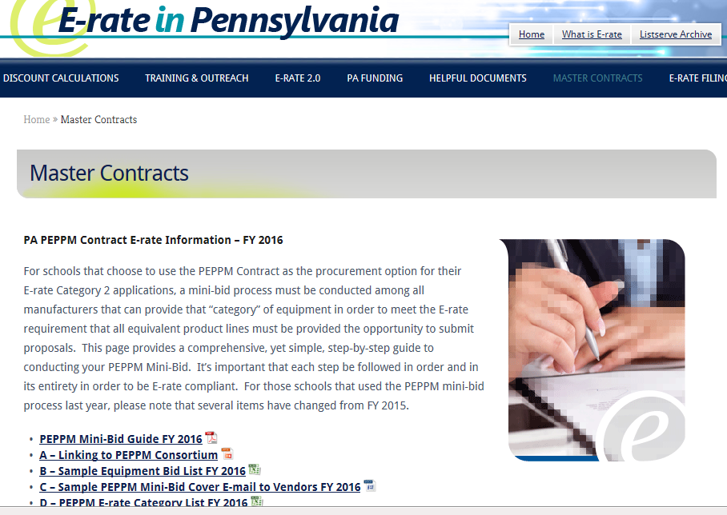
PEPPM Bidding Guide
PEPPM bidding guide and all associated documents available at:
  http://e-ratepa.org/?page_id=6121

Slide 41
PEPPM vs RFP
PEPPM
Don’t have to post Form 470/Issue RFP
Don’t have to advertise in newspaper
DO have to conduct mini-bid of every vendor that sells equipment in that category
Don’t have to wait full 28 days during mini-bid process
Can consider non-cost factors as long as costs of E-rate eligible equipment/services are most heavily weighted factor
Can require compatibility and interoperability with existing equipment
More appropriate for equipment/installation, rather than cabling project
RFP/470
Must post 470 and upload RFP
More appropriate for cabling projects, in addition to equipment/installation
Can provide greater specificity about requirements
Can require compatibility and interoperability with existing equipment
Can list binary disqualification factors
Don’t have to solicit bids from any vendor
Cannot consider non-cost factors during bid evaluation. If all RFP criteria have been met, must select lowest bid

Slide 42
Category 2 Bidding Timeline
Post 470/Release RFP/Issue PEPPM Mini-Bid by Feb 1
Evaluate bids early March
March board approvals of contracts
Sign contracts by March 30
Upload contracts to EPC Contract Wizard by April 1
Complete 471 no later than April ??
Early submissions will be funded first!

Slide 43
New EPC Contract Wizard Requirement
All C2 requests must have signed contracts
All contracts will be uploaded into EPC prior to completing the Form 471
  All contract related information (470 #, contract signing dates, expiration dates, vendor, spin, etc.) will be done outside of 471 in EPC
  Then just refer to that contract in the 471
  Contract can be as simple as a vendor quote that is signed by the school. Be sure to include:
    Contract signing date (must be before 471 filing date)
    Contract term: 4/1/2016 through 9/30/2017
    Purchase is contingent upon E-rate funding and local funding approval

Slide 44
Reminder: Keep Everything!
  Expanded Document Retention Rules
  The document retention requirement has been expanded from 5 years to 10 years from the last date to receive service or service delivery deadline, whichever is later
  Keep:
  All vendor correspondence
  Winning and losing bids
  Proof of newspaper advertisements (if using 470/RFP)
  Contracts
  Purchase Orders
  Vendor Invoices
  Cancelled Checks
  Asset Inventory
Be sure to coordinate this new requirement
with your business office

Slide 45
Questions?
Note: Post funding commitment notes follow this slide for your reference purposes.
More information on these topics will be forthcoming on the listserve after April 1.

Slide 46
After the FCDL Arrives....
Purchase Orders
  Be sure the equipment you order is EXACTLY what was listed on the Form 471
Submit the Form 486!
Be sure to label all equipment
  FY 2016, FRN XXX
Invoicing (applicant choice of discounted bills)
  After equipment received/discounted portion paid
Create and maintain Asset Inventory (requirement)
  Sample available
Maintenance records, if E-rated
  Require detailed invoices (what, when, where)

Slide 47
Purchasing Prior to FCDL...
May purchase Category 2 equipment as early as April 1 prior to the start of the funding year -- even with no FCDL
  Only make early purchases if they are NOT contingent on E-rate funding and you plan to pay for your equipment in full and seek E-rate reimbursement after your Funding Commitment Letter arrives
Be sure your PO is for the FULL amount, not the non-discounted share
Submit Form 486 until AFTER the FCDL arrives
Submit Form 472 BEAR to USAC once your FCDL arrives, and after you have paid your vendor invoice.

Slide 48
Equipment Transfer Rules
Equipment MUST stay at the location indicated on the Form 471 for a period of 3 years after the date of purchase
  After that, the equipment can be transferred to other eligible entities
  Asset Inventory must be updated
If a location closes within 3 years, equipment from that closed location can be transferred to another eligible entity
  USAC must be notified of such equipment transfers using the Form 500
  Asset Inventory must be updated
After 5 years from the date of installation, equipment can be disposed of, sold, transferred, traded, etc. with no USAC notification required
  If equipment is sold, no funding is required to be returned to USAC

Slide 49
Equipment Substitution Rules
To change approved equipment, either due to clerical error on your Item 21, or because the vendor is now substituting a newer/different model number, you must submit what USAC refers to as a "Service Substitution Request"
Service Substitution must generally have the same functionality (i.e. data distribution, wireless distribution, cabling, etc)
If the service substitution results in a change in the pre-discount price, the E-rate funding commitment will be adjusted to the lower cost
File Form 500 to return “commitment” to school’s C2 budget

Slide 50
New Form 471 for FY 2016
471 Window dates will be announced in next week
Window expected to open late January, close mid-late April
Be sure to file your 470s in enough time to have the contracts placed on your February or March board meeting agendas
I will schedule a separate 471 webinar when the draft form becomes available

Slide 51
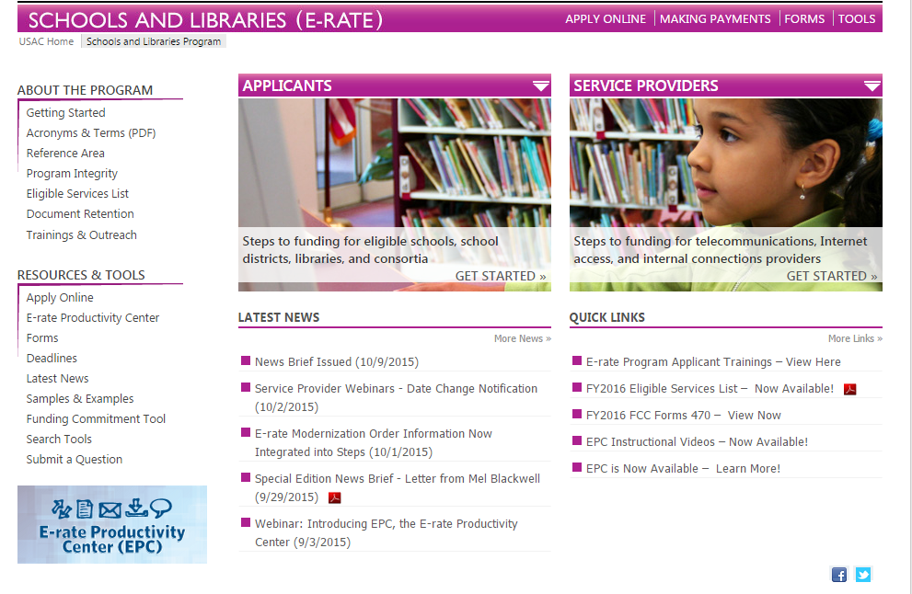
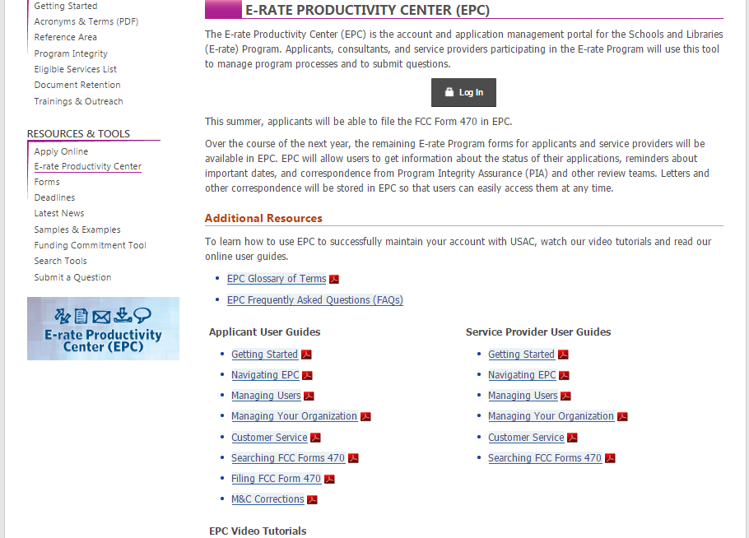
Accessing EPC for 470 Postings

Slide 52
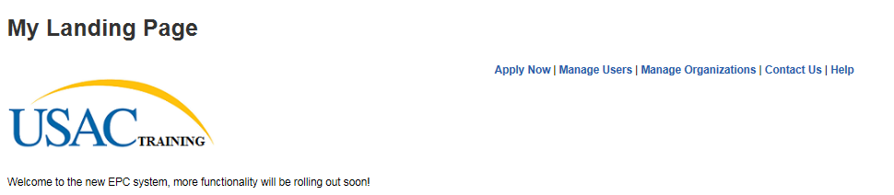

Slide 53
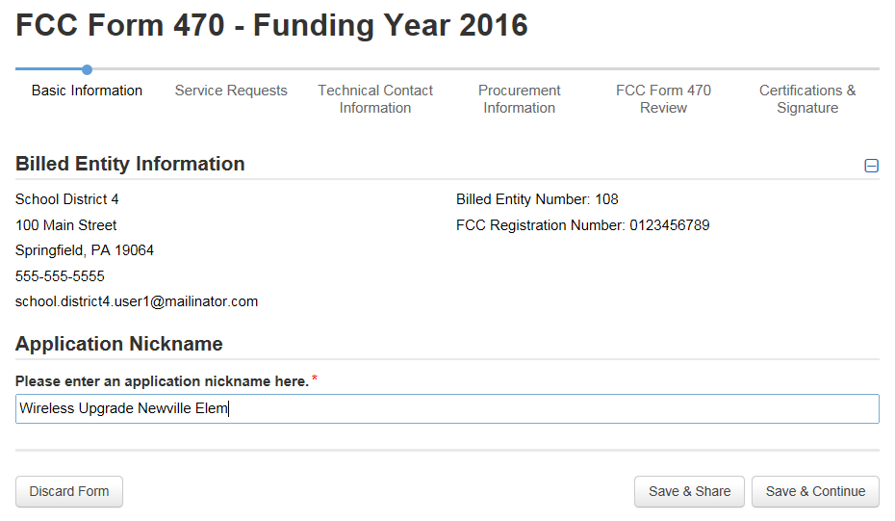
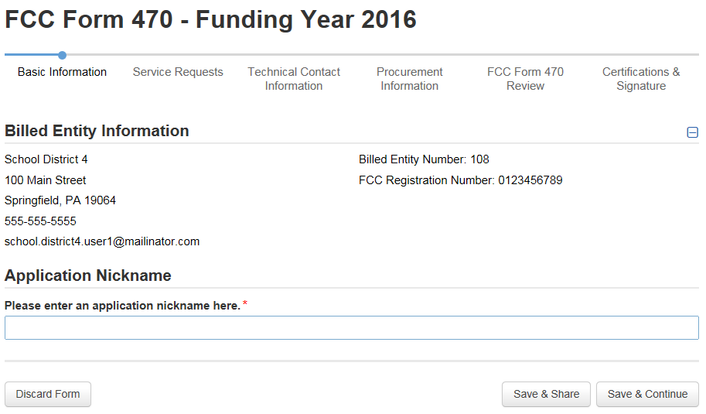
Use a very descriptive nickname.

Slide 54
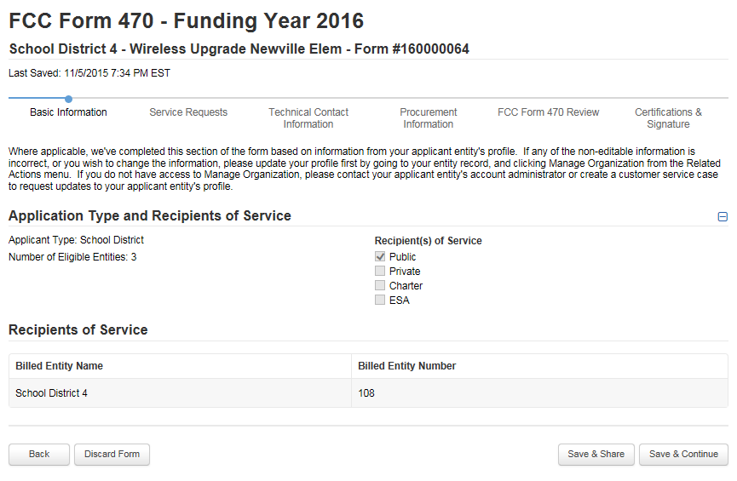
Note: You can’t modify anything on this page.

Slide 55
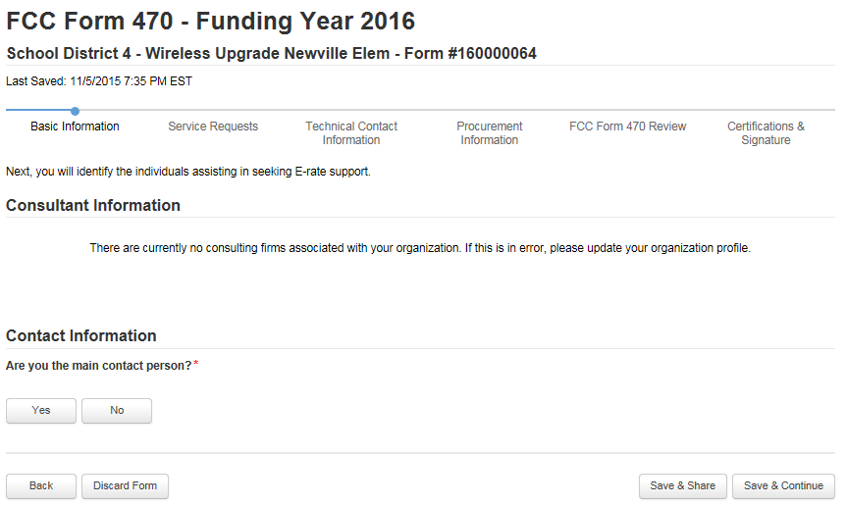

Slide 56
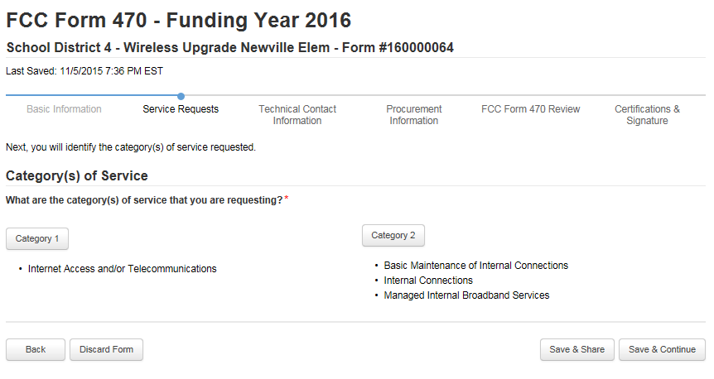

Slide 57
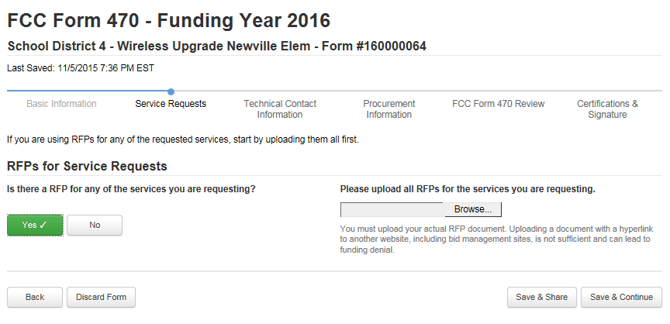

Slide 58
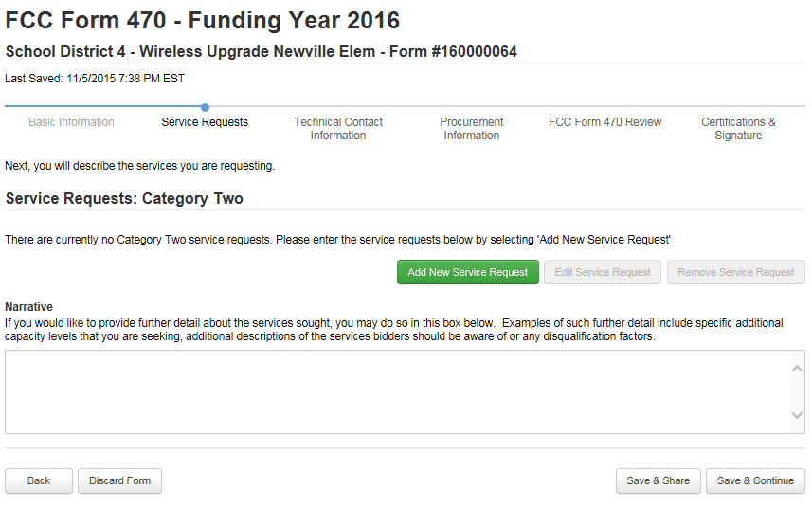

Slide 59
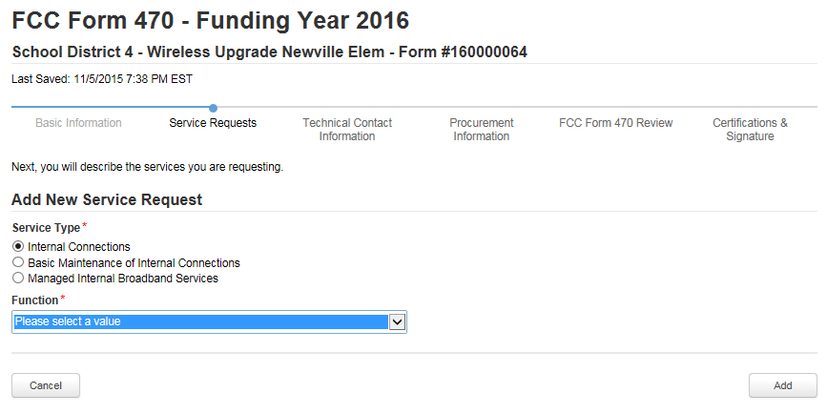
Antennas, Connectors, Related Components
Cabling
Caching
Firewall Services and Components
Racks
Routers
Switches
UPS/Battery Backup
Wireless Access Points (WAPs)
Wireless Controller

Slide 60
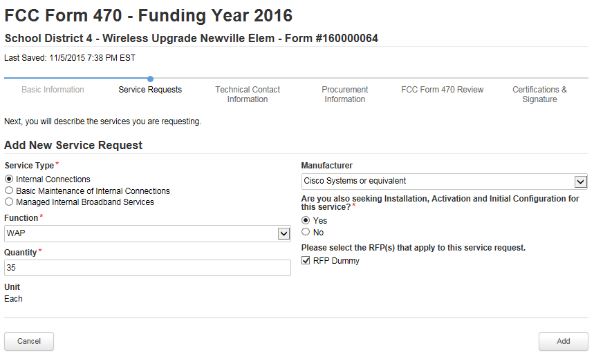

Slide 61
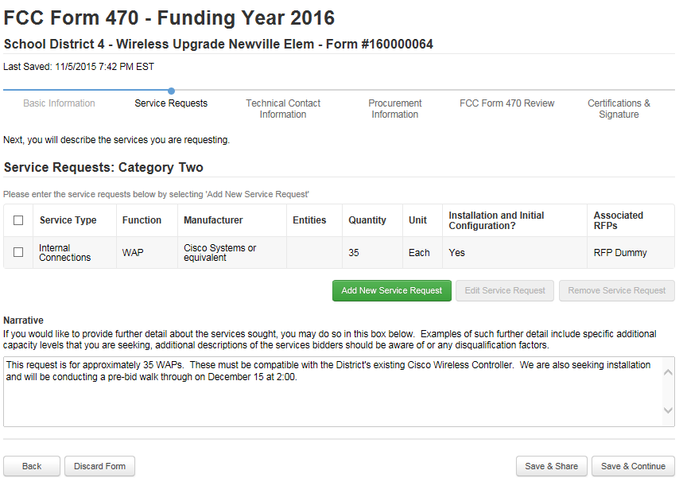
Use the Narrative to provide further details related to your funding request.

Slide 62
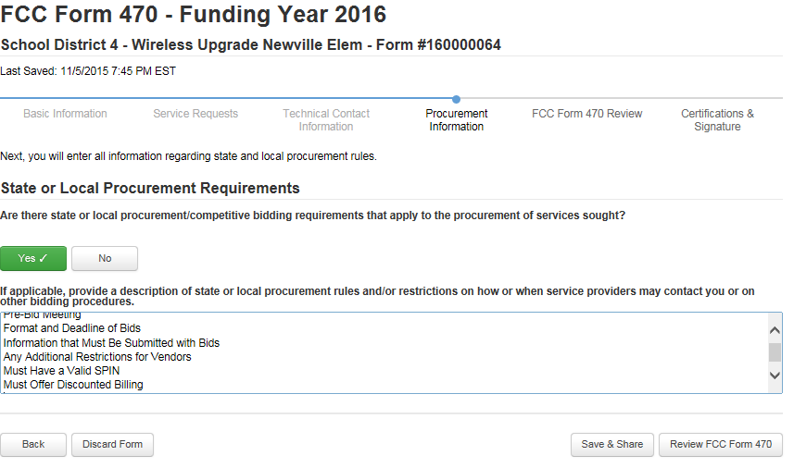
Use the State and Local Procurement Requirements box to list any bidding restrictions you want to place on vendors. Vendors must...

Slide 63
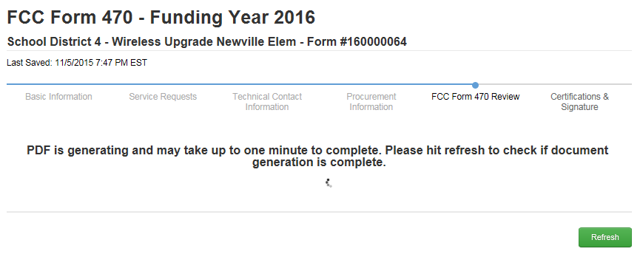

Slide 64
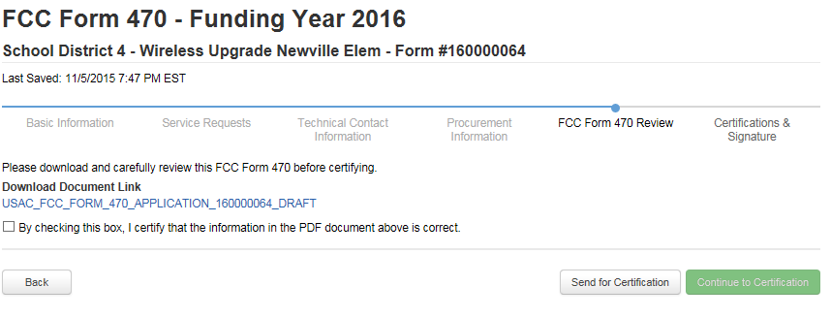

Slide 65
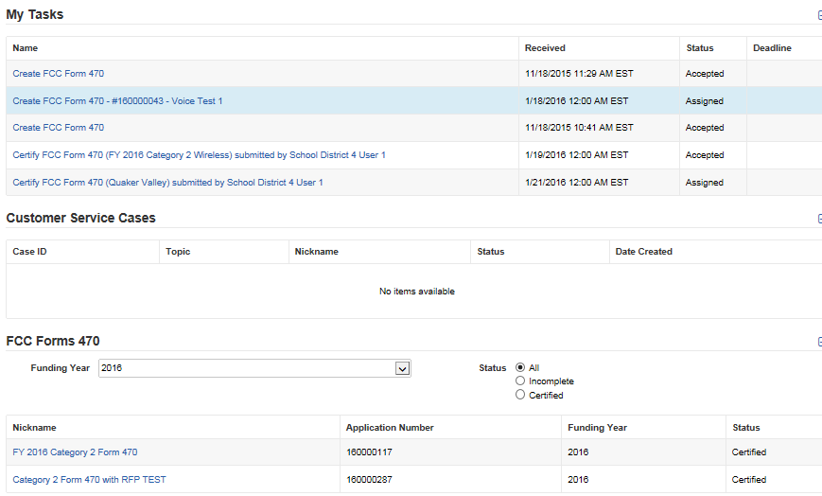
EPC Landing Page. Click on posted Form 470 at the bottom of page.

Slide 66
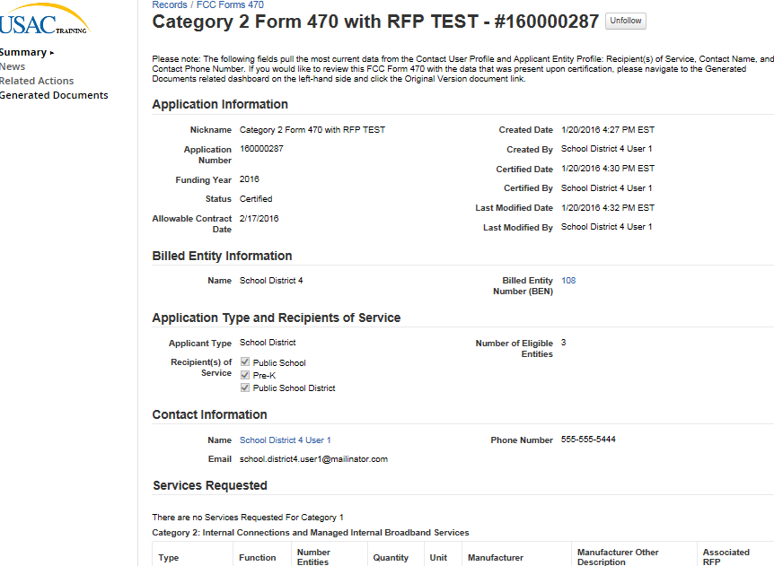
Copy of Form 470. Click on Related Actions on left toolbar

Slide 67
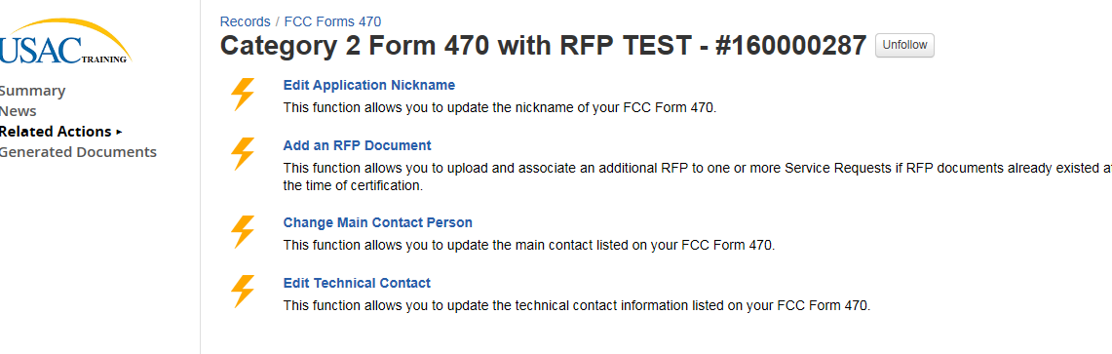
Click “Add an RFP Document” to upload related RFP amendment or document after Form 470/RFP have been posted.

Slide 68
New EPC Contract Wizard
Not currently available
Following screenshots are beta and will change

Slide 69
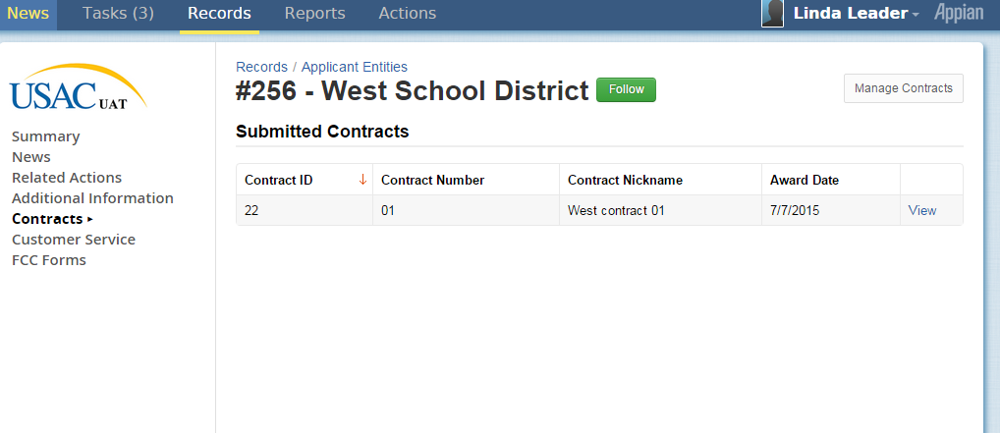
See Contracts from School District’s record

Slide 70
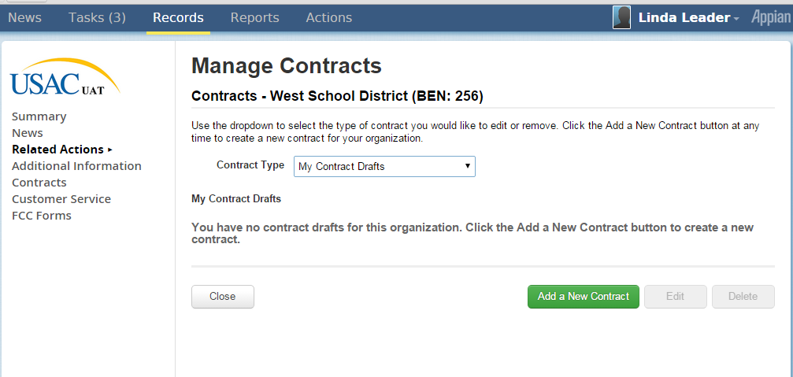
Add New Contract from Drafts

Slide 71
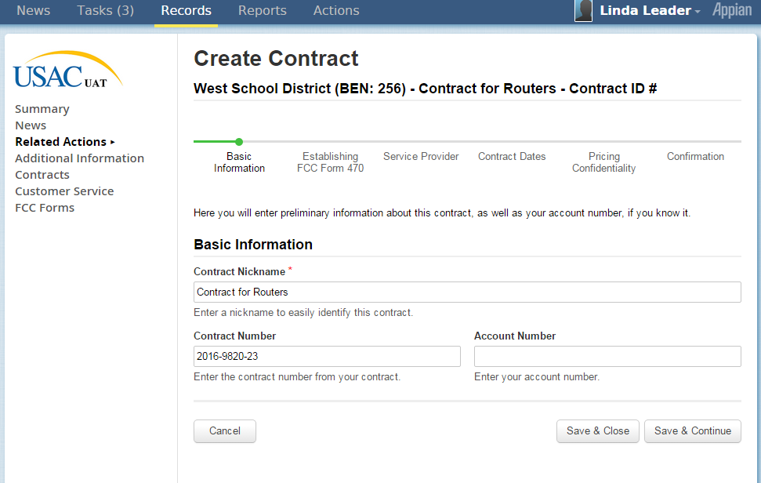
Add Basic Information about Contract

Slide 72
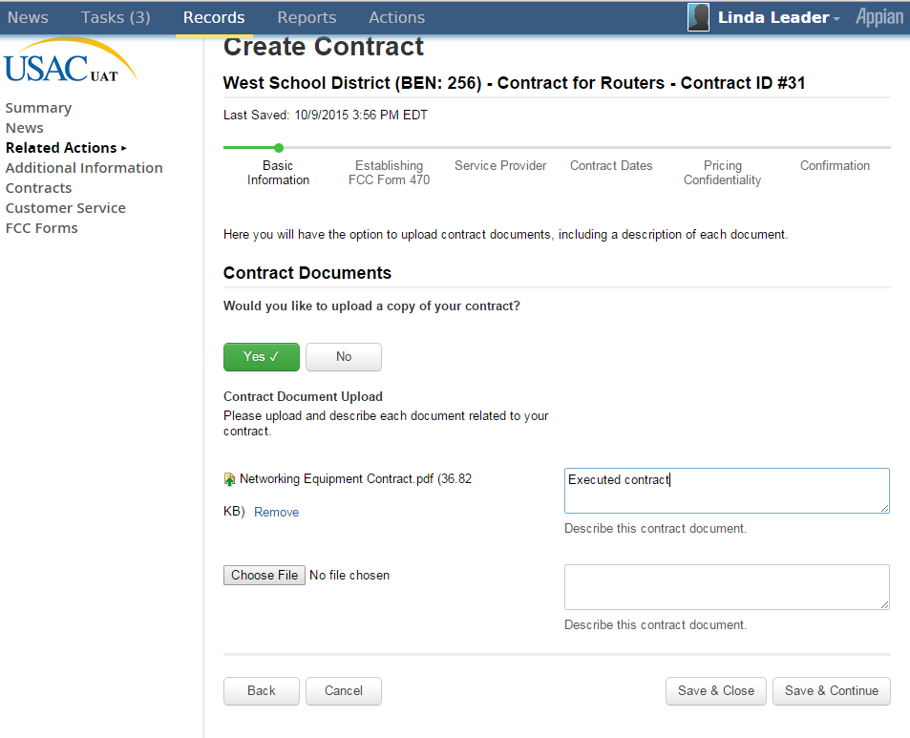
Upload Copy of Contract

Slide 73
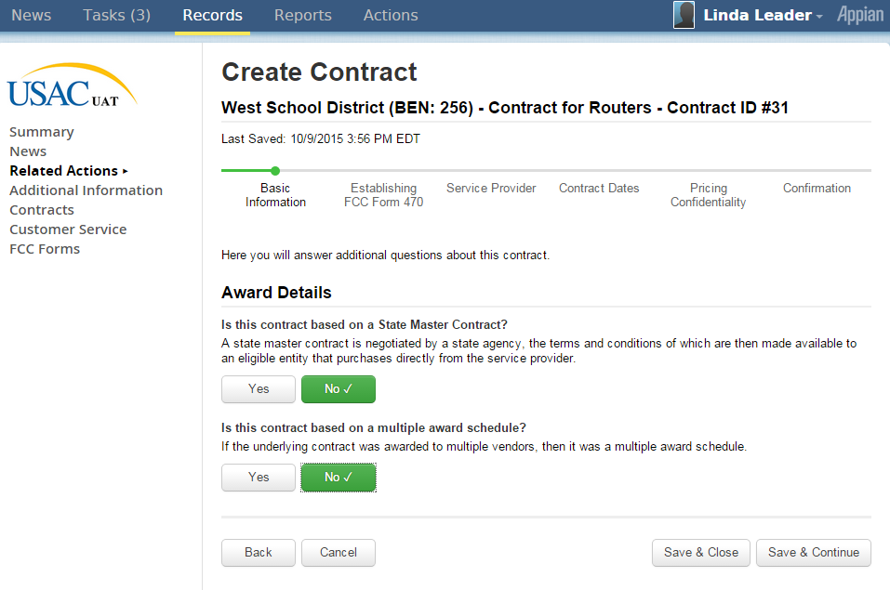
Contract Detail Questions

Slide 74
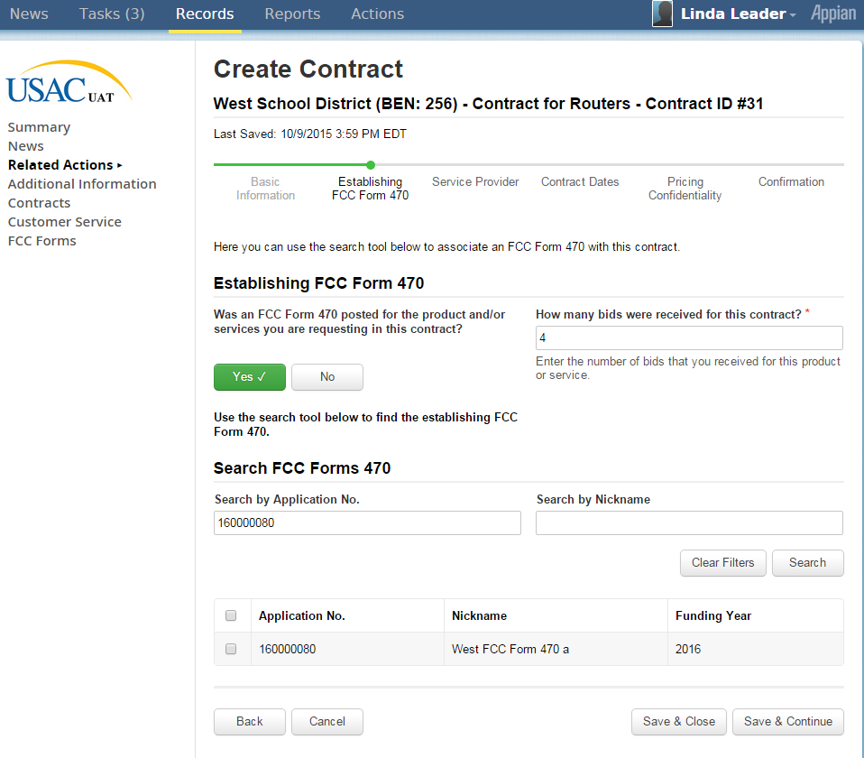
Associate FCC Form 470 with Contract

Slide 75
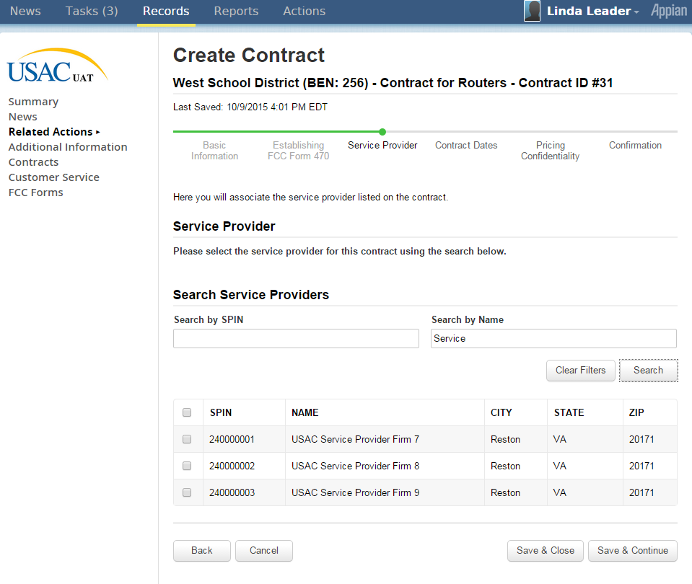
Associate Service Provider with Contract

Slide 76
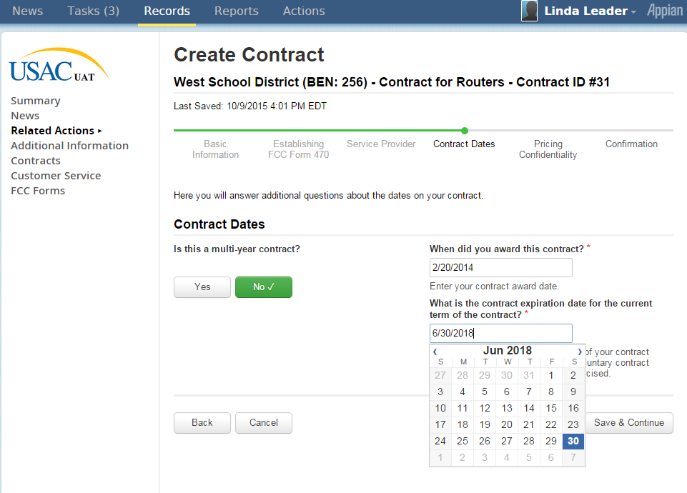
Contract Dates

Slide 77
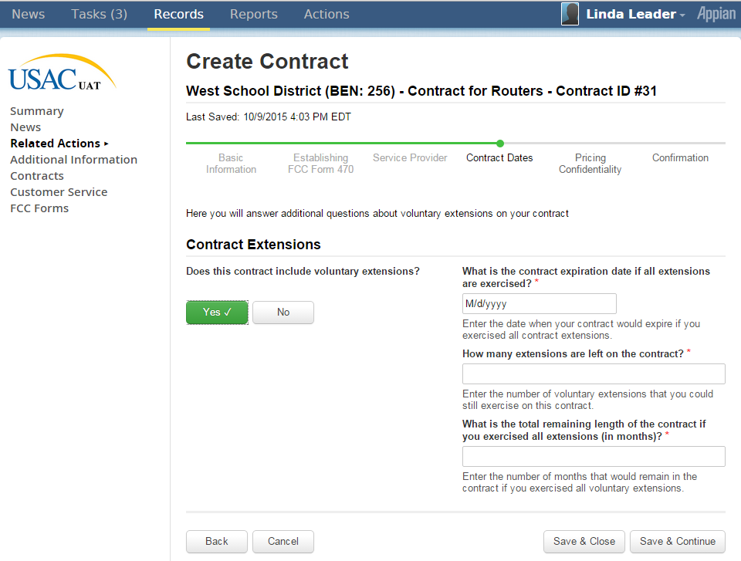
Contract Extensions

Slide 78
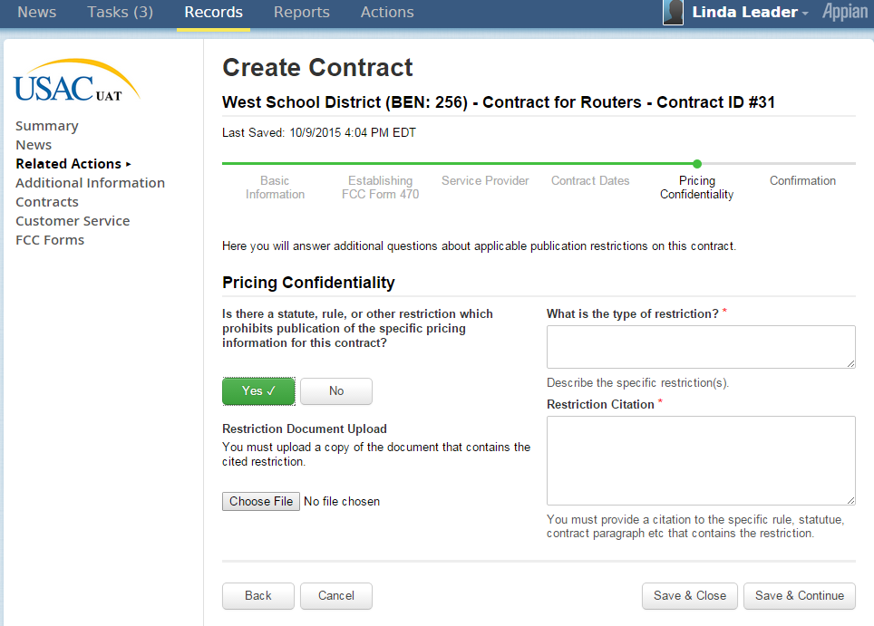
Pricing Confidentiality

Slide 79
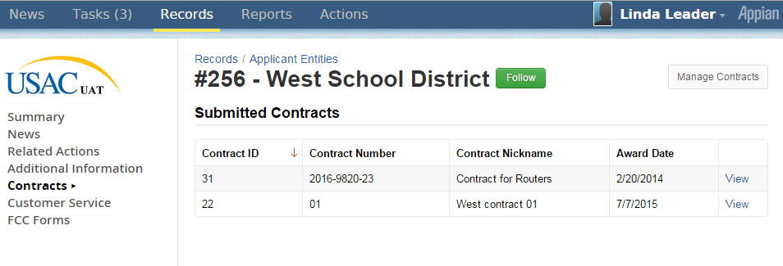
After confirmation by User, Contract Now Appears in EPC Portal Profile

