Slide 1
E-rate Form 498 (Banking Data) Filing Guide
Created by Julie Tritt Schell
PA E-rate Coordinator
May 2016
www.e-ratepa.org

Slide 2
Purpose of the Form 498
Beginning July 1, 2016, all E-rate BEAR reimbursements will be sent via ACH (Automated Clearing House) directly to the school or library’s bank account
The Form 498 identifies the bank and account information where the BEAR reimbursements should be electronically deposited
It’s a simple form to complete, but must be certified before any BEARs can be submitted to USAC

Slide 3
Who Can Submit the Form 498?
EPC User Permission Settings dictate who can create/submit the Form 498
“School or Library Officials” can start, complete, submit, certify, modify, and deactivate Forms 498
Important: Consultants cannot be designated as “School or Library Officials”
“General Financial Contacts” can start, complete, and submit Forms 498, but cannot certify new or updated Forms 498 or deactivate existing Forms 498
Consultants CAN be designated as “General Financial Contacts” and may draft the Form, but it must be sent to a School or Library Official for submission/certification

Slide 4
Information You’ll Need...
Name of General Financial Contact
Name of Remittance Contact
Name of Bank
School or Library’s Federal EIN Number
DUN and Bradstreet Number (DUNS)
Look-up tool available
Financial Institution Account Number for ACH
ACH Financial Institution Transit Number

Slide 5
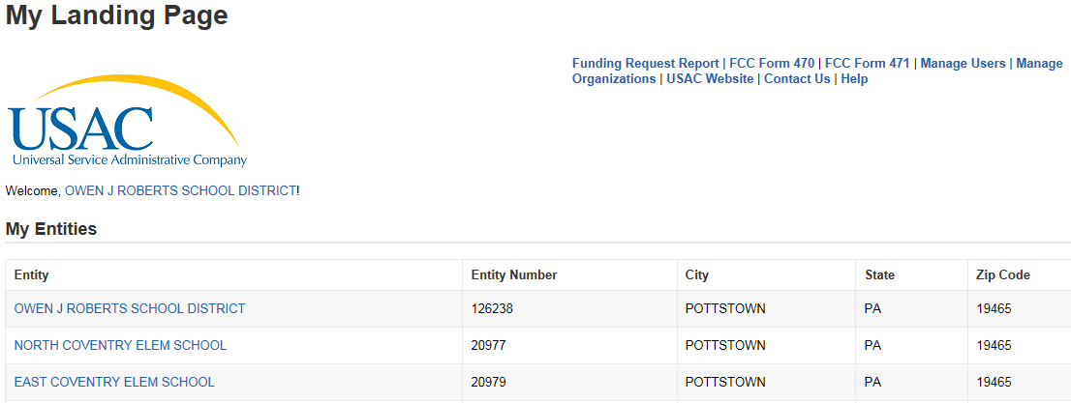
Verify Who Has Permission to Create Form
From your EPC Landing Page:
Click on District Name

Slide 6
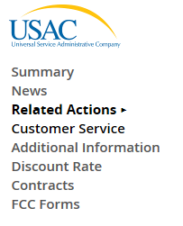
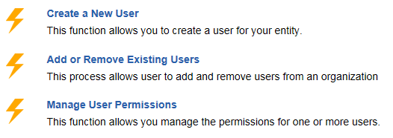
Who Has Permission to Create the Form
Select ‘Related Actions’ from left toolbar, then ‘Manage User Permissions’ from Lightning Bolt list

Slide 7
Identifying 498 Permissions
All users in your EPC portal will be shown here, along with their permissions for each form.
To Draft and Submit form, permission must be “School or Library Official.”
To Draft form only, permission will be set to “General Financial Contact.”

Slide 8
Let’s Complete a Form 498

Slide 9
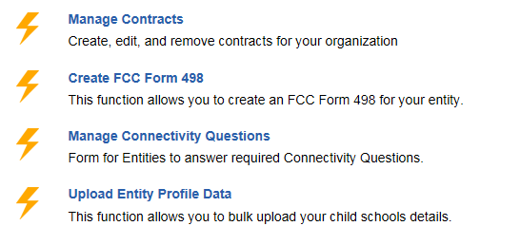
Finding the Form 498 in EPC
Select Related Actions from left toolbar, then Create Form 498 from Lightning Bolt list (it’s near the bottom of the list)

Slide 10
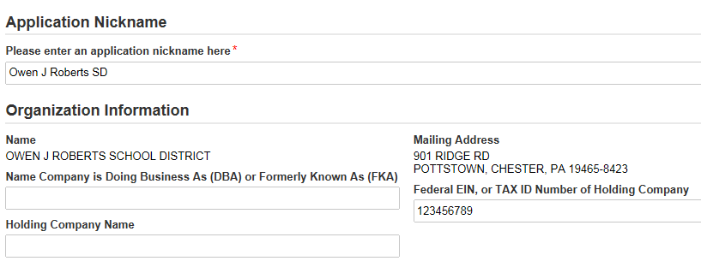
General Information
Make up a form nickname
Federal EIN or Tax ID Number required (9 digits, no dashes)
Fields not required

Slide 11
General Financial Contact
Name entered must match a “user” in EPC
Can be any user, even a consultant

Slide 12
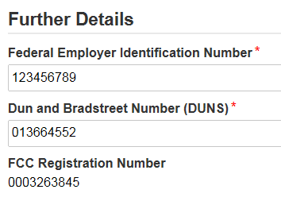
Federal ID and DUNS Numbers
All of these key pieces of data are required.
“Data Universal Numbering System” number (DUNS or D-U-N-S) is a proprietary system developed and regulated by Dun & Bradstreet (D&B) that assigns a unique numeric identifier, referred to as a "DUNS number" to a single business entity.
Note: The FCC Registration Number should pre-populate (note: this is not the same as the Form 471 FRN number).

Slide 13
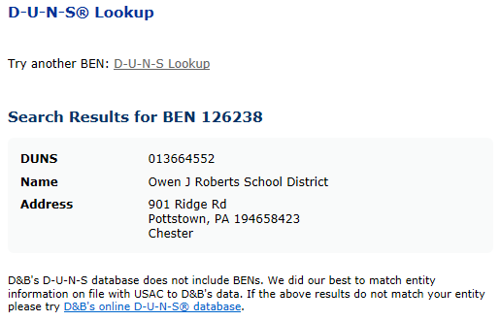
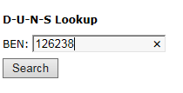
Don’t Know Your DUNS Number?
The easiest way to look it up is at:
http://e-ratecentral.com/us/DUNSLookup.asp
Enter your E-rate Billed Entity Number (BEN) and it will search/display results, if available.

Slide 14
Other Ways to Find DUNS Number
You can also search for your organization, by name, through D&B’s online D-U-N-S database: https://iupdate.dnb.com/iUpdate/companylookup.html
Or call (866) 705-5711 to speak to a representative
If your organization does not have a DUNS Number, you can apply online through Dun & Bradstreet’s website: http://www.dnb.com/get-a-duns-number.html

Slide 15
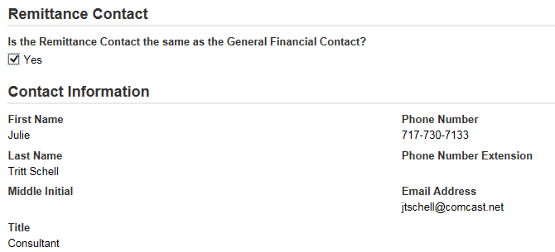
Remittance Contact
If the Remittance Contact is the same as the General Financial Contact on the previous page, check the “Yes” box and data will be prepopulated below.

Slide 16
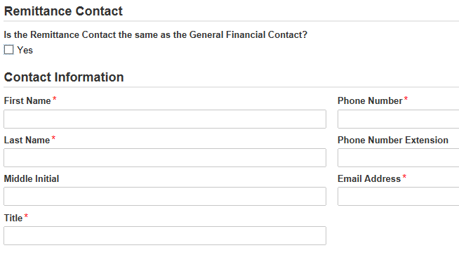
Remittance Contact
The Remittance Contact will receive e-mail notifications when funds have been transferred into the applicant’s bank account
Note: The BEAR Contact Person also will receive confirmation that the BEAR has been approved (via paper until an e-mail notification process has been established)
If the Remittance Contact is NOT the same as the General Financial Contact on the previous page, don’t check “yes” box and enter the data below. Note: The Remittance Contact does NOT have to be a user in EPC.

Slide 17
Financial Information
This is your Account Number.
This is your Bank’s Transit #.
Be 100% certain that the Bank Transit Number and Your Account Number are accurate and placed in the correct fields.
The order of these fields is reversed from how these items are commonly displayed.

Slide 18
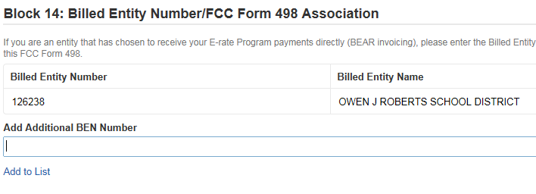
More Than 1 BEN Connected to the Same Bank Account?
If your school or library has more than one Billed Entity connected to this bank account, you can list that additional BEN number here.
Most applicants will leave this blank. Many IUs will use this field.

Slide 19
Certifying
If a School or Library Official completed the form, they can click on
If a General Financial Contact completed the form, they must click on

Slide 20
USAC Verification Process
After the 498 is certified, USAC will e-mail the General Financial Contact and ask proof of the bank account information which can be either:
A clear image of a voided check, or
A statement from your financial institution that includes the bank name and your account number
Fax the requested documentation to (888) 637-6226
Include on cover sheet:
Attn: Form 498 Processing Team
Name of Billed Entity
Billed Entity Number

Slide 21
USAC Verification Process
After bank account proof is sent to USAC, USAC will e-mail you a Form 498 Filer ID
After receiving this e-mail, you may file your Form 472 BEAR and the reimbursements will be deposited directly into your bank account
Both the Form 498 Remittance Contact and the Form 486 Contact will receive copies of the BEAR Approval Letter/Remittance Statements after the BEAR has been approved which will look like this:

Slide 22
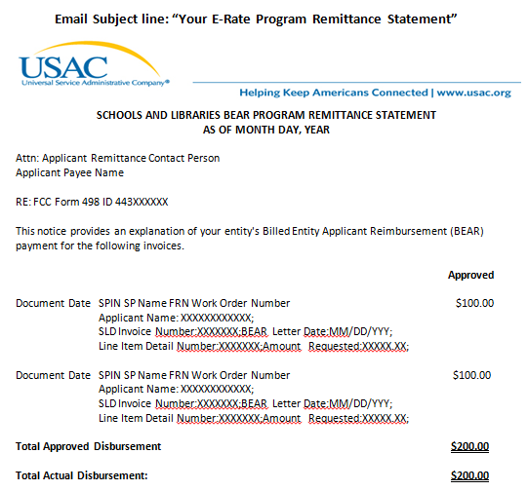
BEAR Form Remittance Statement

