Slide 1
Completing the Contracts Module for PEPPM-Generated Contracts
Complete this task BEFORE beginning a Form 471.
Julie Tritt Schell
PA E-rate Coordinator
October 2016

Slide 2
Do I have to use the contracts module?
For Category 2 funding requests, you must have a contract
Contracts, including PEPPM-generated contracts, must have been entered into the contracts module in order to be used in a funding request on the Form 471

Slide 3
Contracts Module
① On your organization’s Landing Page, click on the link for the school district or independent school if it is a school not associated with a school district

Slide 4
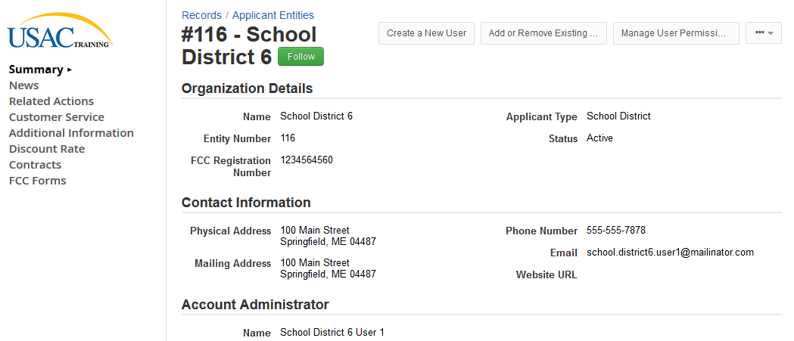
Contracts Module
② Click on the “Contracts” link in the menu of items on the left side of the organization’s page

Slide 5
Contracts Module
③ Click on the “Manage Contracts” button

Slide 6
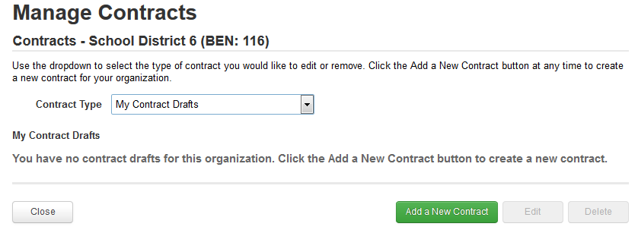
Contracts Module
④ Click on the “Add a New Contract” button

Slide 7
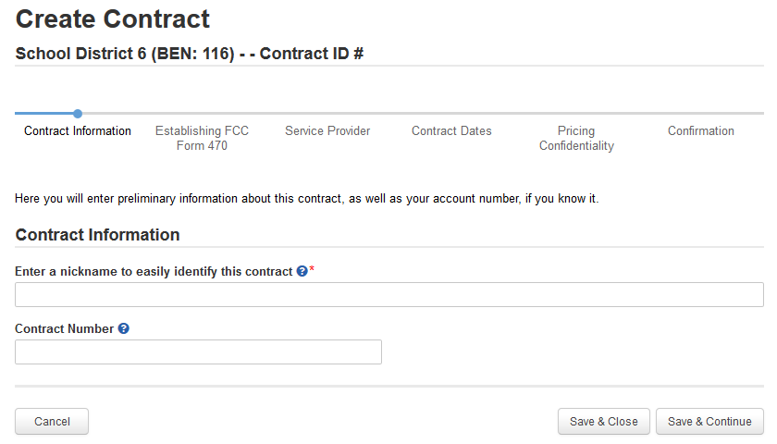
Contract Information
① Provide a Nickname for the contract that will serve as a reminder. It’s important that you list a very descriptive nickname such as:
FY 2017 Meraki/ePlus - High School Contract

Slide 8
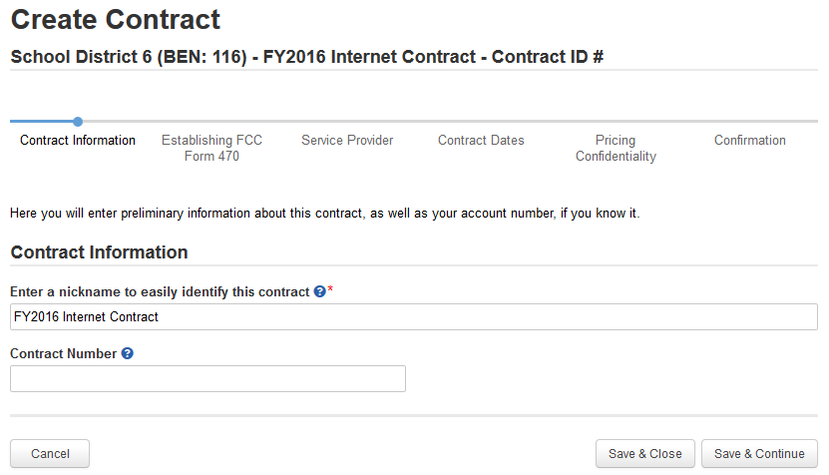
Contract Information
② Enter a contract number if you have one (you may leave it blank)
③ Click on the “Save & Continue” button to continue

Slide 9
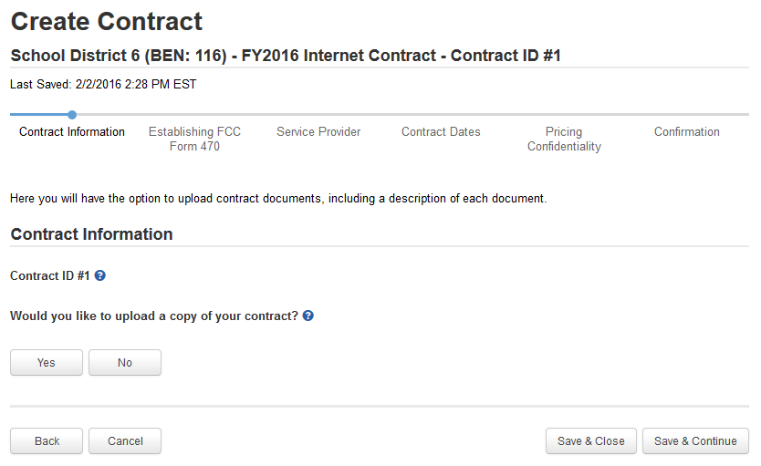
Contract Information
④ Determine if you wish to upload your contract to EPC. Note: It is not a requirement that you upload any contract, but for C2 requests, PIA will ask for them so it’s best practice to upload them into your contract module.
A number is assigned by the system
B
If you do not wish to upload the contract, click on the “No” button.
A
If you do wish to upload the contract, click on the “Yes” button. Hint: Upload C2 contracts because you’ll be asked for them in PIA.

Slide 10
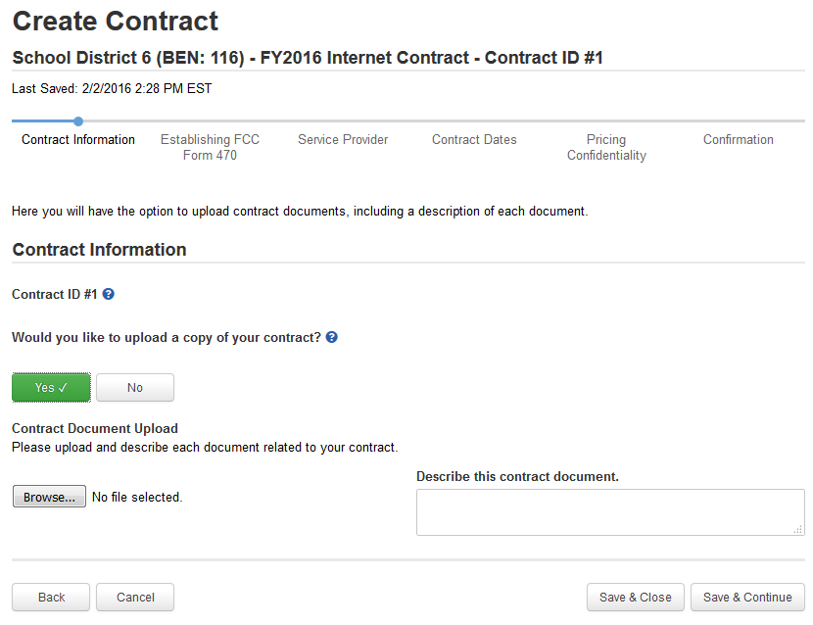
Contract Information
① If you chose “Yes”, use the “Browse …” button to locate your contract. Give the system a second to upload the file.
A

Slide 11
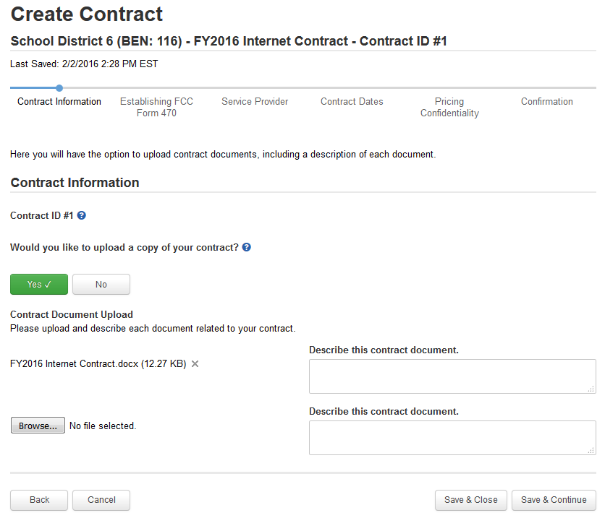
Contract Information
② Add a description if you wish
A
③ Repeat the process for any additional documents associated with this contract
A
④ Click on the “Save & Continue” button to proceed
A

Slide 12
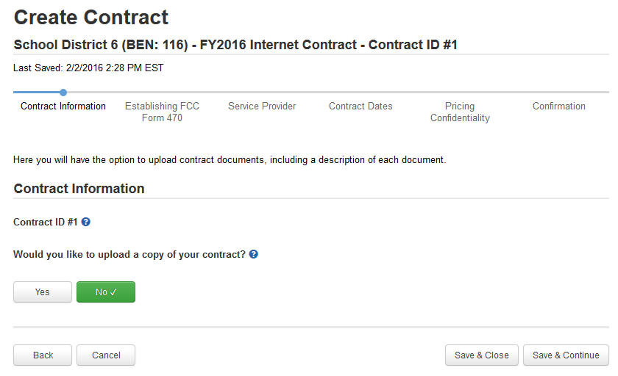
Contract Information
① If you chose “No”, click on the “Save & Continue” button to proceed
B

Slide 13
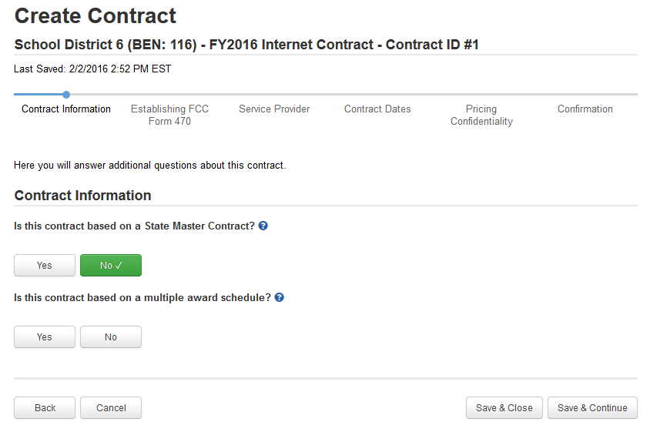
Contract Information
⑤ For PEPPM-generated contracts, select “Yes,” this is based on a State Master Contract.
⑥ For PEPPM-generated contracts, select “Yes,” there were multiple vendors awarded contracts.
⑦ Click on the “Save & Continue” button to continue

Slide 14
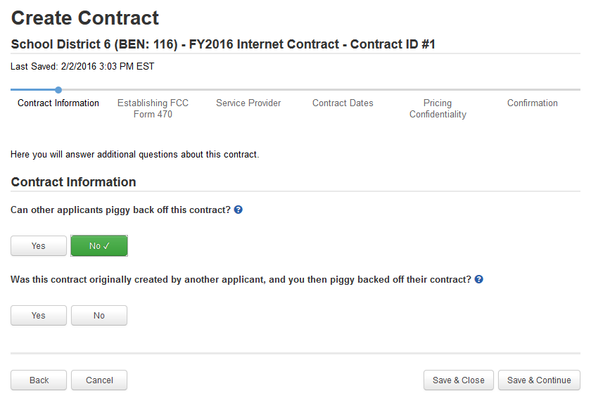
Contract Information
For PEPPM-generated contracts, the answer is “No.”
A
A
① Determine if you piggy backed off someone else’s contract. Most likely, the answer is “No.”
A
② Click on the “Save & Continue” button

Slide 15
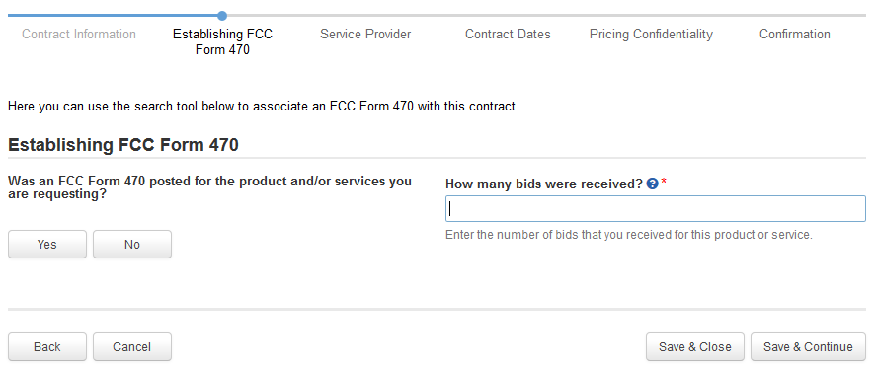
Establishing Form 470
① Click on the “Yes” button to indicate you posted a Form 470.

Slide 16
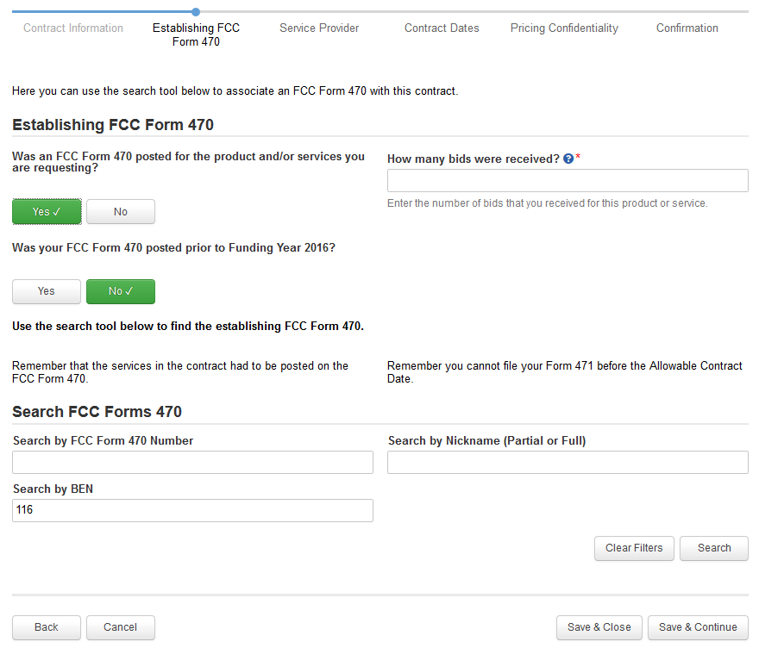
Establishing Form 470
② Enter the number of bids received during your PEPPM Mini-Bid procurement. It’s important that you get this right in case you are ever asked during PIA or in an audit to supply the winning and losing bids.

Slide 17
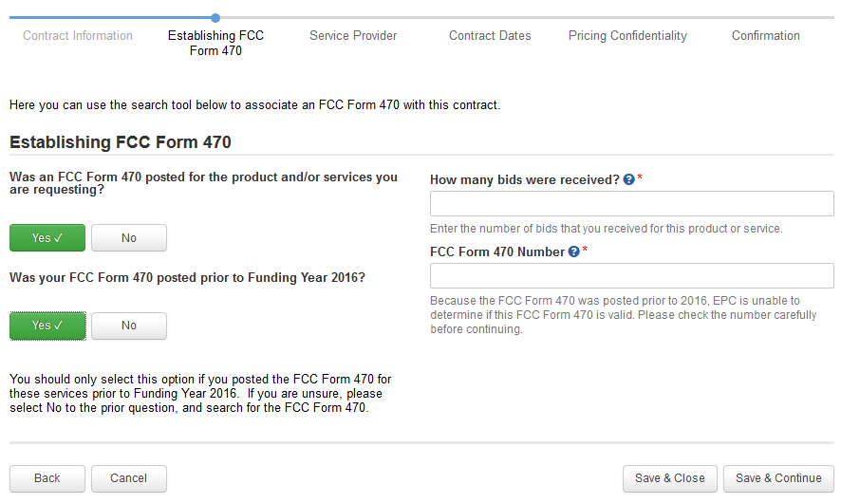
Establishing Form 470
For PEPPM-generated contracts, always select “Yes” as the 470 was posted prior to FY 2016. Then manually enter the 470 # 245730001240230.
245730001240230
B
① Enter the Form 470 Number.
B
② Click on the “Save & Continue” button

Slide 18
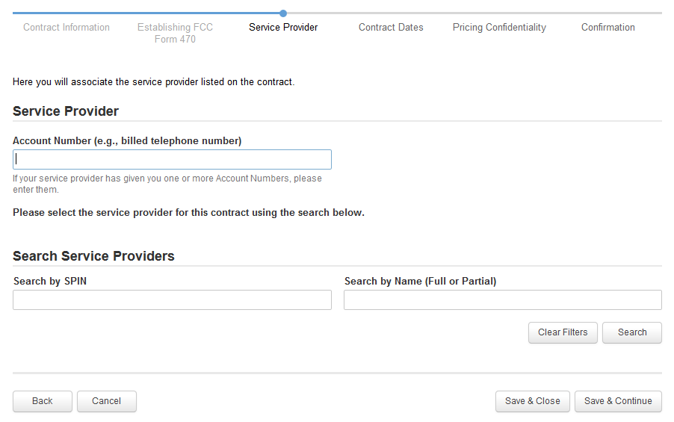
Service Provider
① Enter account number if you have one

Slide 19
Service Provider
② Enter the SPIN or Service Provider Name to search for your vendor
Hint: SPIN numbers are always 9 digits and begin “140xxxxxx”
③ Click on the “Search” button

Slide 20
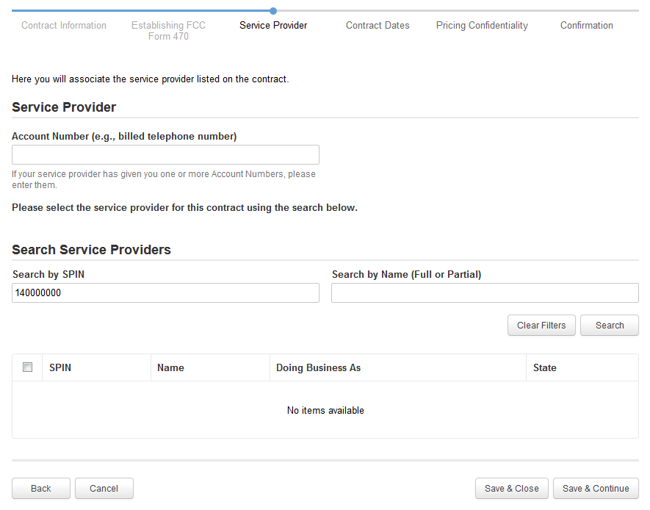
Service Provider
If your search terms were unsuccessful, click on the “Clear Filters” button to remove text entered into the search boxes and then try another search

Slide 21
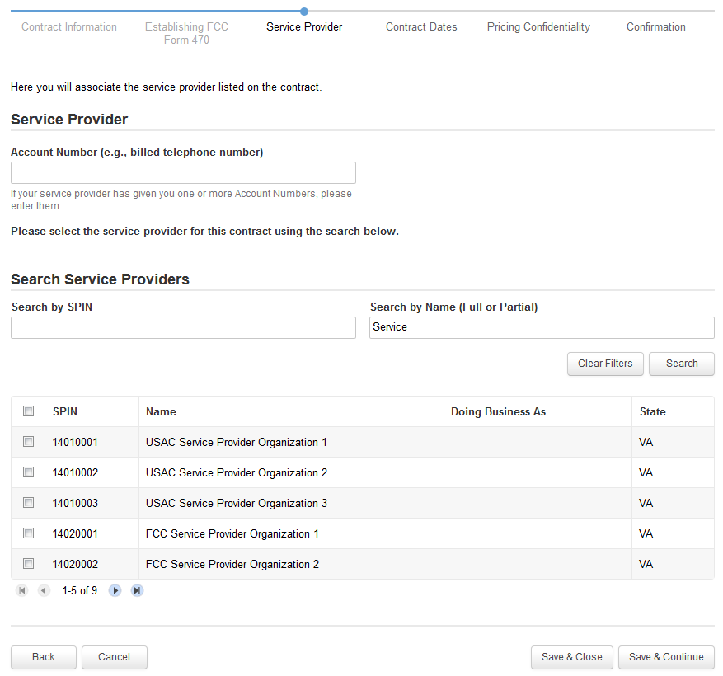
Service Provider
Results matching the criteria you used will appear in a list
④ Click the check box for the appropriate service provider
⑤ Click on the “Save & Continue” button to continue

Slide 22
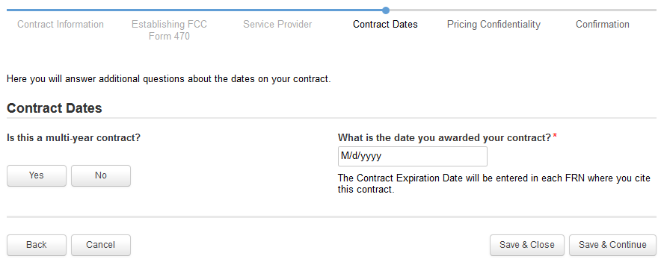
Contract Dates
① Determine if your contract is a multi-year contract. Most PEPPM-related contracts will NOT be multi-year.
A
If the contract is not multi-year, click on the “No button
B
If it is multi-year, click on the “Yes” button

Slide 23
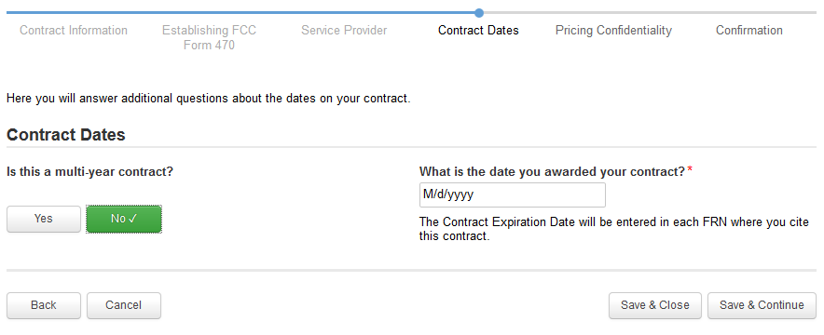
Contract Dates
② Enter the date you awarded this contract. Note: this is NOT the date that the vendor was awarded the contract with PEPPM. This is the date that the contract was signed between the district and the vendor.
Words of Caution: Your Contract Award Date must be before the date you file your Form 471.

Slide 24
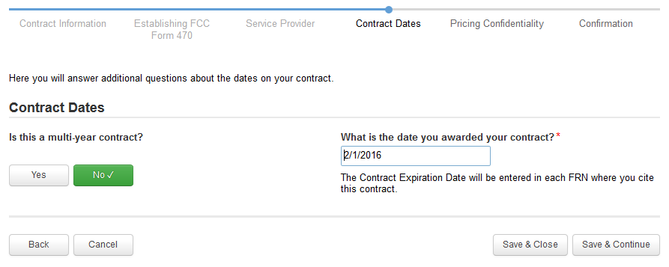
Contract Dates
③ Click on the “Save & Continue” button

Slide 25
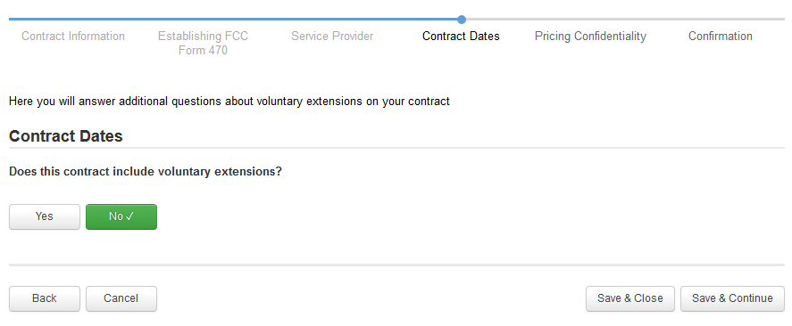
Contract Dates
A
The answer to most PEPPM-generated contracts is “No.”
A
① Click on the “Save & Continue” button

Slide 26
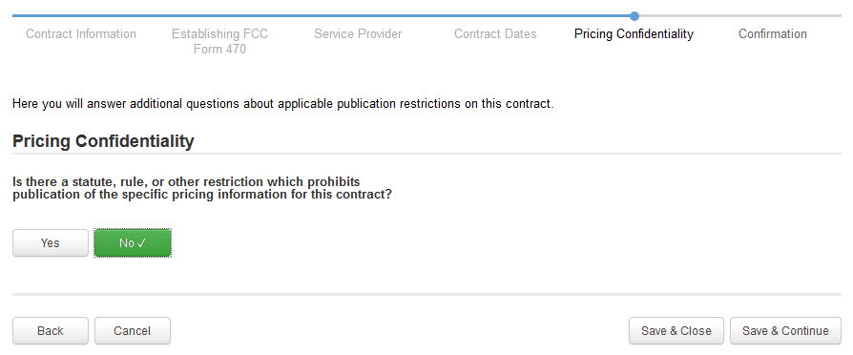
Pricing Confidentiality
For PEPPM-generated contracts, the answer is “No.”
A
① Click on the “Save & Continue” button

Slide 27
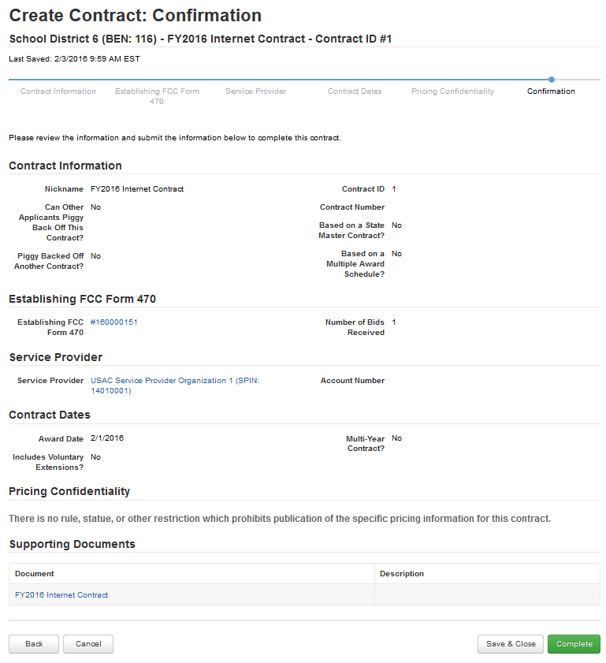
The contract info that has been entered will display
Confirmation
A
To save this contract as a draft so you can continue to edit it, click on the “Save & Close” button
B
To submit the completed contract, click on the “Complete” button

Slide 28
Confirmation
Submitted contracts appear in the Contracts Module list and can be referenced when filing a Form 471

Slide 29
Editing Draft Contracts
You can edit any contract that is still in draft form.
You cannot edit or delete any contract information that has been submitted and is no longer in draft.

Slide 30
Editing Draft Contracts
① On your organization’s Landing Page, click on the link for the school district or independent school if it is a school not associated with a school district

Slide 31
Editing Draft Contracts
② Click on the “Contracts” link in the menu of items on the left side of the organization’s page

Slide 32
Editing Draft Contracts
③ Click on the “Manage Contracts” button
NOTE: Only submitted contracts appear on this page

Slide 33
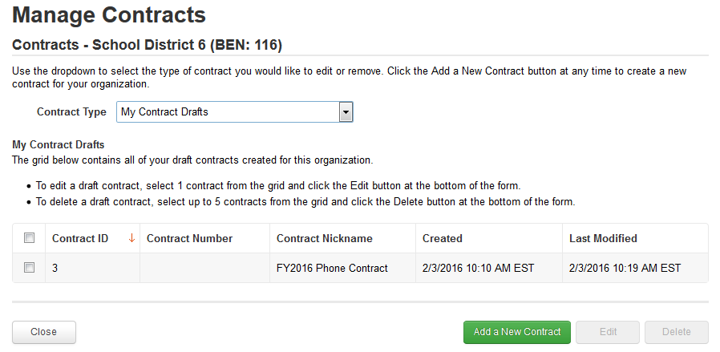
Editing Draft Contracts
Any contracts you have begun creating but not yet submitted and are still in draft form will appear by default in the list
④ Select the check box for the contract you wish to edit

Slide 34
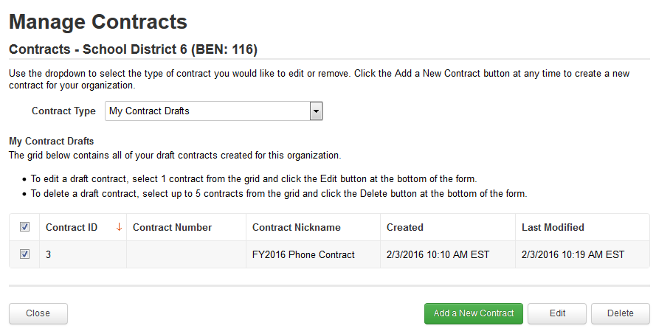
Editing Draft Contracts
⑤ Click on the “Edit” button to edit that contract

Slide 35
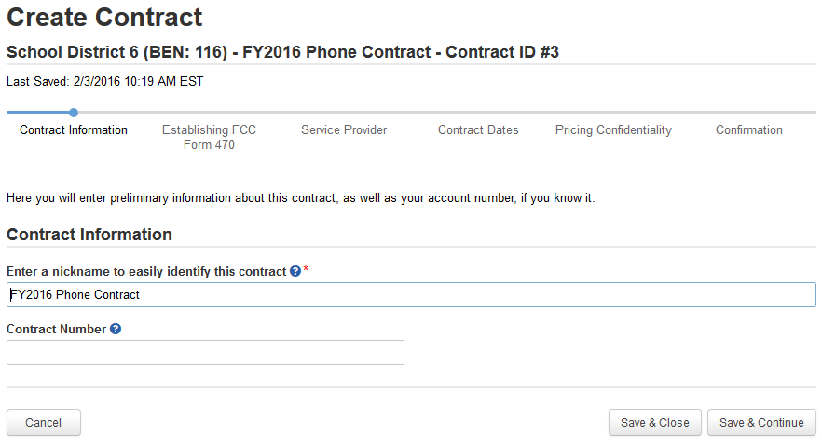
Editing Draft Contracts
⑥ Continue working on the contract creation process or edit the information as necessary

Slide 36
Removing Draft Contracts
You cannot recover a draft contract that has been deleted.
You cannot delete a contract after it has been submitted.

Slide 37
Removing Draft Contracts
① On your organization’s Landing Page, click on the link for the school district or independent school if it is a school not associated with a school district

Slide 38
Removing Draft Contracts
② Click on the “Contracts” link in the menu of items on the left side of the organization’s page

Slide 39
Removing Draft Contracts
③ Click on the “Manage Contracts” button

Slide 40
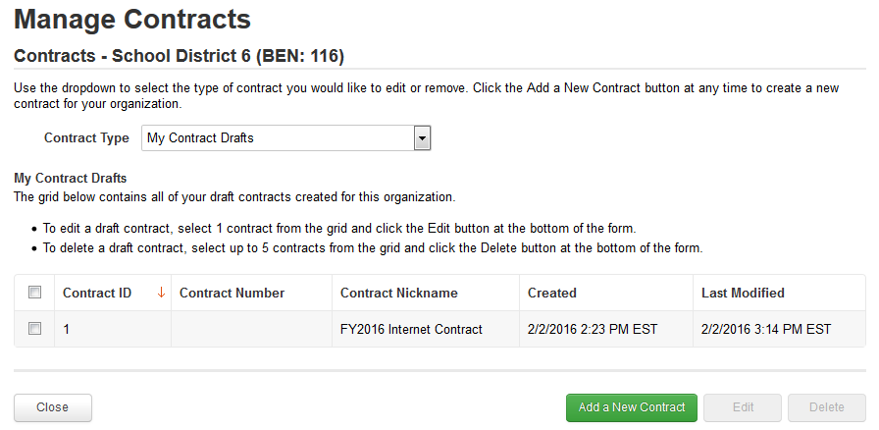
Removing Draft Contracts
Any contracts you have begun creating but not yet submitted (that are still in draft form) will appear in a list
④ Select the check box for the contract you wish to delete
NOTE: You can select up to five contracts to delete at one time

Slide 41
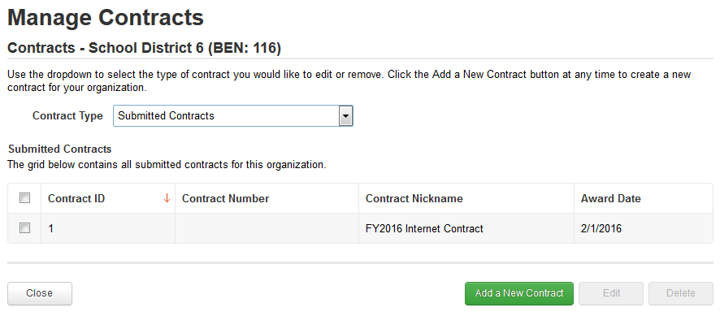
Removing Draft Contracts
To view submitted contracts on this page, change the “Contact Type” drop down menu to “Submitted Contracts”

Slide 42
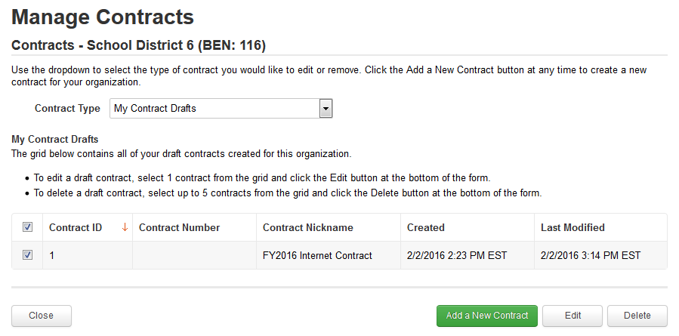
Removing Draft Contracts
⑤ Click on the “Delete” button to delete that contract

Slide 43
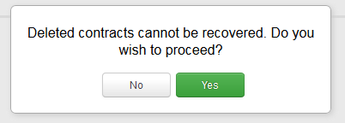
Removing Draft Contracts
⑥ Confirm that you wish to delete the selected contract by clicking on the “Yes” button

