Slide 1

E-rate Category 2 Eligibility and Form 470/Bidding Guide
- Public Schools
Funding Year 2024
Presented by Julie Tritt Schell
PA E-rate Coordinator
for the Pennsylvania Department of Education
October 2023

Slide 2




Categories of Service Recap
Category 1 – Services that go TO the school
  Subcategories:
    Data Transmission Services (fiber, coaxial cable, etc.)
    Internet Access
  Maximum discount is 90%
  No E-rate funding caps
Category 2 – Services/equipment that go INSIDE the school
  Subcategories:
    Internal Connections
    Basic Maintenance of Internal Connections
    Managed Internal Broadband Services (MIBS)
  Maximum discount is 85%
  Subject to 5-year E-rate funding caps

Slide 3
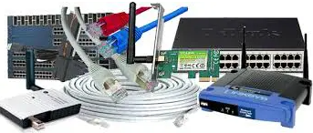
Internal Connections
Wireless Access Points/Controllers
Network Routers & Switches
In-Building Structured Cabling
Caching Servers
  Only eligible servers
Firewalls (appliances only)
  No ancillary modules/functions are eligible, like anti-spam, anti-virus, etc.
  No ‘redundant’ or high availability firewalls
Racks and UPSs
  That support eligible equipment only
  Network cards aren’t eligible
Equipment licenses
  Multi-year licenses can be requested in first year
Cloud-based functionality of this equipment
Operating system software to support eligible equipment
Installation and configuration
  If wanted, be sure to specify this in your 470/RFP
Taxes and fees
Basic training on use of equipment
Not eligible:
  Storage Devices
  Voice/Video Components
  End User Devices

Slide 4
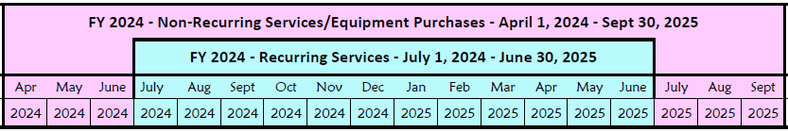
Internal Connections Purchase Timeline
Equipment can be purchased as early as April 1, prior to funding year start
  For example, applicants can purchase equipment on April 1, 2024 for FY 2024, even though funding year doesn’t begin until July 1, 2024
  However… vendors/applicants cannot be reimbursed from USAC until July 1
  Applicants that purchase equipment prior to receiving funding commitment letter are risking paying full price
Equipment can be purchased as late as September 30, following the end of funding year
Allows applicants two full summers to install equipment

Slide 5
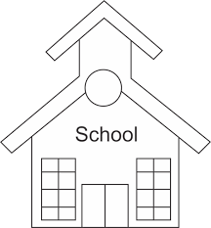
School-to-School Fiber Eligibility
For schools that are in close proximity, applicants often want to use C2 funds to install fiber between them
FCC has well intentioned, but restrictive, rules related to these connections, as follows:
  1 school but located in 2 buildings (rare)
    Fiber between those buildings = Category 2
    Does PDE recognize it as single school?
  2 schools but located in same building (rare)
    Fiber between those schools = Category 2
  2 schools but located in different buildings (common)
    Fiber between these buildings = Category 1
    Considered “Self Provisioned Fiber” and must bid accordingly on Form 470
    Cannot use C2 funding, unfortunately
fiber

Slide 6
Basic Maintenance (BMIC)
Eligible:
  Repair and upkeep of eligible hardware
  Wire and cable maintenance
  Configuration changes
  Basic technical support including online and telephone-based technical support
  Software upgrades and patches including bug fixes and security patches
Eligibility limitations:
  Contract must specifically identify the equipment being covered, including product name, model number and location.
  Support will only be paid for actual work performed under contract.
  Support for bug fixes, security patches, and technical support is 100% eligible
BMIC does not include:
  Services that maintain ineligible equipment
  Upfront estimates that cover the full cost of every piece of eligible equipment
  Services that enhance the utility of equipment beyond the transport of information or diagnostic services in excess of those necessary to maintain the equipment’s ability to transport information
  Network management services, including 24-hour network monitoring
  On-site technical support (i.e., contractor duty station at the applicant site)
  Unbundled warranties

Slide 7
Basic Maintenance (BMIC) Recommendation
I do not recommend that applicants use their C2 budgets for BMIC. Why?
Can only be for services/work performed from during 12 month funding year (7/1/2024 – 6/30/2025)
  Does not follow the 4/1/2024 – 9/30/2025 schedule
  Does not follow the first 12 months of ownership schedule
Multi-year contracts must be amortized
  Cannot apply for full cost of multi-year BMIC contract in Year 1
  Must amortize and request discounts for each year, annually
Next day replacement contracts not eligible
  Only basic tech support, configuration changes are 100% eligible
Conditionally eligible = repair of equipment, cable maintenance
  E-rate will commit based on amount of contract
  BUT…. will only reimburse for time/parts used
  C2 budget takes “hit” based on full commitment, not funds “used”
  ~ Use your Category 2 budgets for equipment and installation ~

Slide 8
Managed Internal Broadband Services (MIBS)
Definition:
  Services provided by a 3rd party for the operation, management and monitoring of eligible internal connections (managed wi-fi)
Eligible:
  Management and operation of the LAN/WLAN, including installation, activation, and initial configuration of eligible components and on-site training on the use of eligible equipment
Eligibility limitations:
  Only eligible equipment may be managed
  Must have listed specific equipment to be maintained in RFP
Has traditionally not been popular among applicants
2 Options:
  Paying an outside vendor to own/maintain the equipment
  Paying an outside vendor to maintain school-owned equipment
Subject to the C2 budget caps

Slide 9
Equipment Transfer/Disposal Rules
Transfers: As of July 1, 2021, E-rate funded equipment from any year may be transferred between eligible buildings
  If equipment is transferred between buildings within 5 years from date of purchase, must record reason and date of transfer and update asset inventory
    No notice to USAC is required
  Asset inventory must be retained for 10 years from date of purchase
Disposal: Equipment may be disposed of, sold, transferred, etc. from 5 years from the date of installation
    No notice to USAC required but asset inventory must be updated

Slide 10

NIFs Not Eligible for C2 Funding
  Non-instructional facilities (NIFs) are ineligible for C2 funding
    Must deduct proportional share of NIFs use of any shared equipment
  Equipment may be housed at a NIF, however
    For example, a Wireless Controller may be housed at data center
    Wireless Access Points in NIFs may not be purchased with E-rate funds
    After 5 years, transfer equipment to NIF

Slide 11
PA Prevailing Wage Requirement
PA public school entities are required to comply with the Prevailing Wage Act for public works contracts which include ‘construction, reconstruction, demolition, alteration and/or repair work other than maintenance work, done under contract and paid for in whole or in part out of the funds of a public body where the estimated cost of the total project is in excess of $25,000.’
Maintenance work is defined as the repair of existing facilities when the size, type or extent of such facilities is not thereby changed or increased.
In speaking with several knowledgeable school officials, they believe that structured cabling projects costing more than $25,000 would be required to comply with the Prevailing Wage Act.
  You will want to check with your school district solicitor to determine if they believe the Prevailing Wage Act applies
If PW applies be sure to obtain a Prevailing Wage Determination from the PA Department of Labor and Industry (http://www.dli.pa.gov/Individuals/Labor-Management-Relations/llc/prevailing-wage/Pages/Prevailing-Wage-App.aspx) and include this requirement and PW Determination in your structured cabling RFP/procurement.
The federal Davis-Bacon Act does not apply to E-rate funds

Slide 12
Category 2 Budget Calculations

Slide 13
Category 2, 5-Year Funding Caps
Current C2 budget cycle – Funding Years 2021 – 2025
  All C2 budgets will reset in FY 2026 and no funding will be carried over
  C2 budgets are pre-discount
    Applicants’ E-rate discounts then apply
C2 Budget Multipliers:
Single Schools:
$167 x total enrollment OR $25,000, whichever total budget is greater
School Districts:
$167 x total district enrollment, OR
$25,000 x total number of schools in the district
– Whichever total budget is greater
Independent Libraries:
$4.50 x total square footage OR $25,000, whichever total budget is greater
Library Systems:
$4.50 x total square feet of all library branches OR $25,000, whichever total budget is greater

Slide 14
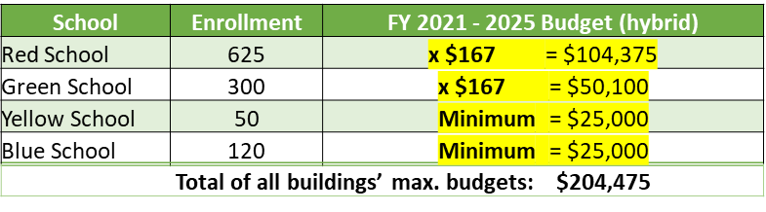
Special C2 Budget Calculation Option for Smaller School Districts
School Districts with 10 or fewer schools – 3 options:
Calculate by total enrollment x $167
  or
Calculate by total number of schools x $25,000
or
Calculate by school and take the higher amount ($25,000, or enrollment * $167) from each school and add together
System will use whichever budget option is higher, a, b, or c

Slide 15
Category 2 Pre-Discount Budget Example
5-Year C2 Budget Cap* | E-rate Discount | E-rate Will Pay: | District's Share % | District Must Pay:
$204,475 | 60% | $122,685 | 40% | $81,790
* The C2 Budget Cap is the pre-discount price. E-rate discounts will then apply on top of the
budget cap. In this example, district would still owe their 40% non-discounted share
Future funding years: To determine what “remains” in a C2 budget for future years in the C2 “cycle”, take the 5-Year Budget Cap and subtract the pre-discount amounts of what has been “committed” in the previous year(s) of the C2 cycle
What is YOUR Remaining Category 2 Pre-Discount Budget for Current 2 Budget Cycle?

Slide 16
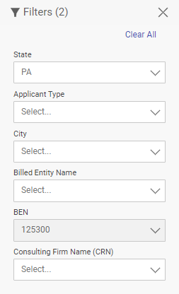

Calculating Remaining C2 Budgets
What is your remaining Category 2 Budget for this C2 cycle?
1) Go to: https://opendata.usac.org/E-rate/E-rate-C2-Budget-Tool-FY2021-/8z69-hkn7
2) Enter BEN to filter just your entity’s data
3) Summary Table will appear
Review these columns:
Amount of any “still pending FRNs” in FY 2021, 2022, 2023
C2 enrollment currently in EPC
5-Year Pre-Discount C2 Budget
Amount “committed” in FY 2021- FY 2023
Remaining available C2 Budget

Slide 17
Data Used for Category 2 Budgets
Enrollment data entered in separate location in EPC (different from discount calculations)
Why? Enrollments are set at first year you apply for C2 during that Category 2 Budget Cycle
Not required to update annually
CAN update if it will increase your C2 budget
  Must then ask for C2 Budget Recalculation from USAC
Where to update C2 enrollment data?
>>> EPC Landing Page > District Name > Manage Organization > Scroll to bottom of page

Slide 18

Requesting More Funding Than Remains in C2 Budget
Don’t Do It.
Ever.
Ever.
What happens if you do?
  Your E-rate application will go into manual processing and funding will be delayed
  You will be required to identify exactly what FRN line items should be reduced or eliminated to come into budget – USAC will not do this for you

Slide 19

Category 2 bidding requirements

Slide 20
C2 Bidding Requirements (applies to all applicants)
Equipment list MUST allow for equivalent manufacturer’s products to be bid
  “Cisco 48-port PoE Switch or equipment that is equivalent in functionality and quality”
  May include a requirement that equivalent equipment must be fully interoperable and compatible with District’s existing “XYZ” equipment
    Be sure to list your existing equipment
Binary bid disqualification reasons be stated in the State and Local Procurement Requirements of the Form 470 or in the RFP
  DQ reasons must be yes/no (either they complied or they did not)
Absent a bid due date, applicants are now required to consider all bids received up until the date you conduct your bid evaluation. Therefore, I suggest including the following language:
“Deadline for vendor proposals is [January 8, 2024] at 9:00 am Eastern. We reserve the right to reject late-submitted proposals. Proposals must be e-mailed to the Form 470 contact unless otherwise noted.”

Slide 21
C2 Bidding Requirements (applies to all applicants)
Companies deemed national security risks
  FCC prohibits the use of Universal Service funding, including E-rate funds, to purchase equipment and services from companies deemed a national security risk. Be certain that you do not consider any proposals that include any of the companies listed here: https://www.fcc.gov/supplychain/coveredlist
All RFP amendments/Q & A/additional information given to bidders besides what is in the original Form 470 or RFP must be uploaded into EPC with original Form 470
  Includes relevant information given to vendors that would impact bid (FAQs)
    Locate 470 in EPC > Related Actions > Add an RFP Document
    Restart 28-day clock for service or entity changes
  Restart 28-day clock if “cardinal change” made to RFP (adding equip/services, modifying project scope)
Cannot contact vendors ahead of bidding to seek equipment list
All C2 services/equipment must have a signed contract before Form 471 is filed

Slide 22

CATEGORY 2 BIDDING OPTIONS FOR PA PUBLIC SCHOOLS
PA public schools have two options to competitively bid E-rate eligible equipment:
Post Form 470 & RFP in EPC
~ or ~
Conduct Mini-Bid Using PA PEPPM Contract
Note:
Directions for using either procurement option take into account PA procurement laws
PA Co-Stars Contract is not E-rate eligible
E-rate is not subject to federal UGG requirements

Slide 23
Comparison: PEPPM vs 470/RFP
470/RFP – Option 1
Must post 470 & RFP if over
$22,500
More appropriate for cabling projects, in addition to equipment/installation
Can provide greater specificity about requirements
Can require compatibility and interoperability with existing equipment (both)
Don’t have to solicit bids from any vendor
Cannot consider non-cost factors during bid evaluation. If all RFP criteria have been met, must select lowest bid
PEPPM – Option 2
Don’t have to post Form 470/Issue RFP
Don’t have to advertise in newspaper
DO have to conduct mini-bid of every vendor that sells equipment in that category
Don’t have to wait full 28 days during
mini-bid process
Can require compatibility and interoperability with existing equipment (both)
More appropriate for
equipment/installation, rather than cabling project
Can consider non-cost factors as
long as costs of E-rate eligible equipment/services are most heavily weighted factor

Slide 24
Bidding Option #1:
Post Form 470 with RFP

Slide 25
Option 1) File a Form 470 and issue an RFP
RFP must be uploaded with the Form 470 as the form is being created, and the procurement must be advertised in at least 2 local newspapers of general circulation once a week for 3 consecutive weeks
  Advertising must be done concurrently with the Form 470 bidding period
On the 29th day after the Form 470 was posted (or later), schools must select the lowest price bid among all qualified proposals (those that met the minimum bid requirements outlined in the RFP)
  Under state law, schools are generally not permitted to consider other bid evaluation criteria besides price
Schools will then contact the winning vendor to obtain a contract document (or final quote with exact quantities) for the District to sign
(C2 Equipment/services costing between $11,800 - $22,500: If no RFP is issued, schools must request written or telephonic price quotations from at least three bidders, in addition the Form 470 bidding process)
Best Practice Timeline: Post 470/File RFP by Thanksgiving, conduct your bid evaluation in early January, have your board approve the contract at their January or February board meeting(s), and file the Form 471 in early March.
Helpful Guide: http://e-ratepa.org/wp-content/uploads/2014/03/8-5-RFP-Form-470-Narrative-Guide-FY-2023-PA-NEW.pdf

Slide 26
Hints When Constructing Form 470
Always list bid due date/time
  “Bids are due on X date/time to Y person. We reserve the right to accept late-submitted proposals.”
List all possible disqualification factors (Y/N format)
List interoperability and compatibility requirements
  “Must be interoperable with the school’s existing XYZ equipment”
Consider pre-bid walk through for cabling projects
It’s ok to forward your posted 470 to potential vendors to encourage bidding
Although RFPs aren’t required, even a 1-page document describing your project and disqualification criteria is a good idea
  That way the system permits future amendments/documents to be uploaded with the existing 470

Slide 27
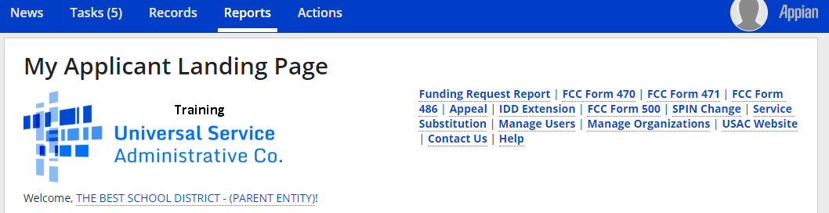
470 – File Inside Your EPC Portal

Slide 28
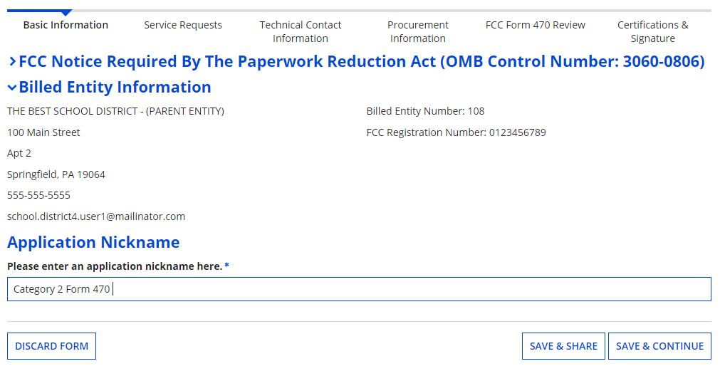
Give it a Nickname
Use a well-described nickname for easier identification in EPC.

Slide 29
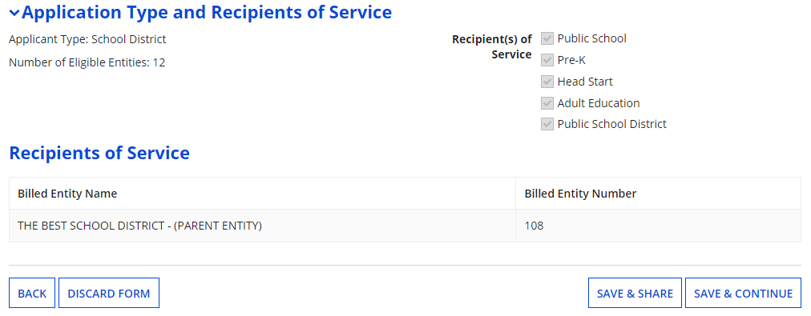
Basic Information – Can’t Change in Form
# of Eligible Entities is pre-populated from the EPC Profile. It is the total # of entities in the district, not necessarily the # of entities seeking service on this 470.

Slide 30
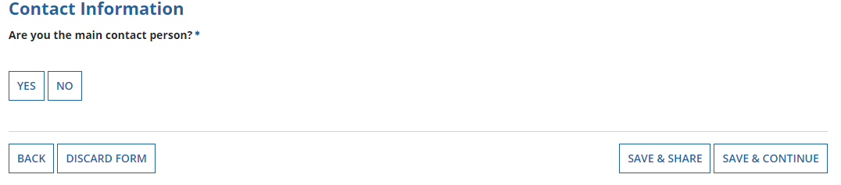
Who is the Main Contact?
If you select ‘No’ then you must select another User in your EPC profile. The system will not let you type-in someone’s contact information. To add a User, have the EPC Account Administrator go to > Related Actions > Add User

Slide 31
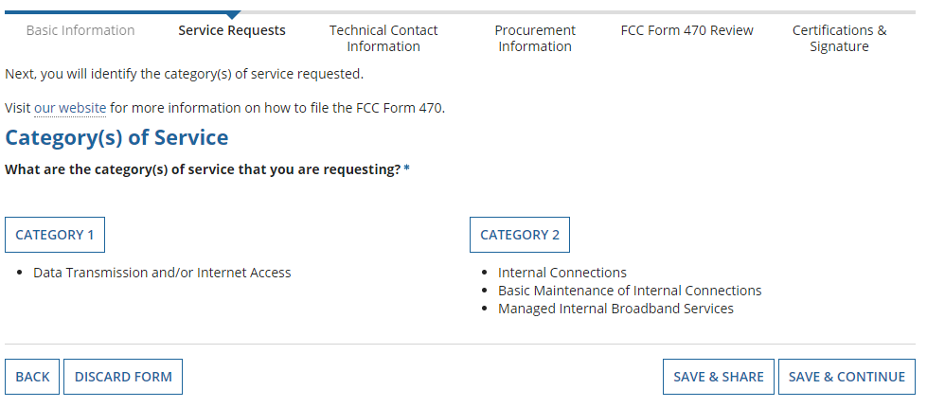
Select Category(ies) of Service
You can include both C1 and C2 requests on the same Form 470, but it’s not required.

Slide 32
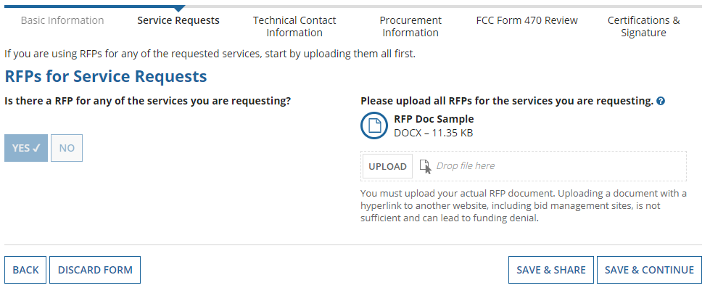
Do You Have an RFP?
If you have an RFP or any documents you will be providing to vendors, you must upload them with the Form 470. The system will allow you to upload multiple documents and then you can decide which requests belong with which RFP documents.

Slide 33
Building Category 2 Service Requests

Slide 34
Category 2 Form 470 for FY 2024
Beginning in FY 2022, the FCC revamped the Form 470 to be description-based
Basic maintenance is now a check-off box on an internal connections request, but can also be a stand-alone request
Using the following “Category 2 Cheat Sheet” to select the option that best reflects the service you’re seeking
  A green star indicates the most common choice

Slide 35
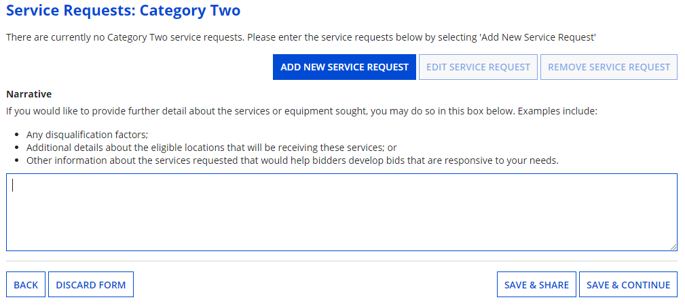
Begin Building the Category 2 470
Choose “Add New Service Request” to select detailed choices.

Slide 36
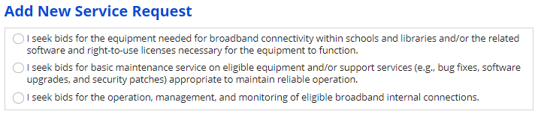
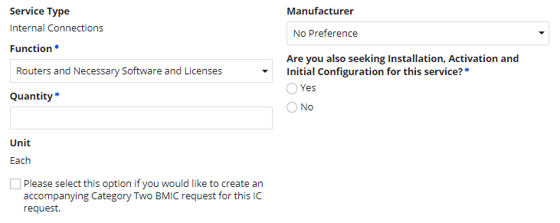
Form 470 Service Requests
Use for equipment/license requests (most common)
Use if bidding maintenance ONLY (uncommon)
Use if bidding managed internal broadband services (MIBS) (uncommon)
If you want vendors to include pricing for support with their quotes, check this box

Slide 37
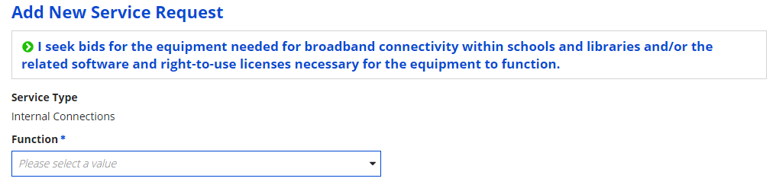
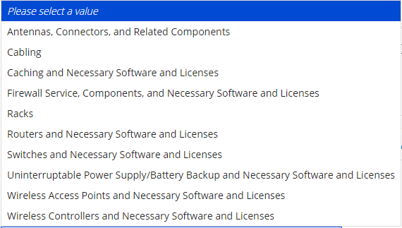
Internal Connections Drop Down Menu Options
Select the equipment type you’re seeking. If more than one, create a separate service request

Slide 38
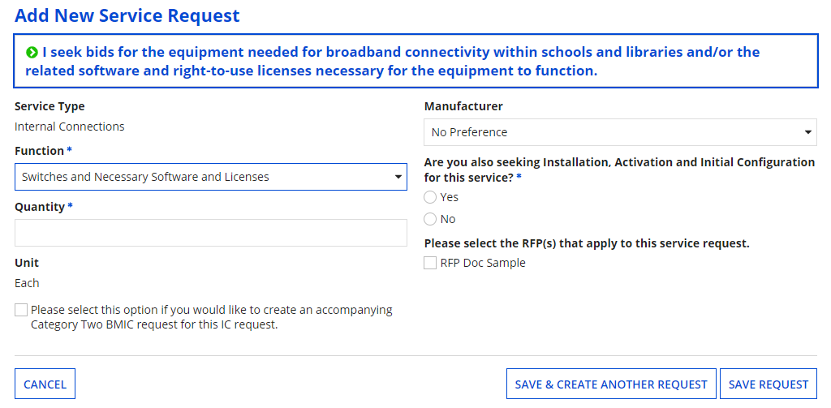
Service Request Details
Choose your preferred manufacturer. If not listed, select ‘Other’ then type in the manufacturer’s name and include the words “or equivalent”
If you want maintenance/support for this equipment, check this box. No separate BMIC service request is needed
Provide additional details about your service/equipment requests in the narrative.

Slide 39
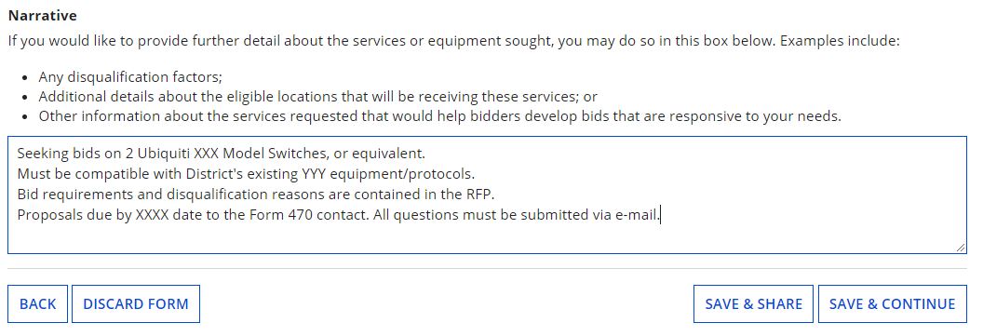
Narrative in Text Box for C2 Requests
Use the narrative text box to describe the equipment you’re seeking, or direct bidders to the attached RFP

Slide 40
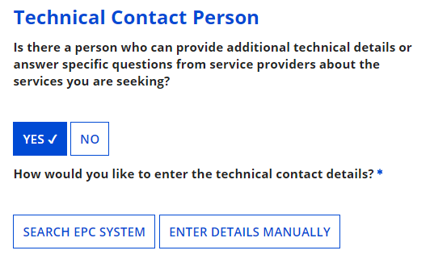
Want to Add Technical Contact?
You may add a technical contact that vendors can contact to ask additional questions about the procurement
  Not a requirement to add a separate technical contact
If you do, you may select a current EPC User OR you can manually enter the name/contact information of the contact

Slide 41
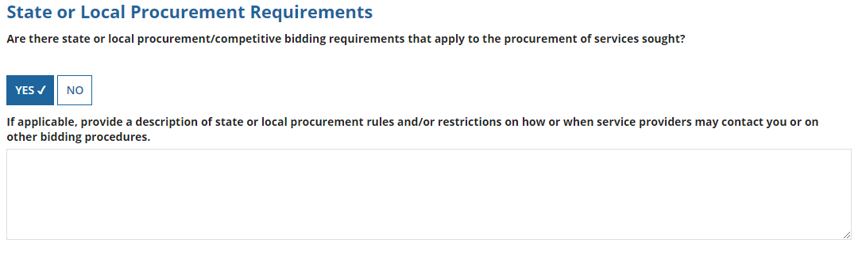
State or Local Procurement Rules?
Always select YES!
Then use the narrative box to provide additional requirements/instructions to vendors or direct bidders to your RFP
For example:
  All bids must be submitted to X person by X date in X format
  Vendor must provide discounted bills
  Vendor must submit 3 references of district officials where identical services were provided within last 2 years
  Vendors must attend pre-bid meeting on X date

Slide 42
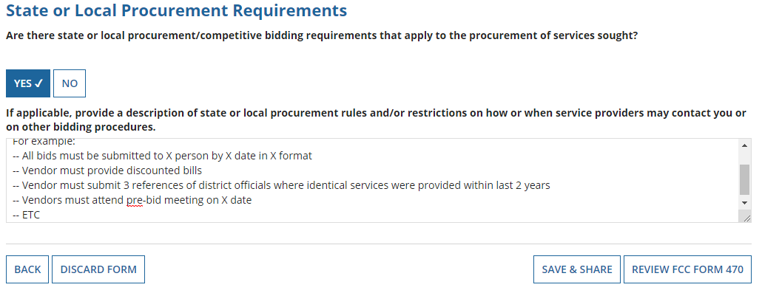
Generate PDF to Review
Click “Review FCC Form 470” to have the system generate a PDF copy of your draft Form 470 to review

Slide 43
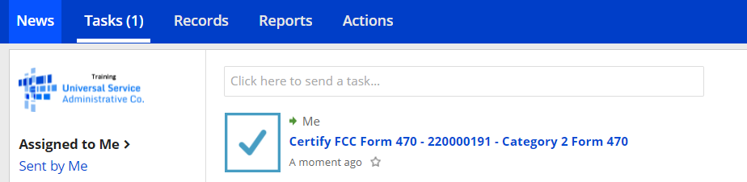
Generate PDF to Review
In about 15 seconds, the draft Form 470 PDF will be available as a “Task” in the top blue toolbar of your EPC Portal. Click on Tasks, then click on “Certify FCC Form 470 to review the draft or to certify the form.
(The system will also send you an e-mail giving you a direct link to the draft page.)

Slide 44
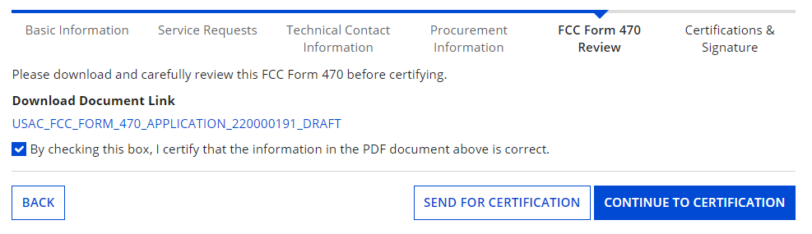
Review PDF and Make Changes
Click here to download the PDF
Click the ‘Back’ button to return to the form and make corrections
If the form is accurate, check the box, and click “Continue to Certification” if you are a Full Rights User, or “Send for Certification” if you are a Partial Rights User.

Slide 45
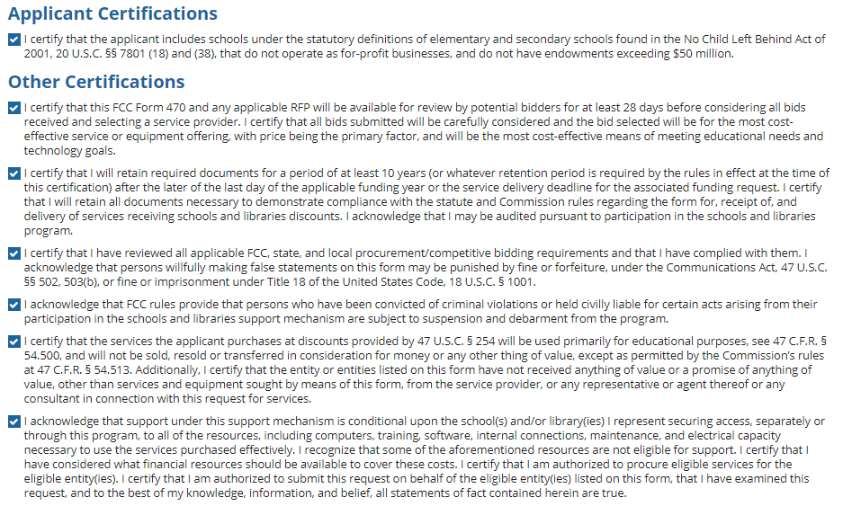
Required Certifications
You must check all of the certification boxes before you can finish the certification and officially submit the form.

Slide 46
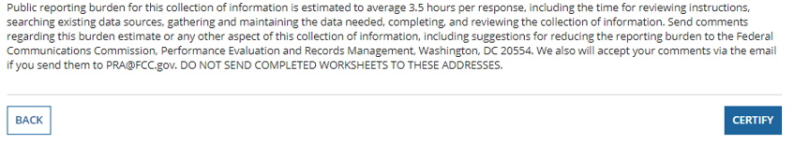
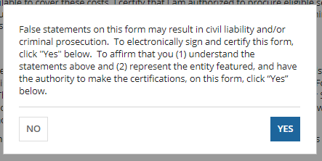
Required Certifications
After all of the Certification boxes are checked, click the live Certify button!
Then click “yes” in the final pop-up box:

Slide 47

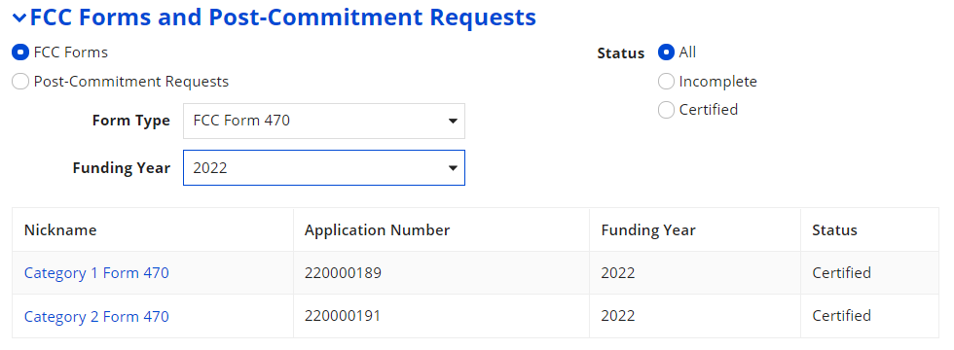
Where to Find a Copy of Your 470
On EPC Landing Page, scroll to the bottom
Select Form 470
Select appropriate Funding Year
Next, click on the appropriate Form 470
Click here to get to your Landing Page!

Slide 48
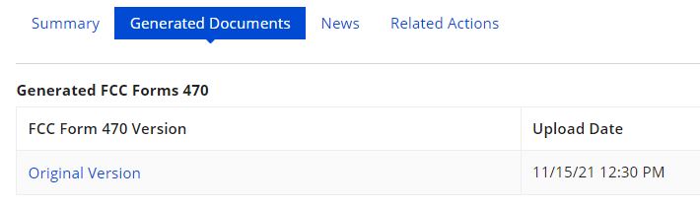
Where to Find a Copy of Your 470
The next screen will be a Summary Page of the submitted Form 470, with a link to the RFP Documents
  RFP documents must be downloaded separately
To obtain PDF of submitted Form 470, select ‘Generated Documents
Click on ‘Original Version’

Slide 49
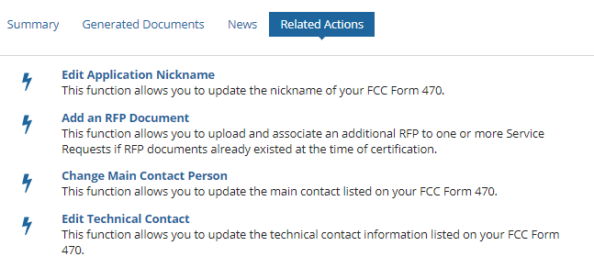
To Make Changes to Submitted 470
Note: very few changes can be made to a Form 470 after it’s submitted
Additional changes can be made to an RFP document, but only if an RFP was uploaded with the original Form 470
  "RFP document" refers to any bidding document that describes your project and requested services in more detail than in the fields provided on the Form 470
To make changes, or upload an additional RFP document, click ‘Related Actions’

Slide 50
Caution When Modifying RFP
Applicants must wait at least 28 days from the date the Form 470 is certified before closing the competitive bidding process
Warning!
Changes to the Form 470 beyond the allowable changes require applicants to wait an additional 28 days from the date of the change before closing the competitive bidding process.
The EPC system will not automatically recalculate the new Allowable Contract Date; applicants must do this manually.

Slide 51
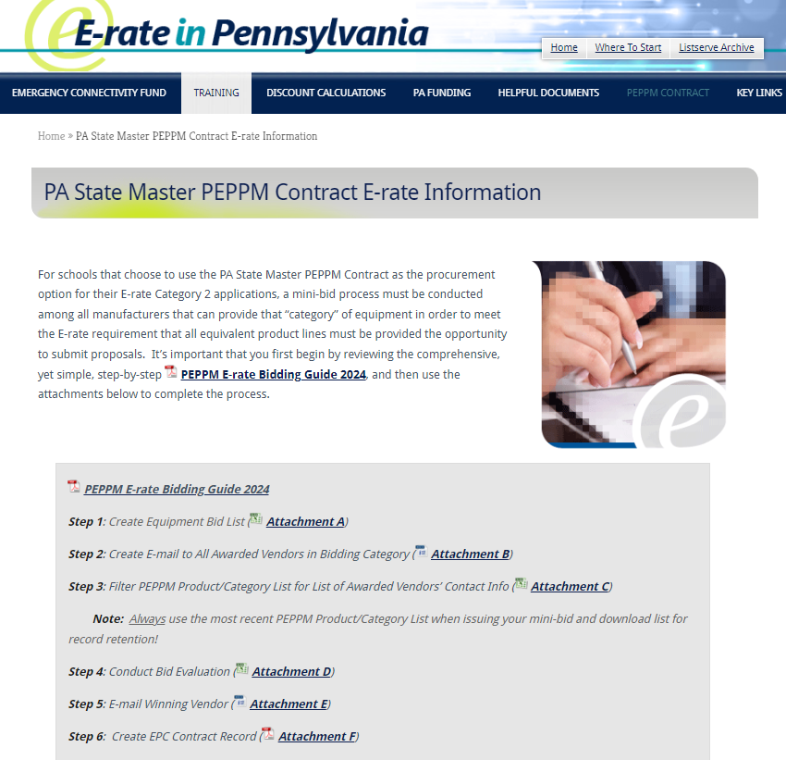
Bidding Option #2:
Issue PEPPM Mini-Bid

Slide 52
Option 2) Conduct a 'PEPPM Mini-Bid’
A complete guide to conducting a PEPPM Mini-Bid is posted at:
http://e-ratepa.org/?page_id=6121
Do NOT post a Form 470
Conduct a PEPPM mini-bid of all product lines in a specific "Category" and then consider all bids submitted by vendors
  Categories are wireless equipment, switches, routers, firewalls, UPSs, cabling/connectors, racks, and caching servers
There is no 28-day mini-bid requirement, but you should give vendors at least 14 calendar days to submit proposals
Using the prices contained in the proposals submitted, schools will then create a bid evaluation to select the successful vendor
  Price of eligible equipment/services must be the most heavily weighted factor, but you may consider other factors such as previous experience with the District, compatibility with existing equipment, references, cost to train or certify staff on new equipment, etc.
Schools will then contact the winning vendor to obtain a contract document (or final quote with exact quantities) for the District to sign
Note: The PEPPM Mini-Bid process is not intended for structured cabling projects.

Slide 53
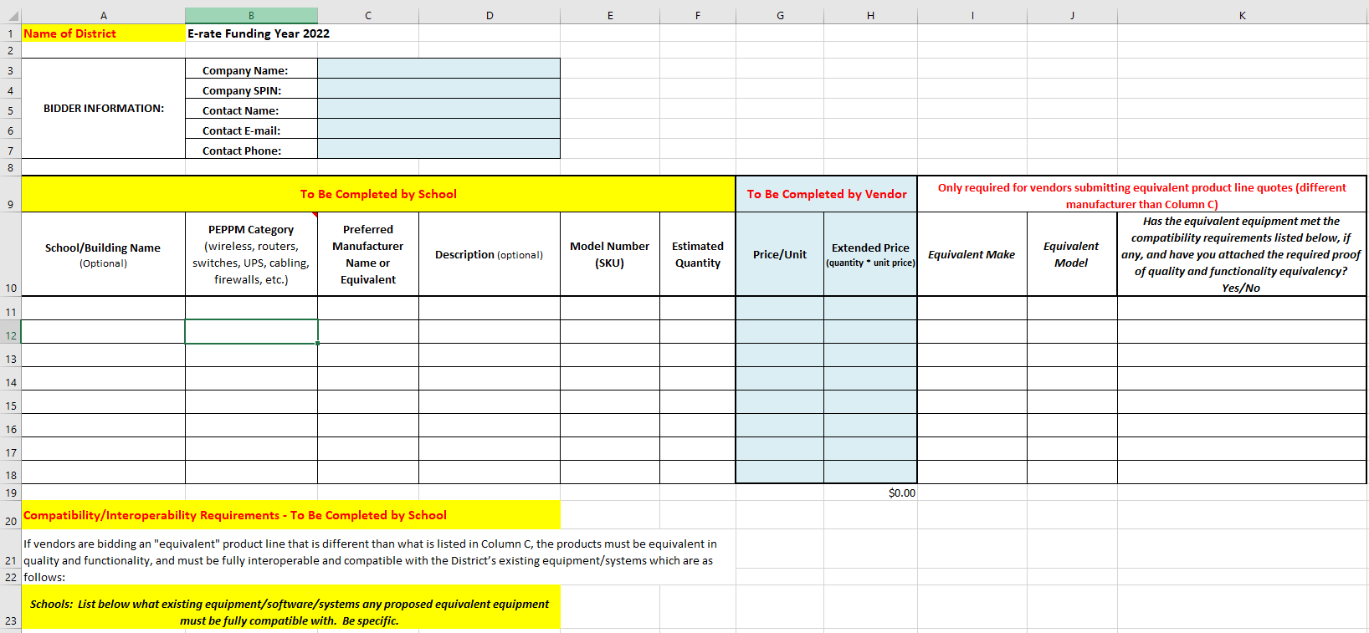
PEPPM Mini-Bid Process
Create equipment bid list
  Schools complete yellow areas
  Vendors complete blue areas
  Second tab shows completed example
  Save to your computer as Excel file

Slide 54
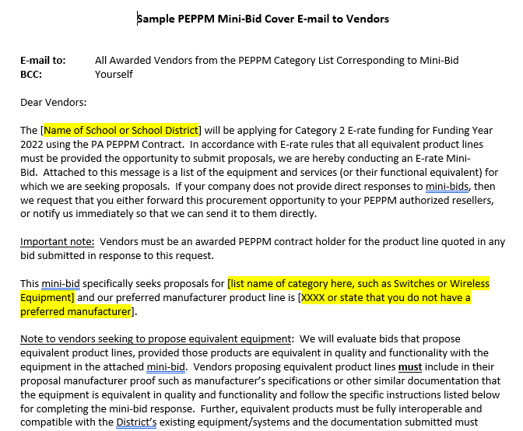
PEPPM Mini-Bid Process
Create cover e-mail
  Modify cover e-mail as needed
  Update yellow areas, at minimum
  Copy and paste into e-mail

Slide 55
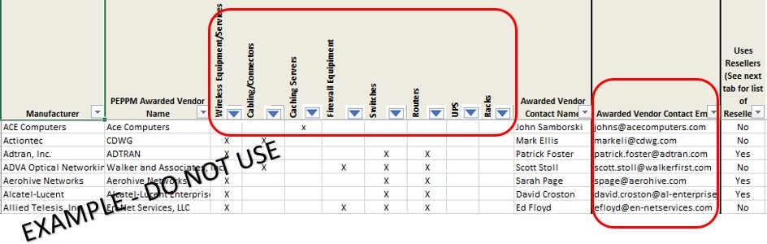
PEPPM Mini-Bid Process
Open PEPPM Product/Category/Vendor spreadsheet
  Filter by which ‘Category’ your equipment falls under so that only Xs remain in the column
  Then copy the e-mail addresses from Column Q into an e-mail message
  Attach copy of equipment bid list
  Then send e-mail with equipment bid list to all awarded vendors in that category. Don’t
combine categories.

Slide 56
Next Steps…

Slide 57
Next Steps – All C2 Procurements
Vendors will submit proposals directly back to the contact indicated on the 470/RFP or PEPPM mini-bid
After bid due date, ensure bids are compliant with minimum qualifications and then conduct bid evaluation
  Be sure that price of eligible equipment and services is the most heavily weighted factor
  If a bid is disqualified, note bid and reason for DQ
    Reminder: All DQ factors must be listed in 470/RFP or PEPPM mini-bid
Contact winning vendor to seek contract
Seek board approval (if required)
Sign contract
  All C2 requests must have signed contracts
  Contract can be as simple as a vendor quote that is signed by the school or library. Be sure to include:
    Contract signing date (must be before 471 filing date)
    Contract term: 4/1/2024 through 9/30/2025
    Purchase is contingent upon E-rate funding and local funding approval
Create Contract Record in EPC and upload contract
Submit Form 471 by March 2024 deadline

Slide 58
C2 Purchasing Reminders
Create and Maintain Asset Inventory
  All audits require this to be submitted
  Sample available
  http://e-ratepa.org/wp-content/uploads/2014/03/Asset-Register-Sample.xlsx
Only purchase exact equipment that was approved on 471
  If equipment is different, seek a Service Substitution from USAC
Keep everything
  E-rate rules now require you to keep all documents related to procurement, purchasing, discount calculations, invoicing for 10 years from the last date to receive service or service delivery deadline, whichever is later
After USAC has issued your C2 FCDL, refer to this C2 purchasing guide for next steps:
  http://e-ratepa.org/wp-content/uploads/2014/03/Equipment-Purchasing-Guide-FY-2023.pdf

Slide 59
Questions?
E-mail Julie at jtschell@comcast.net

